Slide 1
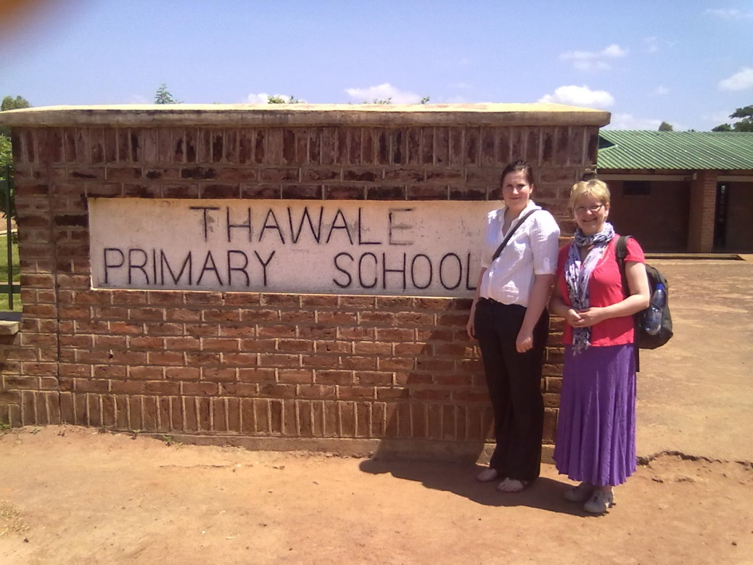
Thawale Primary
& Lockerbie Academy
School Partnership
Began March 2009 through LCD Scotland
H. Wright 5 Oct 2012

Slide 2
Lockerbie Academy
African Link Committee
2016-17

Slide 3
Early Stages – March 2009
PT Humanities ( Link teacher) & HT in regular contact
Staff & Pupil Committees established at Lockerbie & staff group at Thawale
Partnership agreement drawn up
Communication via letters, email & phone calls
Donation of books and money sent for Thawale library.
H. Wright 5 Oct 2012

Slide 4
Shared Projects
Why do we go to school ? May 2009
Rights and Responsibilities – March 2010
Piloted new resources – Global Poverty & Education – Dec 2010
The Environment - Oct to Dec 2011
Tales from Around the World - Sept 2012
Pen pal letters ( staff & pupils)
Poetry writing
Getting to know you books
H. Wright 5 Oct 2012

Slide 5
Wider Community
Annual fundraising coffee morning in Lockerbie Town Hall Nov
Visits to feeder primaries
Talks to community groups
Support from local businesses – raffle prizes, boxes ( D S Smith ) , surplus clothing stock ( Tesco)
News items in the local paper
Members of the Scotland – Malawi Partnership
H. Wright 5 Oct 2012

Slide 6
Extra Curricular Activities
Chichewa Club Friday lunchtimes
DFID Christmas Card Competition
Design a t-shirt competition
African Cup – Summer Football Competition
H. Wright 5 Oct 2012

Slide 7
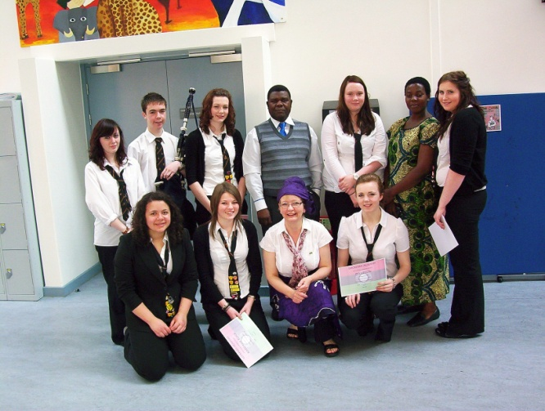
Curricular Links
English – pen pal letters & Tales from Around the World
Music – African Drumming
Art – African masks
Modern Studies – Human Rights
Geography – The Environment
Science – Climate Change & Soil Testing
PSD Higher – S6 African Link Committee work
History – David Livingstone
H. Wright 5 Oct 2012

Slide 8
Visiting Speakers / Groups
Magdalene Sacraine – Tales from African Dreamtime
Dance 4 Life – Aids/HIV presentation
Toto Tales – Tyi Wara performance
Glasgow High Life Band
Dr Mizeck Chagunda
Lorna Argente
Gameli Todzro – drumming workshop
H. Wright 5 Oct 2012

Slide 9
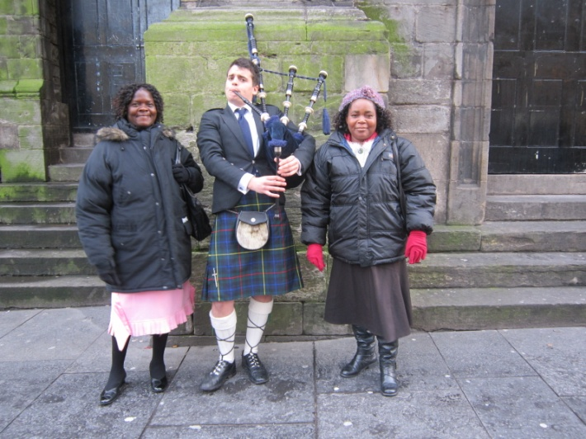
Reciprocal Visits
Feb 2011 - link teacher & senior student to Thawale
April 2011 – Thawale HT & colleague to Lockerbie
Dec 2011 – Thawale Depute & colleague to Lockerbie
Sept 2012 – 2 Lockerbie teachers to Malawi
H. Wright 5 Oct 2012

Slide 10
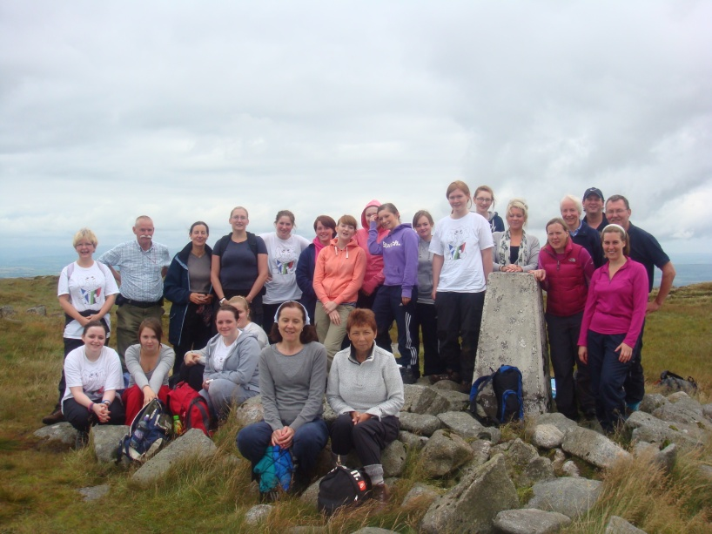
S6 African Link Committee
A growing number involved each year
Meet weekly
Design own t-shirts
Up date Link notice boards
Sell pin badges
Present school assemblies
Plan various events and activities
H. Wright 5 Oct 2012

Slide 11
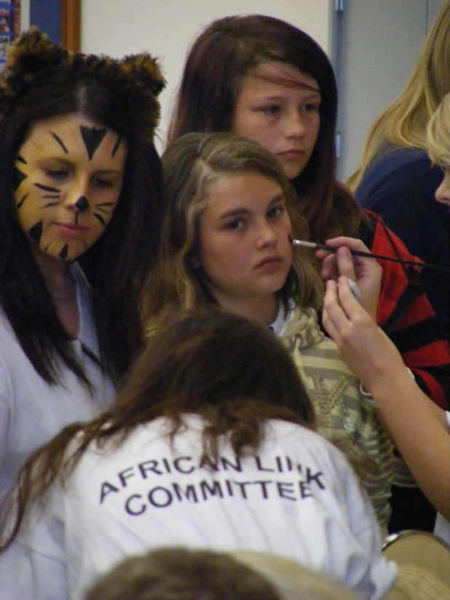
Fundraising and Donations
Books & money for stationery
Annual Community Coffee Morning
Leap for Life
Malawi Karnaval
Criffel Climb
Whole School Sponsored Walk
H. Wright 5 Oct 2012

Slide 12
Global Citizenship
Active international links at Lockerbie
1st partnership with a developing country
Shared teaching and learning at its heart
Richness in diversity but also commonality
Generate enthusiasm and motivation for learning
H. Wright 5 Oct 2012

Slide 13
Openness to new thinking and ideas
Willingness to tackle sensitive issues
A sense of your own identity and your place in the global community
Inspire a desire to affect positive change
H. Wright 5 Oct 2012

