Slide 1
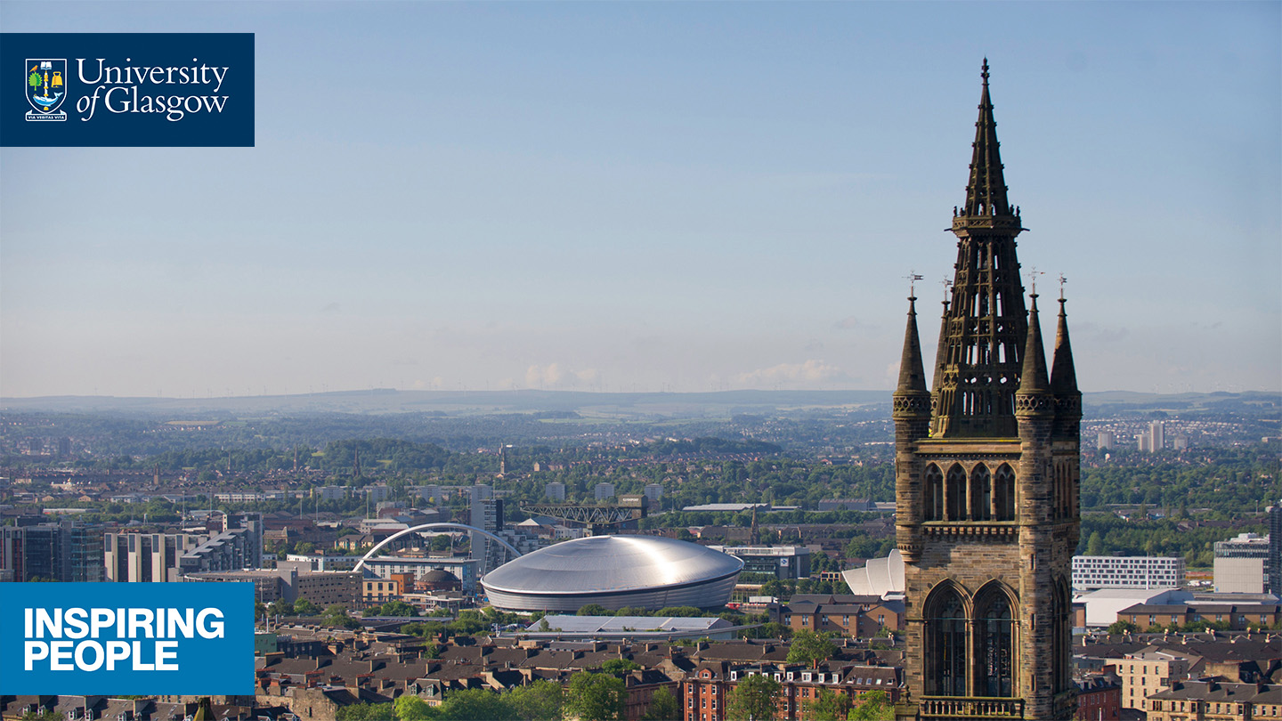
Malawi – Biology of Parasitism (MALBOP)
Sustainable Futures in Africa (SFA)

Slide 2
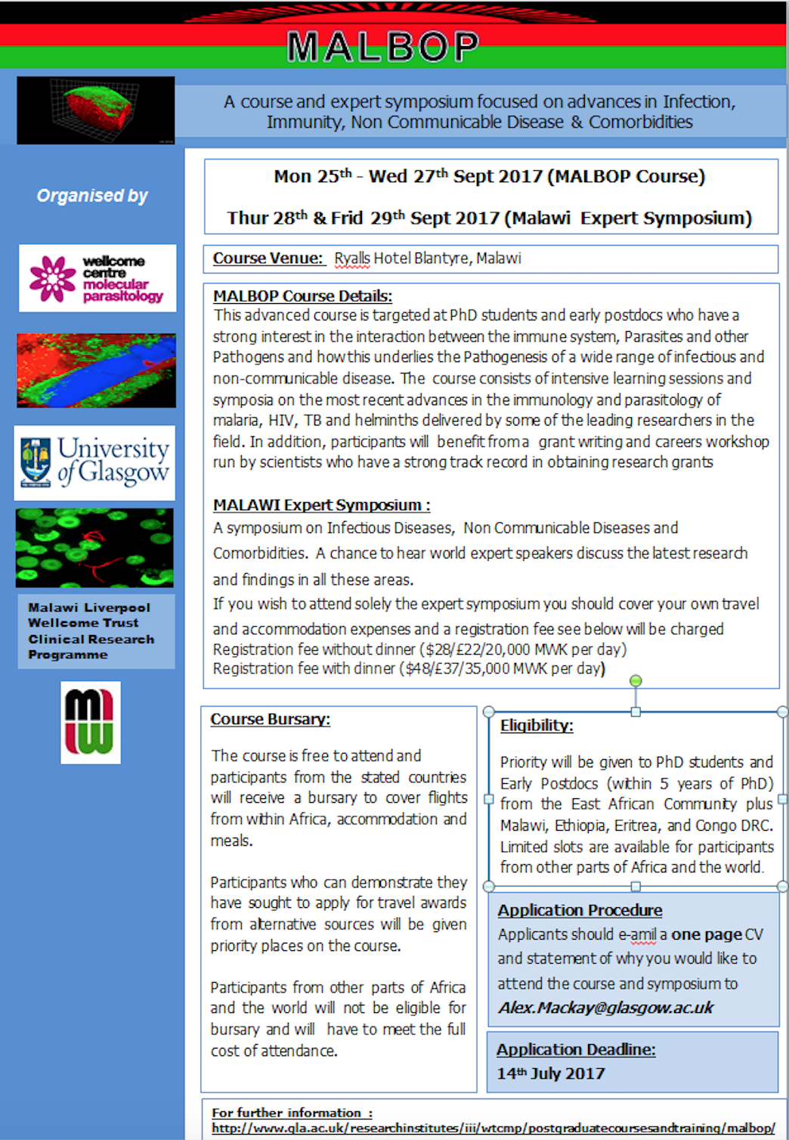
Malawi – Biology of Parasitism (MALBOP)
Professor Paul Garside, PhD, FRSB, FRSE,
Director of Centre for Immunobiology,
Medical, Veterinary & Life Sciences, Glasgow Biomedical Research Centre, University of Glasgow

Slide 3
Glasgow-Led Advanced Training:
in the interaction between the immune system, parasites and other pathogens and how this underlies the pathogenesis of a wide range of infectious and non-communicable disease
http://www.gla.ac.uk/researchinstitutes/iii/wtcmp/postgraduatecoursesandtraining/malbop/

Slide 4
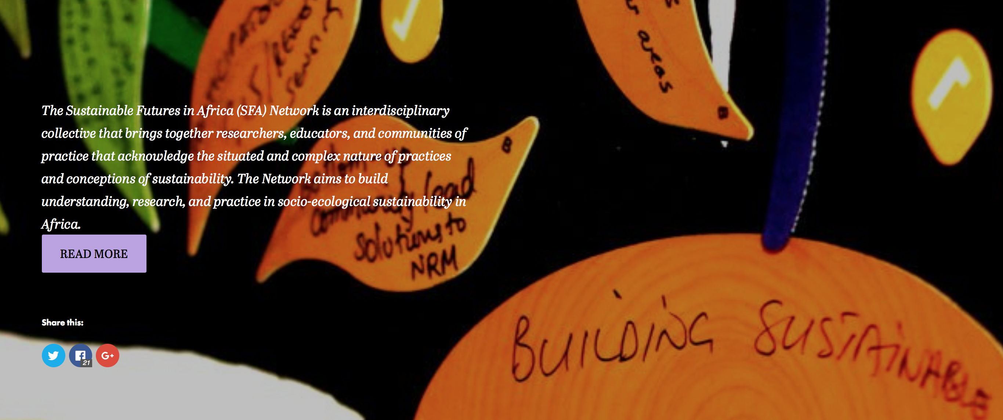
Sustainable Futures in Africa Network

Slide 5
Sustainable Futures in Africa Network
the relationship between social, cultural, and ecological factors in sustainability in Africa through interdisciplinary research initiatives
opportunities in the disparities between ontologies of the global north and the global south inherent in international collaborations and global endeavours
shaping and supporting new opportunities for impact and inquiry that address locally-articulated, socio-ecological challenges

Slide 6
Interdisciplinary
The SFA Network brings together environmental and social scientists in community and public pedagogies to address the knowledge implementation gap.
Education
Geographical and Earth Sciences
Engineering
Climate change due to deforestation
Geothermal Energy usage
Environmental stress
Water resources and management
Soil classification and preservation
Include communities actively
New ways of communication
Communities define problems
Arts and Culture
Health
Physics
Investigating the relationship between traditional
African belief systems and socioecological
sustainability through the Arts
One Health and culturally specific
understandings of health and well being
Multiple knowledges and tools
of engagement with lived realities
Notes:
The SFA Network brings together environmental and social scientists in community and public pedagogies to address the knowledge implementation gap. The gap between environmental research, innovation, and policy and the communities impacting and being impacted by the environment needs to be mitigated, in order to effectively address the growing issues related to biodiversity degradation.
The SFA Network seeks to develop Innovation and Economic Growth by facilitating innovative cross-disciplinary and cross sector collaborations to address biodiversity loss in engagement with the social, cultural, and economic factors experienced by communities.
Environmental scientists and authorities too often find innovation and policy objectives unmet, misunderstood, or de-railed in the hands of the populations of people asked to implement new practices
There is a significant field of research and practice in community engagement, indigenous ways of knowing, and vocational development in the African context, but this social science area rarely works directly with environmental science. Hence, there are parallel objectives (environmental sustainability and the well being of people) but a lack of common language, approach, or expertise. In the context of environment-dependent populations, community and public pedagogies are the strongest, fastest, and most appropriate forms of engagement required to connect new scientific information with existing socio-cultural knowledge and realities.

Slide 7
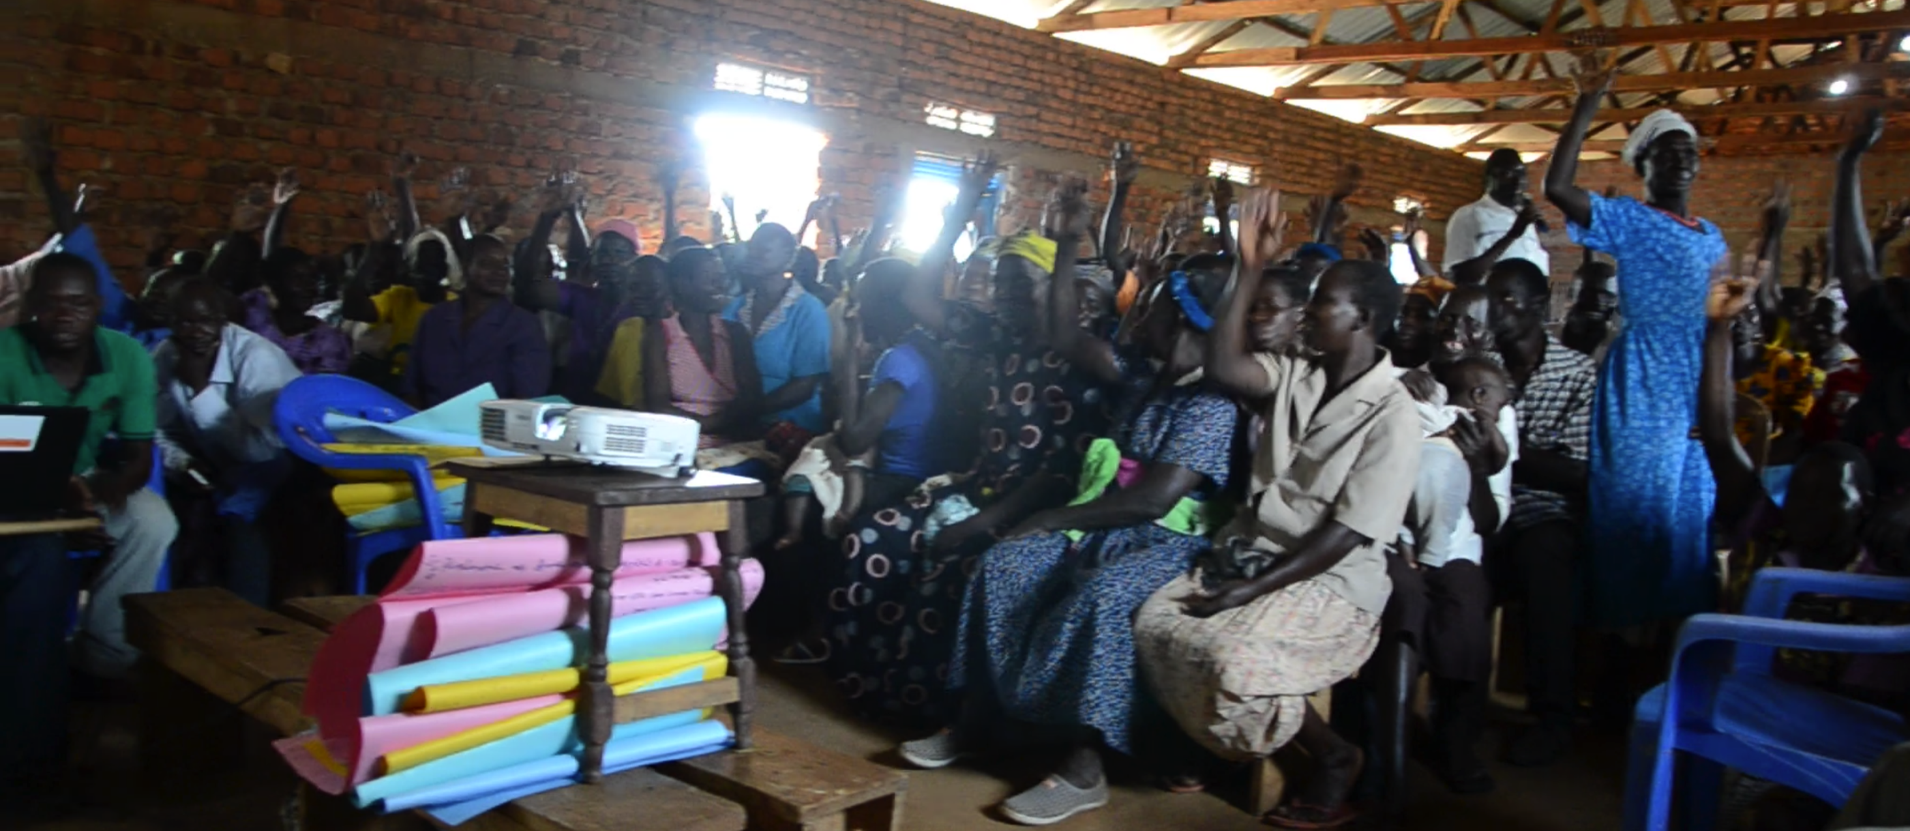
Research and development aid is often applied without community, cultural, faith-based, or indigenous engagement or input This is why we are working as an interdisciplinary team with African Universities and NGOs to develop new methods of direct interaction with the local communities.
Locally Driven
Notes:
The SFA Network brings together environmental and social scientists in community and public pedagogies to address the knowledge implementation gap. The gap between environmental research, innovation, and policy and the communities impacting and being impacted by the environment needs to be mitigated, in order to effectively address the growing issues related to biodiversity degradation.
The SFA Network seeks to develop Innovation and Economic Growth by facilitating innovative cross-disciplinary and cross sector collaborations to address biodiversity loss in engagement with the social, cultural, and economic factors experienced by communities.
Environmental scientists and authorities too often find innovation and policy objectives unmet, misunderstood, or de-railed in the hands of the populations of people asked to implement new practices
There is a significant field of research and practice in community engagement, indigenous ways of knowing, and vocational development in the African context, but this social science area rarely works directly with environmental science. Hence, there are parallel objectives (environmental sustainability and the well being of people) but a lack of common language, approach, or expertise. In the context of environment-dependent populations, community and public pedagogies are the strongest, fastest, and most appropriate forms of engagement required to connect new scientific information with existing socio-cultural knowledge and realities.

Slide 8
Collaborative
Non-Governmental Organisations
Malawi
Art House Africa
Abundance
Arts and Global Health Centre
Uganda
Apala Widows and Orphanage Center
Nigeria
GEF-CSO Network
Women’s Environmental Program
Botswana
Ngamiland District CBNRM Forum
Village Development Committees
Educational Institutions
University of Malawi
Lilongwe University of Agriculture and Natural Resources
Obafemi Awolowo University (Nigeria)
University of Botswana
Makerere University (Uganda)
Notes:
Disciplines of SFA Network members:
Institute of Biodiversity
Dept. of Adult Education
Dept. of Environmental Science
School of Education
Department of Environmental Management
Dept of Adult Education and Lifelong Learning
Department of Agricultural Extension & Rural Development
Department of Crop Production and Protection
Department of Theatre and Fine Arts (Malawi)
I think it would be worth noting that we have a .4 administrator, Molly, who is working with a part-time administrator in Botswana, Goitse, and are soon to have an intern at the u of Glasgow. This team collectively are working on establishing a communications systems across these various countries, cultures, and disciplines that will hugely help our practical abilities to work together.

Slide 9
Dr Mia Perry
School of Education
University of Glasgow
mia.perry@glasgow.ac.uk

