Slide 1
“GLOBAL CITIZENSHIP:
SCOTLAND’S INTERNATIONAL DEVELOPMENT STRATEGY”

Slide 2
Ministerial Foreword
“International development is a key part of Scotland’s global contribution within the international community. It encompasses our core values, historical and contemporary, of fairness and equality. It is also about Scotland acting as a good global citizen. We are the inheritors of that tradition; it is who we are today, and it who we want our next generation to be”.

Slide 3
Our Vision
“Embedding the Global Goals, Scotland will contribute to sustainable development and the fight against poverty, injustice and inequality internationally”

Slide 4
Our Priorities
Encourage new and historic relationships
Empower our partner countries
Engage the people of Scotland
Enhance our global citizenship

Slide 5
Our Partner Countries
Malawi, Zambia and Rwanda will form our sub-Saharan project base; and
Pakistan will see a strong emphasis on education through scholarships

Slide 6
Our Ways of Working
Investing our International Development Fund - 3 funding streams:
development assistance;
capacity strengthening; and
investment
Utilising Scottish expertise
Collaborating with others:
partner countries;
civil society;
other donors

Slide 7
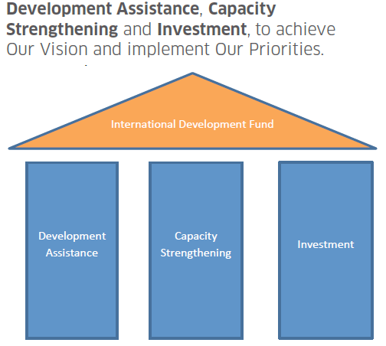
3 Funding Streams

Slide 8
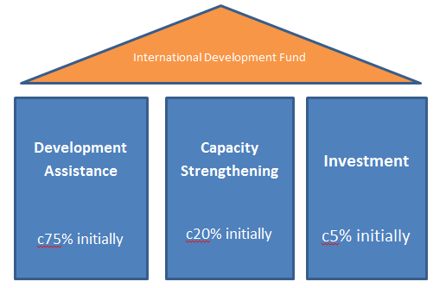
Proportions (with caveats)

Slide 9
Development Assistance: c75% of IDF (initially)
Empower our partner countries / Encourage new & historic relationships: support development assistance overseas:
majority thro competitive challenge funding models for Malawi, Zambia & Rwanda, and the Small Grants
match funding.
Engage people of Scotland, & Enhance global citizenship: support civil society in Scotland incl (non-competitive):
core funded bodies: SMP, MaSP, SFTF & The Alliance. [Total £780k for 2017/18]
Development Education Centres (DECS)
volunteering support for Scotland’s young people

Slide 10
Capacity Strengthening: up to 20% of IDF (initially)
Empower our partner countries / Encourage new & historic relationships / Engage the people of Scotland:
Pakistan: we will also continue to support education through women and children’s scholarships run by British Council Pakistan.
targeted at harnessing Scottish expertise:
capacity building & strengthening partnerships thro institutional links, e.g. Police Scotland work in Malawi or Blantyre-Blantyre project with Liverpool Welcome Trust, University of Glasgow and College of Medicine
skills sharing through professional volunteering, e.g. NHS

Slide 11
Investment: up to 5% of IDF (initially)
Empower our partner countries: our partner countries WANT investment.
We believe trade & investment is important, as is role of private sector: to support Malawi, Zambia & Rwanda move beyond aid & build sustainable economic growth domestically, in line w/ their wider govt policies.
Support too for social enterprise models.
Recent investment initiative for Malawi saw SG obtain £1M in match funding from private indivs.
We are clear that IDF spend – for devpt assistance, capacity strengthening or investment – must be to implement Our Vision, ie tackling poverty & inequality & contributing to sustainable devpt.

Slide 12
3 streams working together?
Development assistance: Malawi funding rounds opened 03 November 2017
Capacity strengthening funding stream: will then overlay, to support:
needs identified (by Malawi)
incl health “volunteering” & Police work
could include business mentoring/interns
Investment: to help grow local economy in Malawi

Slide 13
Malawi Development Programme 2018-2023
Main Changes
Two Stage application process (Concept Note and Full application)
Maximum funding available increased to £300k pa (£150k in year 1) (Max £1.35 million)
Maximum project period increased to 4.5 years

Slide 14
Malawi Development Programme 2018-2023
Main changes (cont)
Capital expenditure increased to 20% of project budget (50% for RE projects)
Scottish admin costs capped at max of 10% of project budget
Current projects can apply for funding to continue their current work

Slide 15
Malawi Development Programme 2018-2023
Application Process
For this funding round we will operate a two stage application process.
Concept Note Stage - organisations submit a concept note summarising why the project is needed and what it seeks to achieve.
Application Stage - Successful organisations will be invited to complete a full application form which will require more detail of the project plans.

Slide 16
Malawi Development Programme 2018-2023
Themes
In accordance with the existing 2005 Cooperation Agreement between the Scottish and Malawian Governments, we will only fund projects for work within the priorities set by the Government of Malawi in the areas of:
Health
Education
Civic Governance;
sustainable economic development; and
With the agreement of the Government of Malawi, we will also fund Renewable Energy projects in Malawi

Slide 17
Government of Malawi’s Priorities
Health Strand
Human resources for health system strengthening
Universal coverage of essential health services
Addressing conventional and traditional determinants of health in Malawi
Quality Assurance and Quality Improvement of Essential Health Services

Slide 18
Government of Malawi’s Priorities (Cont)
Civil Society and Governance Strand
Capacity building for the new Parliament i.e. Committee work etc.
Institutional capacity building for the Malawi Prison Service (including Young Offender services)
Support towards the fight against Corruption
Support organisations advocating for good governance and human rights
Support organisations advocating for gender equality
Support for free Paralegal services

Slide 19
Government of Malawi’s Priorities (Cont)
Education Strand General
Teacher training (including Special Needs, especially teacher training for working with students with Learning Difficulties)
Internal efficiency of the Primarily school structure
Decentralisation of education management
School infrastructure (new classrooms, teachers houses and latrines)
Provision of teaching and learning materials
Inclusive education
Curriculum strengthening at all levels
Bursaries to support vulnerable students (particularly Secondary school)
Up scaling of school feeding programme (particularly Primary school)
Upgrading of Community Day Secondary Schools
Introduction of more double shift schools

Slide 20
Government of Malawi’s Priorities (Cont)
Higher Education
Access to Higher education
Training of Higher education staff
Curriculum strengthening in Technical, Entrepreneurial and Vocational Education and Training (“TEVET”) institutions
Cost recovery mechanisms and finance mobilisation in public universities
Public Private Partnerships
Support for capacity to strengthen procurement, financial management, planning, budgeting and monitoring and evaluation systems.

Slide 21
Government of Malawi’s Priorities (Cont)
Sustainable Economic Development
Agricultural Development & Value Addition (Including irrigation elements as part of projects)
Tourism
Energy (Renewable Energy) (especially alternative sources of power from Solar)
Environment & Natural Resources Management
Finance and Investment Promotion

Slide 22
Malawi Development Programme 2018-2023
Timetable
Dates | Actions
03 November 2017 | Opening
03 November 3017 – 26 January 2018 | Concept Note Stage
29 November 2017 | Information Day
March 2018 | Concept Note Decisions
02 April – 11 May 2018 | Full Application Stage
July 2018 | Application Decisions
01 October 2018 | Projects Commence

Slide 23
Zikomo! Scottish Govt International Development Team T. @scotgovID

Slide 24
Eligibility Criteria

Slide 25
A concept note should only be submitted if you clearly meet all aspects of the eligibility criteria:
Applicant organisations must constitute a “legal person”
Applicants must have a presence in Scotland
Applicants must provide audited/examined accounts for their most recently completed financial year

Slide 26
A concept note should only be submitted if you clearly meet all aspects of the eligibility criteria:
Projects must fit within the Scottish Government’s current International Development Strategy
Scottish Government must be the main funder. Up to 50:50 match funding split allowed with another funder: must be identified and approved.
Note: there is no minimum limit on the budget

Slide 27
What cannot be funded:
The Scottish Government will not award funding directly to other Governments or to individual representatives of other Governments
The Scottish Government will not provide direct financial support solely for the transportation of goods to partner countries
Transportation of goods often undermines local industries/economies
Exceptions may be granted where the transportation of specific equipment is an essential and proportionate part of the project
Evidence must be provided that the equipment cannot be sourced in-country or from others parts of Africa

Slide 28
What cannot be funded:
Scottish Government Funding cannot be used for:
Per diems
Land purchase
Supporting predominately capital infrastructure projects or capital spend which is primarily to create a fixed asset, such as building accommodation or new institutions.
The maximum that may be spent on capital costs is 20% of the overall project budget (for renewable energy assets, the limit is set at 50%)
Purchase of vehicles

Slide 29
Scottish Government particularly welcomes applications from:
Currently under-represented or diaspora-led groups
Projects which are innovative or support innovation
Projects with joint or matched funding (within guidelines stated)
Collaboration with private sector organisations where support is to enable the sharing of expertise, but not to generate profit

Slide 30
Relevant weight will be given to…
Projects with evidence of complementarity with any of the following:
Other applicants to the Malawi Development Programme 2018-2023
Scottish Government funded work under capacity strengthening or investment funding streams of the IDF
Scottish Government funded work under the Climate Justice Innovation Fund
This is to enable clusters of relevant Scottish Government funded work to work together to provide greatest impact

Slide 31
Relevant weight will be given to…
Where a project is stand-alone renewable energy project, it should build upon previously funded SG renewable energy work
Where a project has a renewable energy component that this aspect is delivered by a lead organisation or partner with a proven track record in delivering renewable energy for development
Projects, which are delivered over the full 4.5 years with a maximum £300k budget to reflect feedback from the Scottish Government’s consultation for longer term funded partnership and projects

Slide 32
Concept note guidance

Slide 33
Concept note purpose
Concept note is the opportunity to give an overview of:
The project and activities
The intended impact of the project
Alignment with strategy
Proposed partnerships and wider collaborations intended for the project

Slide 34
What are we looking for?
A clear demonstration of the challenges you are seeking to overcome through the project and what changes you anticipate will be brought about through the project.
A clear understanding of how this project aligns with GoM priorities, SG Strategy and the Global Goals
Clear demonstration of the relevance of the proposal– evidence of a robust needs assessment and evidence that an inclusive approach is being taken
Evidence of well thought out partnerships which add value to the proposal (roles and responsibilities) evidence of collaboration through process
Indication of cost which considers the headline restrictions on budgets

Slide 35
How much information?
The concept note is a ‘first look’ proposal, rather than a full application – opportunity to develop ideas at the second stage
Wordcounts – clear, specific information
Annual totals required at this stage (although evidence that limits set within guidance have been considered is critical!) Indicate if total project cost higher than total request to establish balance of funding
Clear partner information helps us to evidence collaboration and helps build understanding of how the project management structures will work.

Slide 36
Review Process
Two stage process - concept note followed by full application
Review process: Criteria checks, full assessment of concept notes, recommendations
Annual accounts reviewed as part of concept note stage – due diligence plus capacity to manage size of request
Reviews include consultation with SG on past performance / project management of previous SG funded projects and if a new phase being applied for, performance of the project itself will be commented on by the Scottish Government

Slide 37
Once reviews are complete, recommendations made on which projects should be taken forward to the next stage.
Outcomes from the concept stage will be communicated as soon as possible to ensure maximum time for organisations progressing to complete full application
All projects will be reviewed in light of being a fit with the overall programme – aim to fund overall coherent programme for maximum impact in line with the Strategy. Importance of demonstrating fit
Applicants may be asked to consider alternative partners and / or to make some changes to project design to complement proposals in other concept notes.

Slide 38
Key dates in process
Concept note deadline – 26th January
Results of first stage W/C 26th March 2018
Full Application workshop – 9th April 2018 (tbc)
Full application deadline – 11th May 2018
Funding round announcements - July 2018

Slide 39
Advice and support
Developing your application – full application documents are online, helpful for looking at developing full budget
Background and criteria documents
Q & A Documents
Corra Foundation - contact with any questions:
Email: International@corra.scot
Tel: 0131 444 4020

Slide 40
Scotland Malawi Partnership
Malawi Development Fund
Information Session
29th November 2017

Slide 41
Introduction
Events
Malawian input
Collective learning
Collaboration
On-going support
Active networking

Slide 42
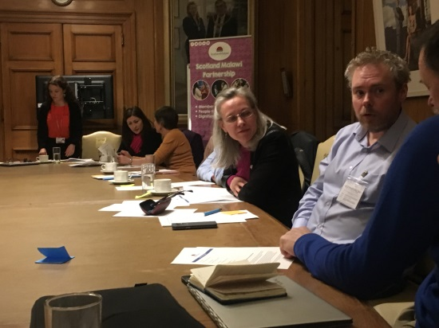
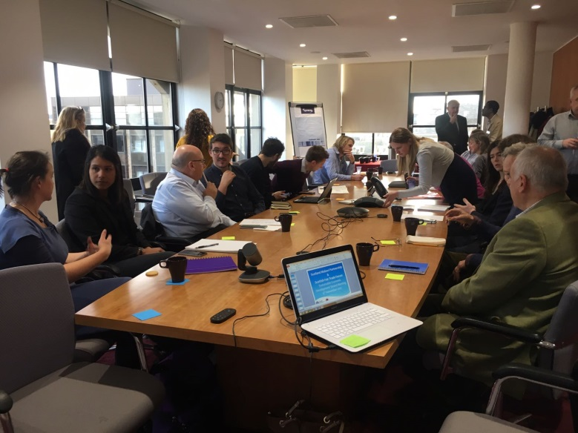
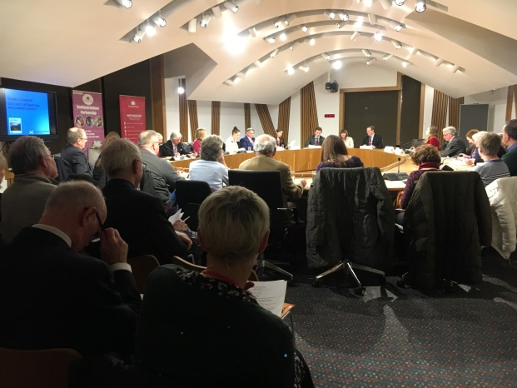
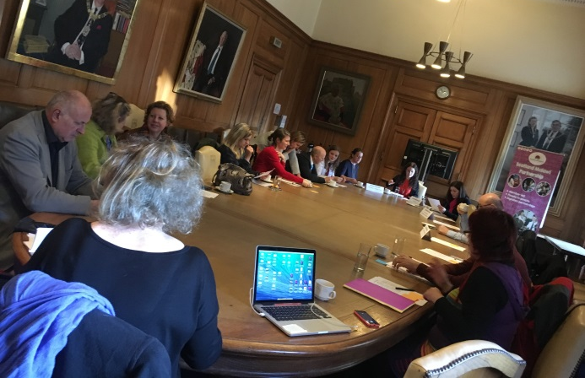
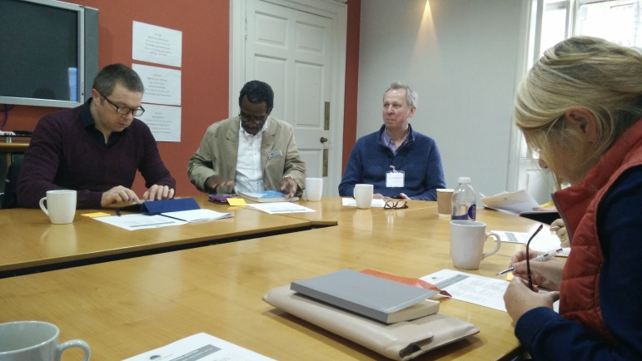
Events

Slide 43
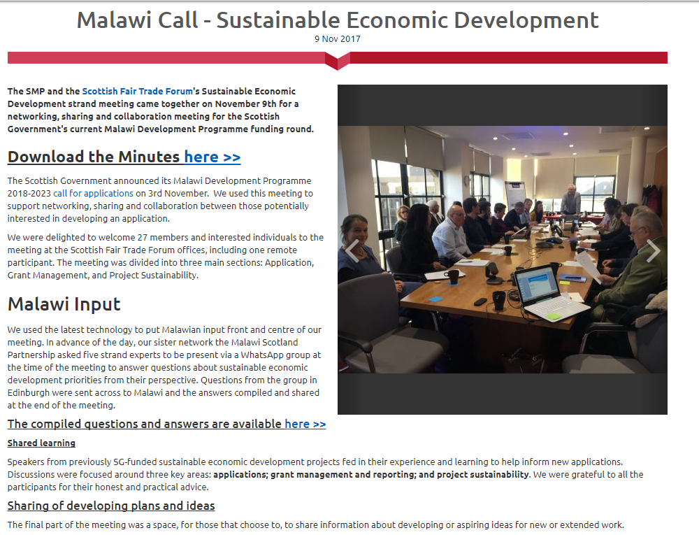
On-going support
Health
Sustainable Economic Development
Civic governance
Education
Renewables

Slide 44
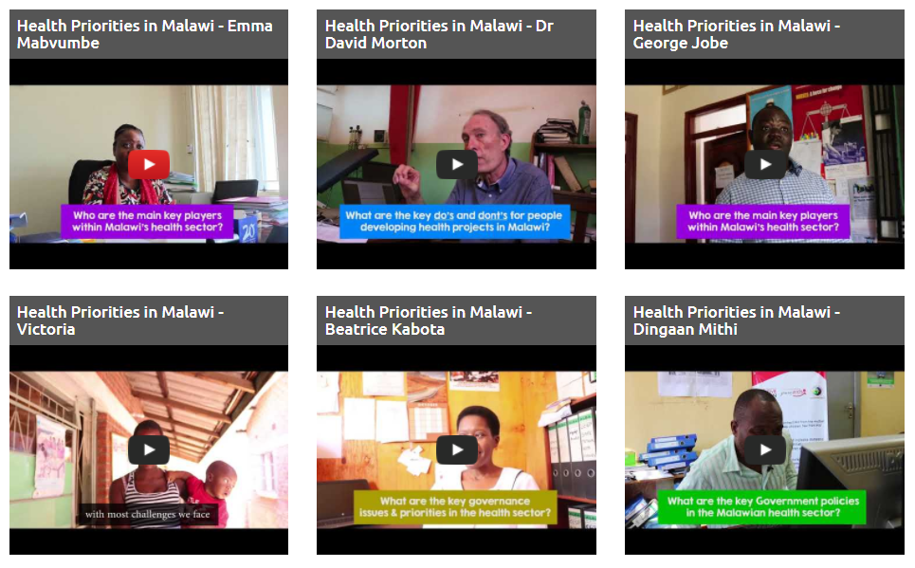
Malawian input

Slide 45
Health
Question:
Where does cancer sit in Malawian priorities? A major part of NCD or a separate strategic objective?
Answers:
Cancer is a major part of the NCD agenda, it is not a separate objective. It mainly falls under Objective 1 of the HSSP II as part of the Essential Health Package (EHP). Screening for cervical cancer is the intervention included in the EHP and meant to be rolled out nationwide.
The Ministry of Health is currently constructing a Cancer Treatment Centre at the Kamuzu Central Hospital in Lilongwe due for completion in September 2018.
The Ministry of Health also successfully piloted the Human Papiloma Virus (HPV) vaccine in two districts (Rumphi and Zomba) and it will be rolled out nationally.

Slide 46
Civic governance
Question:
How do you see future leaders emerging from the young people of Malawi who represent such a large part of the population?
Answers:
Young people hold the key to Malawi’s Development Agenda. The next election, for example, happening in 2019 shall be decided by the youth, most of whom did not vote in the 2014 general election but will be eligible to vote in this coming election. Therefore, candidates who shall speak the language of young people in terms of job creation, etc. will have a better chance. In that regard, young people may also be largely inclined to support young candidates as well.

Slide 47
Education
Question
In terms of the Malawi Government priorities – does higher education include ‘further’ education?
Answer
As we stand, Malawi needs to improve its transition rate from primary to secondary and from secondary to tertiary. As of 2017, only 16% of children transitioned from primary to secondary and of those only 8% move on to tertiary education. The youth who do not proceed to higher education turn out to be unemployed in the long run.

Slide 48
Collective learning
Application
Grant management and reporting
Sustainability

Slide 49
Collective learning
Malawian input and ownership
Consultation with sector, district officers and strand leads
Communication key - within own organisation, with partners, with governments, with stakeholders
Don't hide challenges or changes
Budget enough time and money for MEL and reporting
Currency fluctuations, inflation and delays on international transfers
Sustainability will mean different things to different projects

Slide 50
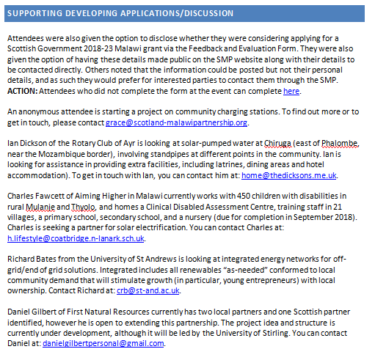
Collaboration

Slide 51
On-going support
Collaboration, introductions
Information and support
MaSP
Dissemination of learning

Slide 52
Active networking
Who?
What?
Where?
Opportunities?
Connections?

Slide 53
Scotland Malawi Partnership
Malawi Development Fund
Information Session
29th November 2017

