Slide 1
Ethnicity, Regionalism, and Nation-Building in Post-1994 Malawi:
Whither a Federal State System?

Slide 2
…
- Authors:
Gift Wasambo Kayira (University of Malawi)
and
Paul Chiudza Banda (Tarleton State University)

Slide 3
Background and Introduction
- Since the turn of this century, there have been calls for a Federal System of Government.
- Coming from stakeholders and groups who claim elements of marginalization (political and socio-economic).

Slide 4
…
- Mostly championed by politicians, who argue that only a federal system of government can resolve the historical wrongs.
- Many of them propose working with the current “3 or 4 administrative regions” as foundations for such a system.

Slide 5
…
- We briefly discuss the country’s post-colonial historical trends (1964-1994 and from 1994-present).
- We discuss the arguments FOR and AGAINST a federal system.
- Comparing with trends in other African countries, we propose a “devolved system of government” as the best possible solution.
- Aim: To achieve aims of nation-building and equitable distribution of development opportunities.

Slide 6
Nation-Building in Multi-Ethnic Societies
- Malawi, just like other multi-ethnic African countries, has had a problem of failing to achieve the goal of “nation-building.”
- The Banda regime - 1964-1994, scholarship blames Banda’s pro-Chewa and pro-Central Region policies.
- Chichewa as a “national language.” Lilongwe as capital city (with more development opportunities).

Slide 7
…
- The northern region – most neglected … hence the name “Dead North.”
- The southern region, also largely neglected, apart from the Shire Highlands (Zomba and Blantyre urban).
- From the late 1970s onward … the SAPs created further discontent as the state “withdrew” from its socio-economic responsibilities.

Slide 8
…
- Regional and Ethno-biased voting trends in 1994 and 1999 general elections and beyond … a reflection of that history.
The post-Banda era (1994 – present) still exhibits the regional/ethnic divide.
The 1995 Constitution (as amended) did not address these issues.

Slide 9
Calls for Federalism
- The belief that a “strong or top politician” from their region will bring about socio-economic development.
- Those in favor of Federalism:
Politicians (from various parties), academics, the clergy, and other pressure groups (such as FAFESRUDEM).

Slide 10
…
- FAFESRUDEM: “Federal System of Government and Rural Development in Malawi.”
- Its leaders are mainly based in Mzuzu.

Slide 11
…
Those against Federal System of Government:
- Politicians (from various parties), the Public Affairs Committee (PAC), academics, and other stakeholders.
- PAC’s study: 64 percent of Malawians against.

Slide 12
False Prospects of Federalism and Way Forward
- The pro-Federalism claims often disregard the complexities and fluidities of “regional identities.”
i.e., the “administrative regions” comprise of multiple ethnicities, such that the dominant groups will continue “oppressing” the minorities.
Cases from Nigeria and Ethiopia … show us how federalism hasn’t resolved challenges … ethnic-based civil wars.

Slide 13
…
- Our proposal: A “DEVOLVED SYSTEM OF GOVERNMENT.”
- We use the case of Kenya for illustration purposes.
- Kenya’s 2010 Constitution devolved the three arms of government in the 47 counties.

Slide 14
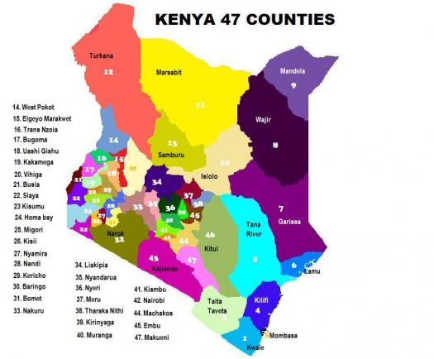
…
Kenya has a
“devolved system,”
47 Counties

Slide 15
…

Slide 16
…
A county is headed by an elected governor. Serves 2 elected terms (4 years each term).
Accountability is taken to a lower level, moving away from the monopoly of the central government.
Advantages: (a) Equitable distribution of national resources to the counties.

Slide 17
…
(b) There is growth at both national and county levels.
- Counties are a source of jobs and oversee development initiatives (health, education, transport, agriculture, etc.).
(c) Marginalized communities elect their own immediate leaders, from whom they demand accountability.

Slide 18
Conclusion
- We must accept that we haven’t achieved our goals of nation-building and equitable distribution of development opportunities.
- Calls for Federalism remain debatable and inconclusive.
- Solution lies in a “Devolved System of Government.”

Slide 19
Afro-Barometer survey results – April 2020

Slide 20
…
Thank You!

