Slide 1
MALAWI COVID 19
Epidemiology
John Phuka
Chairperson – Presidential Task Force
2020-07-15

Slide 2
Presentation focus –
Status, determinants, challenges and considerations for way forward

Slide 3
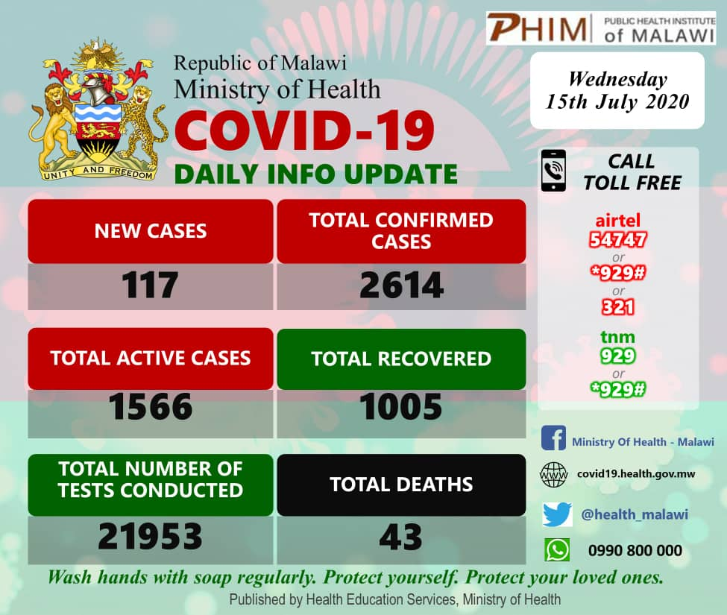
Current status

Slide 4
The Epi-Curve in Malawi

Slide 5







Doubling Speed

Slide 6


Major Factors Associated with status

Slide 7
The Epi-Curve in Malawi

Slide 8
Age and Sex Distribution - Cases

Slide 9
Age and Sex Distribution - Deaths

Slide 10
Major observation from Data
Major strategies and well taken measures
Closure of schools
Reduced attendance of churches
Enhanced hand washing in entry points of workplaces
Cultural changes – no hand shake
Not so well taken up measures
Crowding in rallies, social functions (funeral, weddings), markets (road side)
Use of face mask
Hand hygiene inside buildings
Use of sanitisers in workplaces(Banks, others ……)
Use of sanitiser during meetings

Slide 11
Observation from Data
Health care environments
  214 HCW
Case Fatality
  19/1265 = 1.6%
  40/2457 = 1.6%
High Case fatality for admissions
  19/ 44 = 43%
  43/ 75= 57%
  Severe disease pattern
Continued Returning Residence

Slide 12
WHAT CAN WE DO SLOW THE SPREAD

Slide 13
Risk Communication
Goal: Appropriate level of perceptions and health seeking behaviour
  Susceptibility
  Extremities of severity
  Benefits of good behaviour
  Reflective walking hazard
Challenges | Solutions
Low perception of risk | Interpersonal communication
 | Talks by localised champions – Local radio
 | Community health/ Primary health care system
Low self efficacy | Motivation
 | Mentorship
 | Person centred solutions
Low reflective empathy | Special messaging

Slide 14
Community Mobilisation
Goal: Appropriate level of perceptions and health seeking behaviour
  Susceptibility
  Extremities of severity
Challenges | Solutions
Poor understanding of the disease | Interpersonal communication
Violence | Talks by localised champions – Local radio
Misconception of reasons for returning | Community health/ Primary health care system
Stigma | Motivation
 | Mentorship
 | Person centred solutions
 | Special messaging

Slide 15
Infection Prevention and Control
Goal: Interruption of transmission
  Self protection
  Limiting spreading
  Limiting hospital based infections
Challenges | Solutions
Increasing local transmission | Enhanced measures
Community transmission | Mandatory use face mask
Institutional/Workplace transmission | Mandatory hand sanitation at multiple location
 | Behaviour support
Health care facilities | Triage
 | PPE
 | Compliance control
Weak adherence to supportive strategies | supportive strategies to reduce crowding

Slide 16
Surveillance
Goal: Interruption of transmission
  Self protection
  Limiting spreading
  Limiting hospital based infections
Challenges | Solutions
Unclear community status | Intensified Screening
Screening | Institutional based screening
 | Decentralised testing
 | Health centre based triaging
Surveillance | HCW
 | Digital surveillance

Slide 17
Testing
Goal: Realistic Target of tests/Day
  Diagnostic testing (5,000)
  Screening (#?)
  Antigen Test
Challenges | Solutions
Unclear community status | Intensified Screening
Screening | Institutional based screening
 | Decentralised testing
 | Health centre based triaging
Surveillance | Health Care Workers
 | Digital surveillance
 | Pooled testing (move out orthodox)
Surveillance | Validation

Slide 18
Numerical targets
Primarily a surveillance question and should be guided by the strategy tailored to Malawi (needs vs capacity)
  Number of suspected cases currently
  Average contacts per case
  Sentinel populations, how often will we test HCW?
  All people on HIV/TB treatment progs?
  How many tests in current and future hotspots?
Immediate targets
  7000 tests by 30th June
    Moving us from 56 per million to 389 per million
    All contacts, community (hotspots) studies and health worker survey
Medium to long term targets
  500 – 1000 tests per week by July
  Build towards 2000+ tests per day in case we enter stage 3 and 4 of epidemic (community transmission) by August

Slide 19
Testing
Goal: Realistic Target of tests/Day
  Diagnostic testing (5,000)
  Screening (10000/month)
  Antigen
Challenges | Solutions
Unclear community status | Intensified Screening
Screening | Institutional based screening
 | Decentralised testing
 | Health centre based triaging
Surveillance | Health Care Workers
 | Digital surveillance
 | Pooled testing (move out orthodox)
Surveillance | Validation
Supply Chain | Enhanced planning implementation and monitoring

Slide 20
Clinical Care
Goal: Reduced Case Fatality Rate
  Improved health seeking behaviour
  Improved quality of care and services
  Assurance of the population
Challenges | Solutions
Centralised care | Clear protocols and care pathways
Home based care (asymptomatic and mild cases) | Structured roles for Community and Health Centres Facilities (CHW, medical assistants, nurses)
Low number of care centres | Good protocols with good referral system
Home based care | Increase in COVID critical care facilities
 | Enhanced
 | Proportionate services to burden of disease per district
 | Private sector involvement

Slide 21
Coordination
Goal: Good governance and leadership
  Indicators (open and go rules)
  Inclusiveness of all sectors, partners and community in response
  Continuity of other health care programmes and services
Challenges | Solutions
Speed of response amidst dynamic and multidimensional challenges | Focused secretariat to serve as national coordination and implementation centre
Reception of returnee | Multisectoral approach
Challenged economic activities | Clear roles of operational committees
Flow and limited financial resources | Efficient frequent meetings
 | Dynamism of protocol production
 | Adaptability of solutions
 | Enhanced response mechanism
 | Technical support to high burden districts
 | Decentralised response yet well coordinated

Slide 22
Decentralisation
Goal: Localisation and community empowerment
  Contextualisation of response
  Localised indicator (open and go rules)
  Community owned and lead response
  Horizontal (geographical sensitivity) and vertical (epidemiology sensitivity)
Challenges | Solutions
Central | District Implementation plan
Weak DRRT | Formation of DRRT and HC -RRT
Weak HC-RRT | Culturally sensitive solution
Weak accountability | Person-centred
Limited innovation | Community involvement
Care for vulnerable population (Age and Disease) | Shielding
disability

Slide 23
Co-existences with COVID-19 and other emergencies
Resilience plans
Recoveries plans
Responsiveness
  Legal framework to support rights and liberties
  Restriction and easing of restriction indicators
  Early warning systems
Social and developmental services
  Education, Health, Genders, Population
Impact mitigation on economic activities
  Trade, Transport

Slide 24
Institutionalisation of COVID-19 and Emergency Response in Preservice Training Research
Academic Centres
  Review of curriculums
  Response support system
Research
  Medical anthropology
  Behavioural change modification
  Behavioural economics
  Care practices at community level
  Clinical care in hospitals
  Health economic
  Governance and leadership adaptation in emergencies

