Slide 1
Peter Mackay Archive
Karl Magee
University Archivist

Slide 2
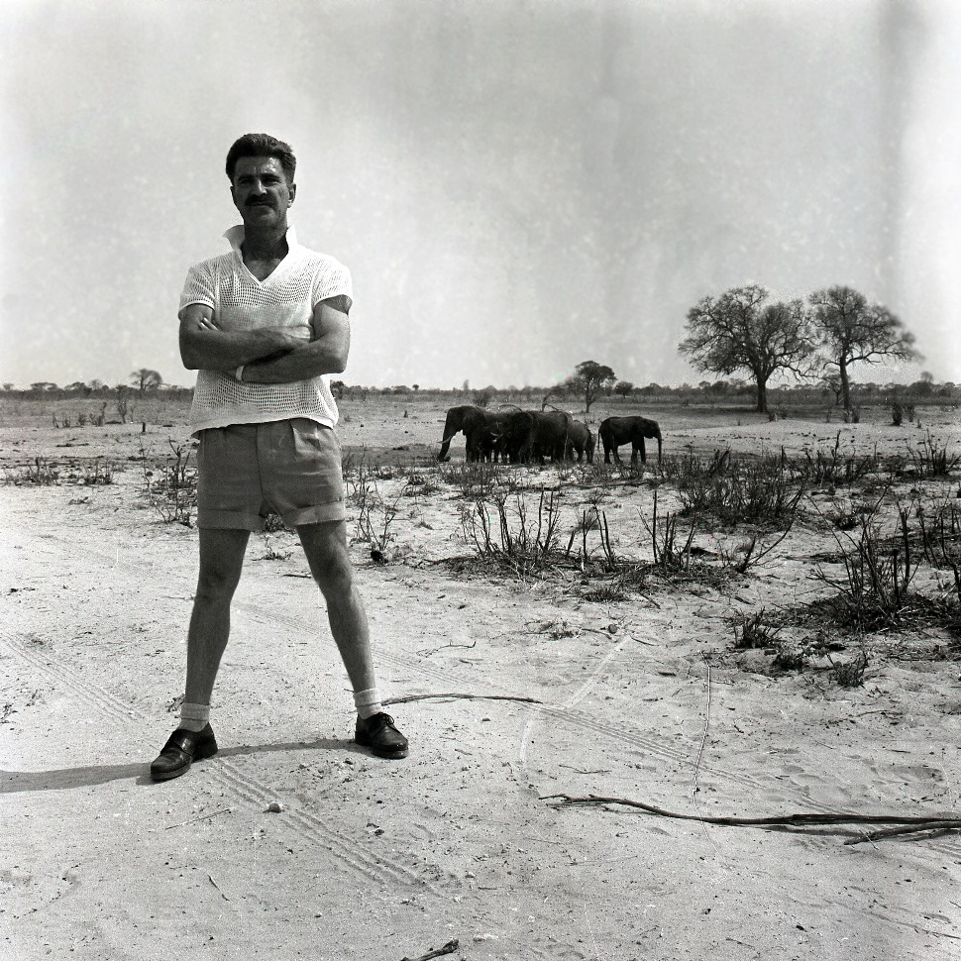
Peter Mackay (1926-2013)
Notes:
Heritage is a distinctly modern concern – linked to modernity’s relationship with time which aims to order and classify things from the past.
But heritage in many ways has little to do with the past – it emerges out of the relationship between the past and the present as a reflection on the future.
This suggests heritage is an active process – it is linked to a set of values we may wish to take with us in to the future.
Sport heritage is particularly potent in this respect as it is loaded with value – it draws our attention on the ability to take an active role in the production of our own and collective future – which may be about health and wellbeing, equality and diversity, overcoming conflict through co-operation, or the environment and sustainability.
As I’m sure we shall hear today, sport heritage emerges from the inter-relationships between people, objects, places and practices - our experiences thus far in sharing the Commonwealth Games Archive through the Hosts and Champions exhibition is that sport heritage can be a fantastic medium for making new connections, new material ways of linking the past with the present and new dialogues between individuals and communities that did not have a voice before.

Slide 3
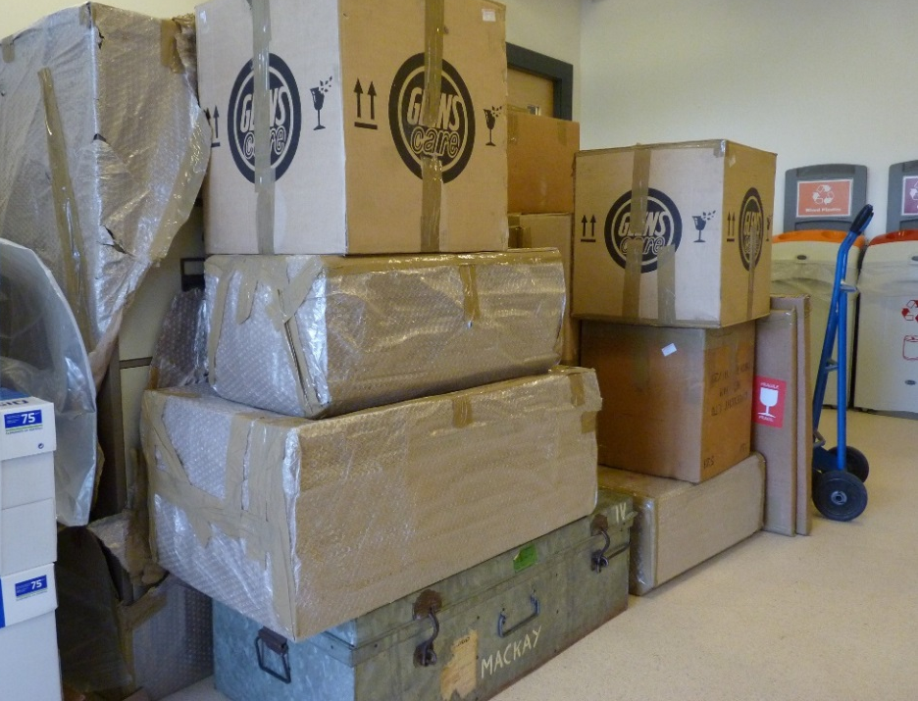
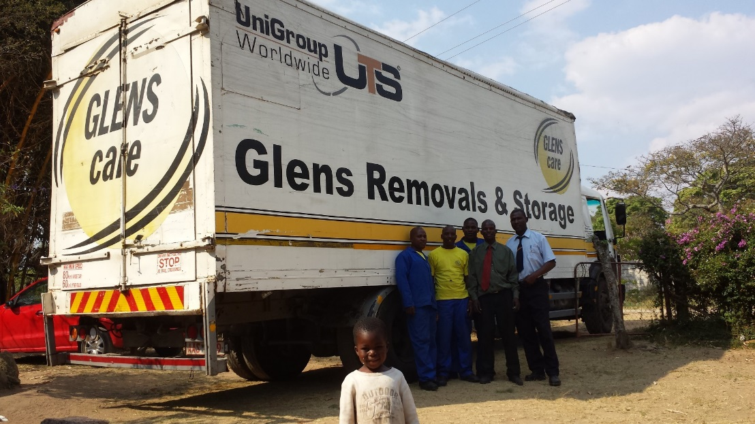
The journey…
Notes:
The pilot research and community project aimed to explore interpretations of local sports heritage between different generations in order to understand how the concept of heritage is understood, contested and authenticated, and assess the role and value of sports heritage for cultural and social change.
The project investigated the cultural transmission of sporting cultures of the past, and its influence over, or disconnection from, contemporary sporting practices of young people.

Slide 4
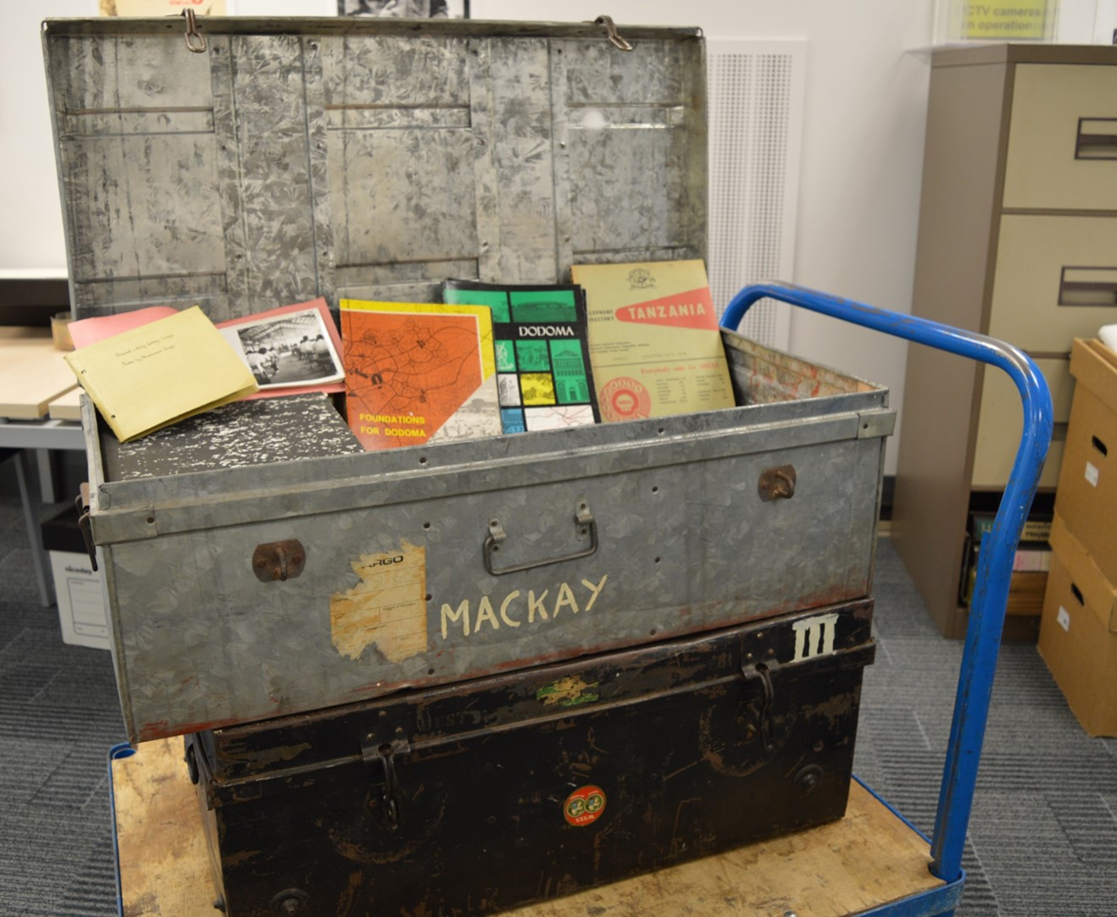
The challenge…

Slide 5
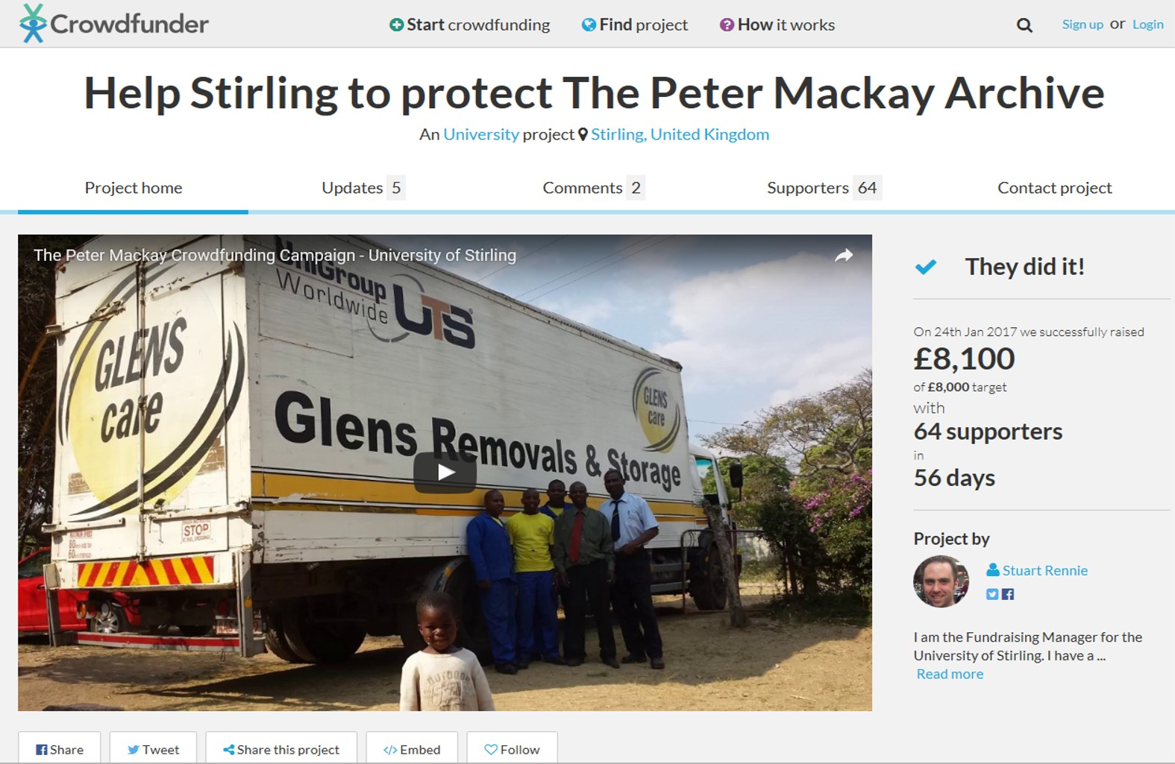
The campaign…

Slide 6
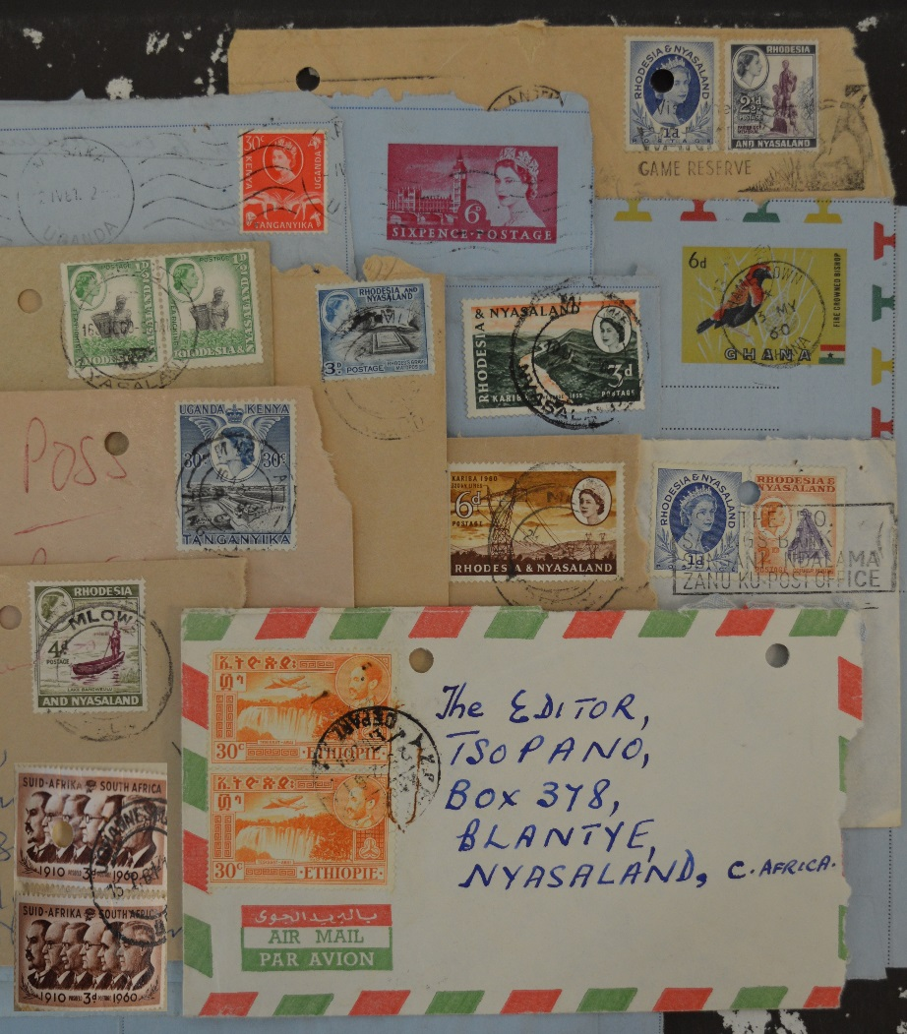
The Archive
Notes:
The Scottish Curriculum for Excellence contains guidelines for schools to design their own teaching materials, along with underlying principles, capacities and qualities that education should develop in children. Sport heritage has a role to play in this process.
For Early to Level 1 learners – the photo album introduces a new form of evidence about the past, and raises awareness that evidence varies in the extent to which it can be used to learn about history.
Level 2 learners can connect primary and secondary sources to research events in the past.
Level 3 learners can use this evidence to interpret the past and develop an informed view about the present and perhaps the future.
Level 4 learners can evaluate conflicting sources of evidence and form a sustained line of argument.
The Sir Peter Heatly Archive provides a good example:
Global travel – photo evidence of long-journeys to overseas events – what was the impact on job security and family life? What was life on a liner like, especially for young women who required a chaperone? How did athletes keep fit and prepare for their event? How does evidence in the archive relate to the experiences of contemporary athletes and their global travel?
Team Scotland – how was the team selected, how big was it, how were they funded? What was it like representing Scotland in the Commonwealth Games? What were relationships like with other British teams? How does representing Scotland now relate to what it meant then? How might this change post-Brexit?
Photo albums – How did Sir Peter select and annotate his photographs? Does his personal media archiving tell us something about the social and archival nature of photo albums? How does this form of social documentation relate to contemporary digital documentation via social media? Can we learn anything about personal archives as cultural capital and a way of documenting friendship?

Slide 7
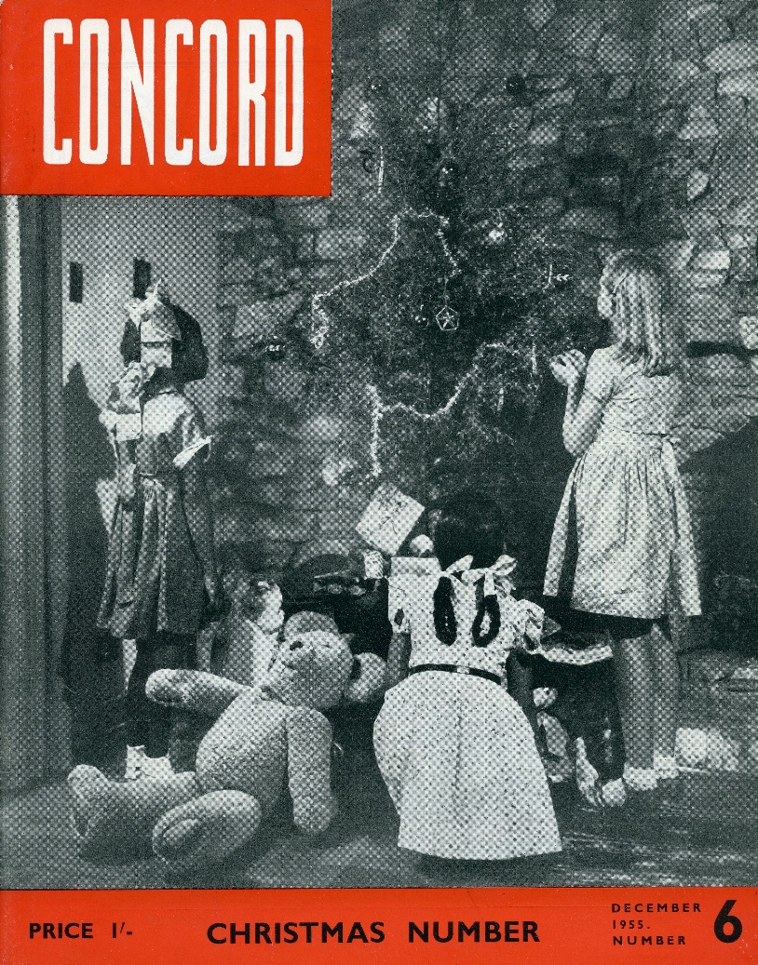

Slide 8
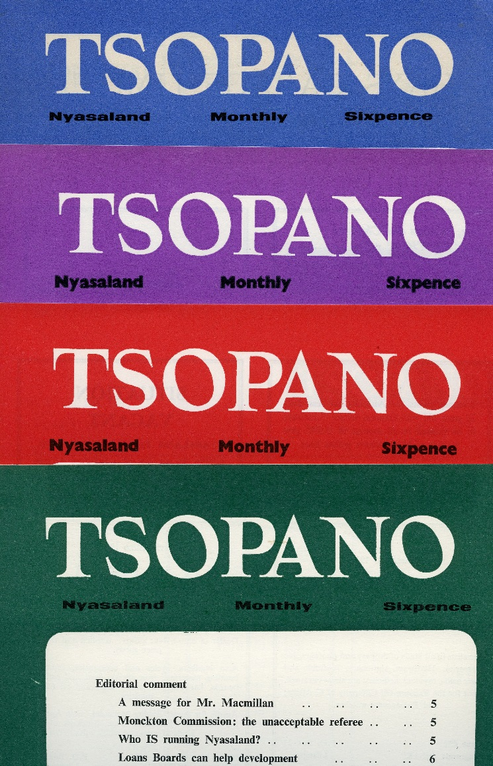
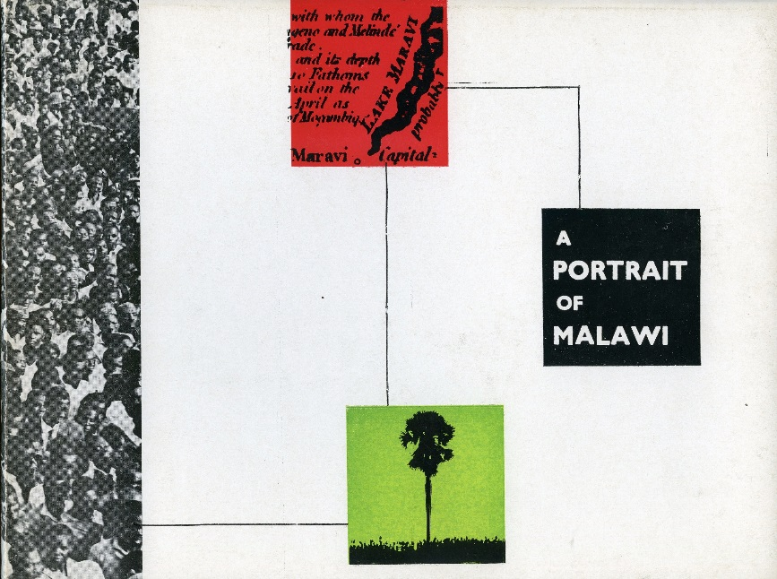
Notes:
The Scottish Curriculum for Excellence contains guidelines for schools to design their own teaching materials, along with underlying principles, capacities and qualities that education should develop in children. Sport heritage has a role to play in this process.
For Early to Level 1 learners – the photo album introduces a new form of evidence about the past, and raises awareness that evidence varies in the extent to which it can be used to learn about history.
Level 2 learners can connect primary and secondary sources to research events in the past.
Level 3 learners can use this evidence to interpret the past and develop an informed view about the present and perhaps the future.
Level 4 learners can evaluate conflicting sources of evidence and form a sustained line of argument.
The Sir Peter Heatly Archive provides a good example:
Global travel – photo evidence of long-journeys to overseas events – what was the impact on job security and family life? What was life on a liner like, especially for young women who required a chaperone? How did athletes keep fit and prepare for their event? How does evidence in the archive relate to the experiences of contemporary athletes and their global travel?
Team Scotland – how was the team selected, how big was it, how were they funded? What was it like representing Scotland in the Commonwealth Games? What were relationships like with other British teams? How does representing Scotland now relate to what it meant then? How might this change post-Brexit?
Photo albums – How did Sir Peter select and annotate his photographs? Does his personal media archiving tell us something about the social and archival nature of photo albums? How does this form of social documentation relate to contemporary digital documentation via social media? Can we learn anything about personal archives as cultural capital and a way of documenting friendship?

Slide 9
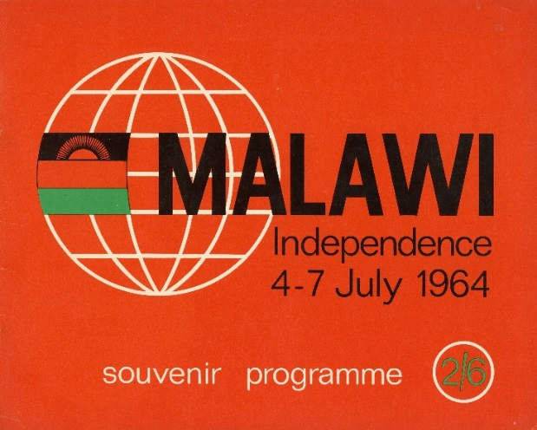
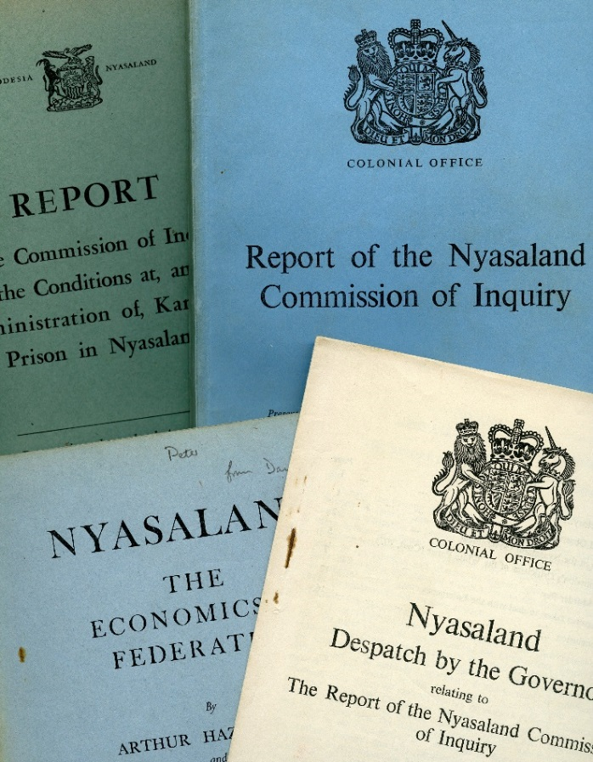
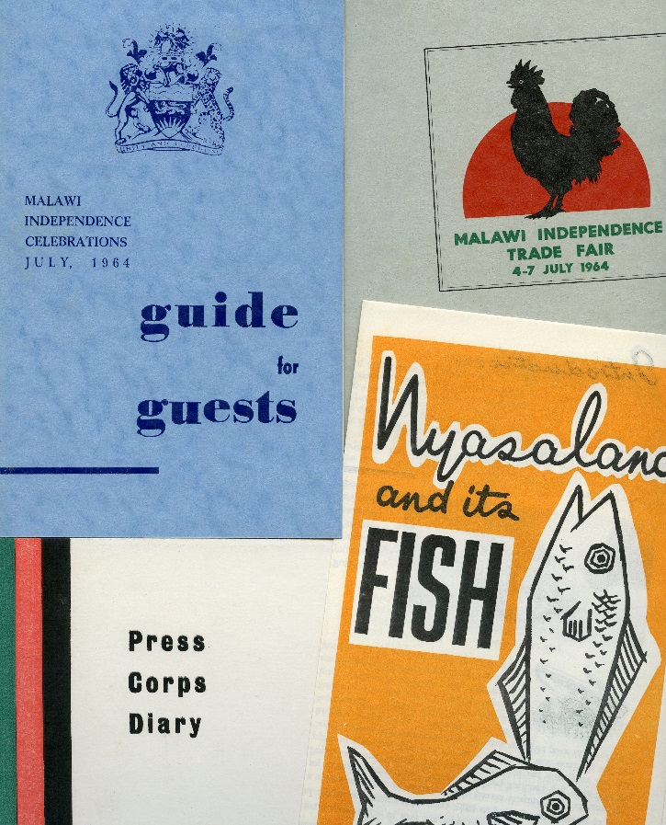
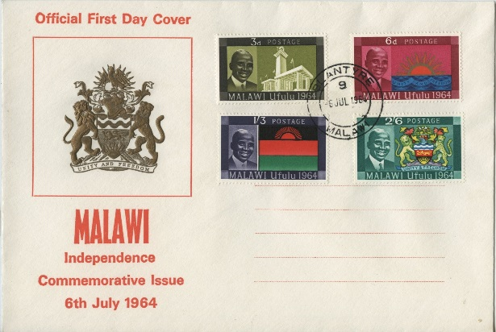
Notes:
The Scottish Curriculum for Excellence contains guidelines for schools to design their own teaching materials, along with underlying principles, capacities and qualities that education should develop in children. Sport heritage has a role to play in this process.
For Early to Level 1 learners – the photo album introduces a new form of evidence about the past, and raises awareness that evidence varies in the extent to which it can be used to learn about history.
Level 2 learners can connect primary and secondary sources to research events in the past.
Level 3 learners can use this evidence to interpret the past and develop an informed view about the present and perhaps the future.
Level 4 learners can evaluate conflicting sources of evidence and form a sustained line of argument.
The Sir Peter Heatly Archive provides a good example:
Global travel – photo evidence of long-journeys to overseas events – what was the impact on job security and family life? What was life on a liner like, especially for young women who required a chaperone? How did athletes keep fit and prepare for their event? How does evidence in the archive relate to the experiences of contemporary athletes and their global travel?
Team Scotland – how was the team selected, how big was it, how were they funded? What was it like representing Scotland in the Commonwealth Games? What were relationships like with other British teams? How does representing Scotland now relate to what it meant then? How might this change post-Brexit?
Photo albums – How did Sir Peter select and annotate his photographs? Does his personal media archiving tell us something about the social and archival nature of photo albums? How does this form of social documentation relate to contemporary digital documentation via social media? Can we learn anything about personal archives as cultural capital and a way of documenting friendship?

Slide 10
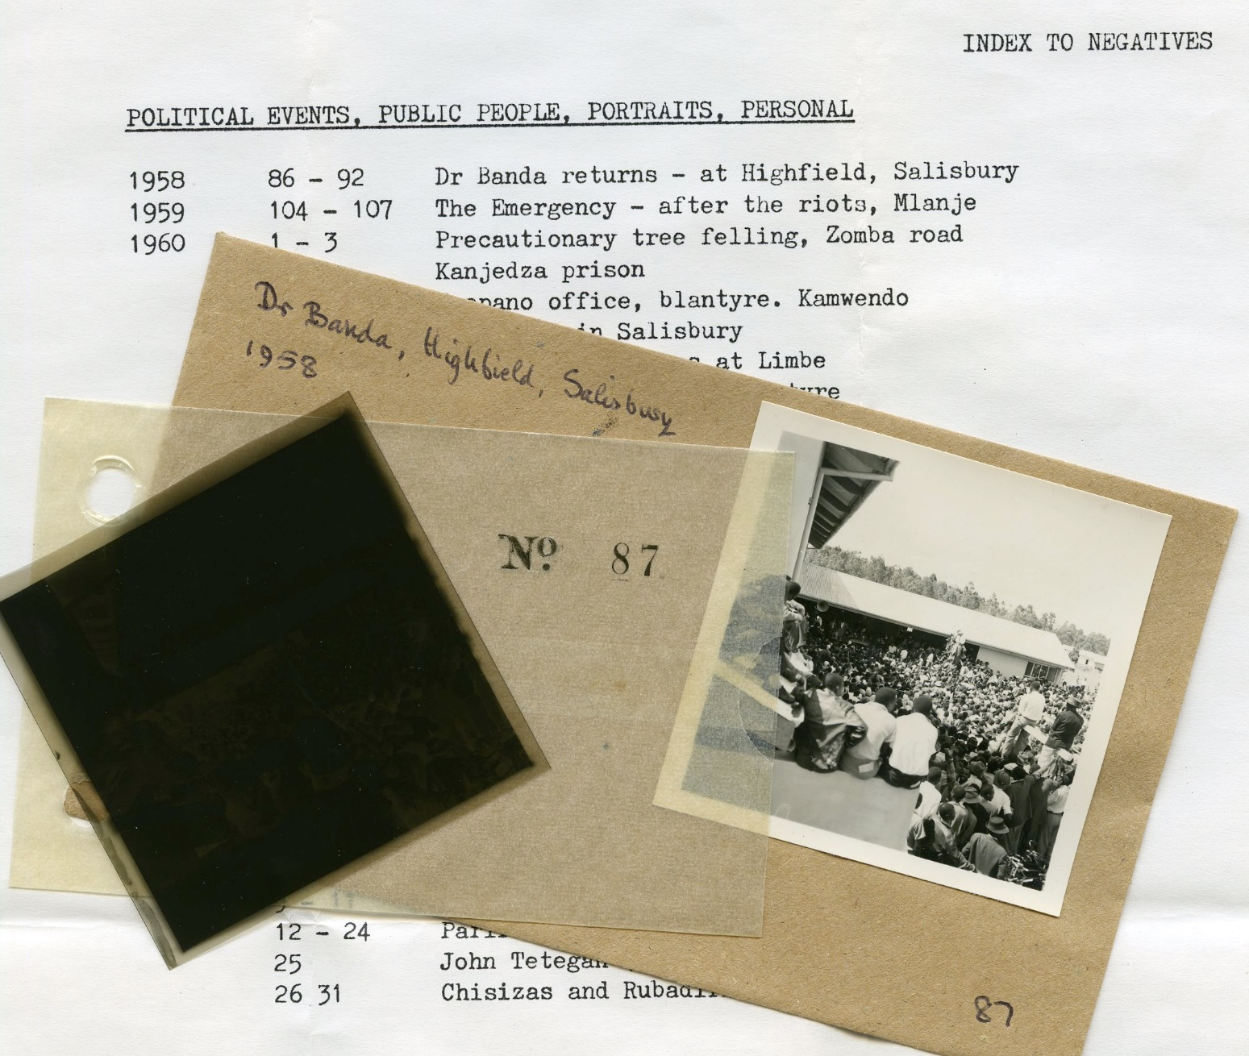

Slide 11
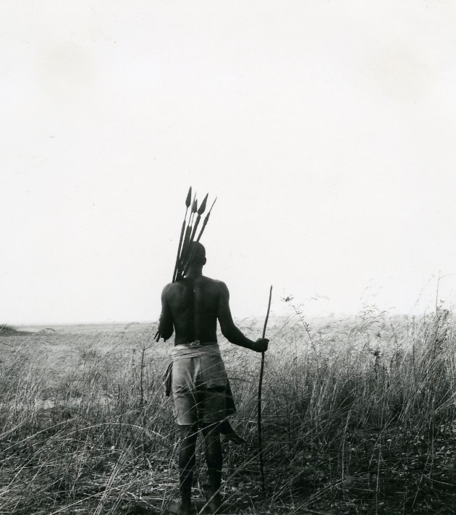
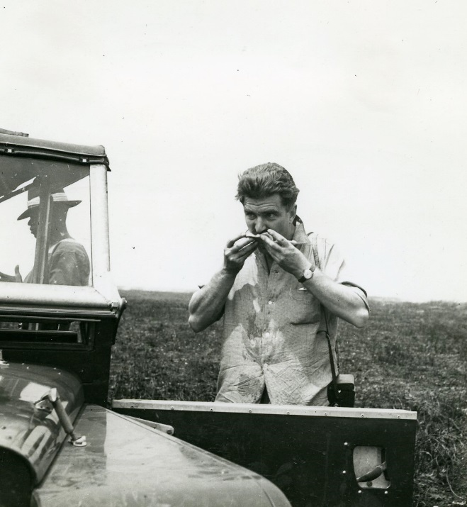
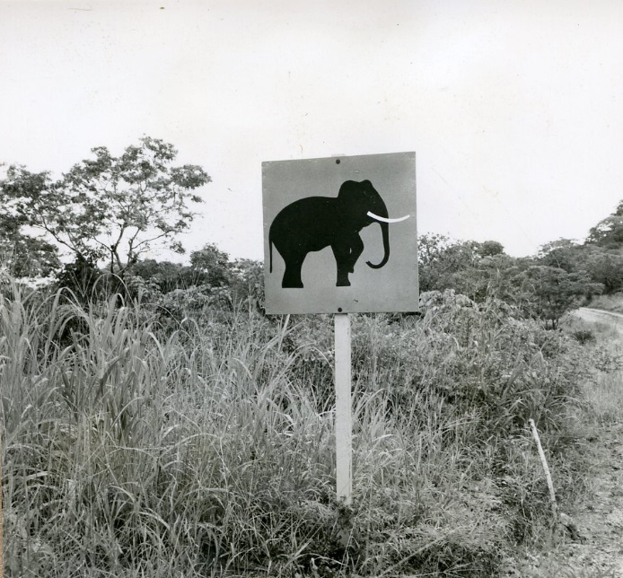
Notes:
The Scottish Curriculum for Excellence contains guidelines for schools to design their own teaching materials, along with underlying principles, capacities and qualities that education should develop in children. Sport heritage has a role to play in this process.
For Early to Level 1 learners – the photo album introduces a new form of evidence about the past, and raises awareness that evidence varies in the extent to which it can be used to learn about history.
Level 2 learners can connect primary and secondary sources to research events in the past.
Level 3 learners can use this evidence to interpret the past and develop an informed view about the present and perhaps the future.
Level 4 learners can evaluate conflicting sources of evidence and form a sustained line of argument.
The Sir Peter Heatly Archive provides a good example:
Global travel – photo evidence of long-journeys to overseas events – what was the impact on job security and family life? What was life on a liner like, especially for young women who required a chaperone? How did athletes keep fit and prepare for their event? How does evidence in the archive relate to the experiences of contemporary athletes and their global travel?
Team Scotland – how was the team selected, how big was it, how were they funded? What was it like representing Scotland in the Commonwealth Games? What were relationships like with other British teams? How does representing Scotland now relate to what it meant then? How might this change post-Brexit?
Photo albums – How did Sir Peter select and annotate his photographs? Does his personal media archiving tell us something about the social and archival nature of photo albums? How does this form of social documentation relate to contemporary digital documentation via social media? Can we learn anything about personal archives as cultural capital and a way of documenting friendship?

Slide 12
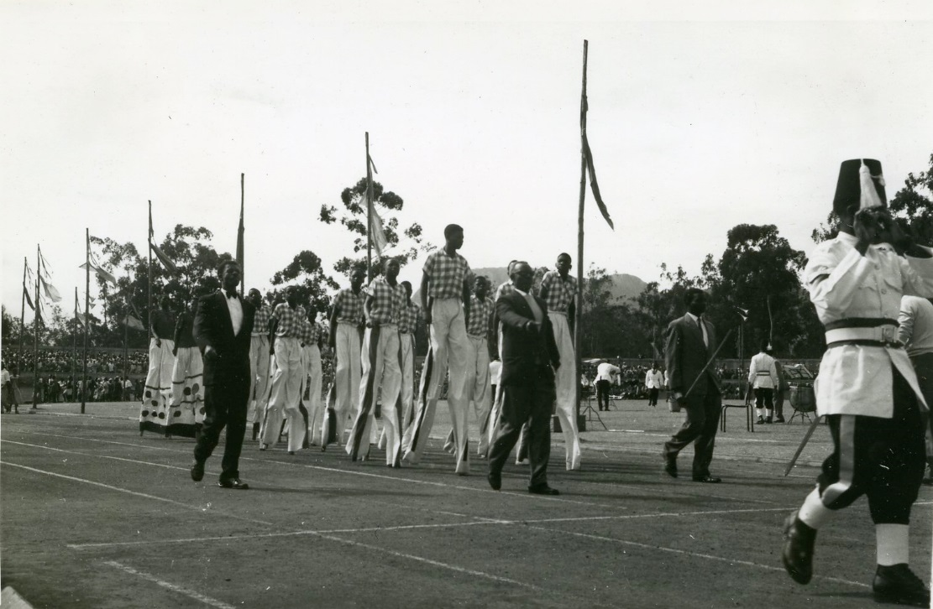
Notes:
The Scottish Curriculum for Excellence contains guidelines for schools to design their own teaching materials, along with underlying principles, capacities and qualities that education should develop in children. Sport heritage has a role to play in this process.
For Early to Level 1 learners – the photo album introduces a new form of evidence about the past, and raises awareness that evidence varies in the extent to which it can be used to learn about history.
Level 2 learners can connect primary and secondary sources to research events in the past.
Level 3 learners can use this evidence to interpret the past and develop an informed view about the present and perhaps the future.
Level 4 learners can evaluate conflicting sources of evidence and form a sustained line of argument.
The Sir Peter Heatly Archive provides a good example:
Global travel – photo evidence of long-journeys to overseas events – what was the impact on job security and family life? What was life on a liner like, especially for young women who required a chaperone? How did athletes keep fit and prepare for their event? How does evidence in the archive relate to the experiences of contemporary athletes and their global travel?
Team Scotland – how was the team selected, how big was it, how were they funded? What was it like representing Scotland in the Commonwealth Games? What were relationships like with other British teams? How does representing Scotland now relate to what it meant then? How might this change post-Brexit?
Photo albums – How did Sir Peter select and annotate his photographs? Does his personal media archiving tell us something about the social and archival nature of photo albums? How does this form of social documentation relate to contemporary digital documentation via social media? Can we learn anything about personal archives as cultural capital and a way of documenting friendship?

Slide 13
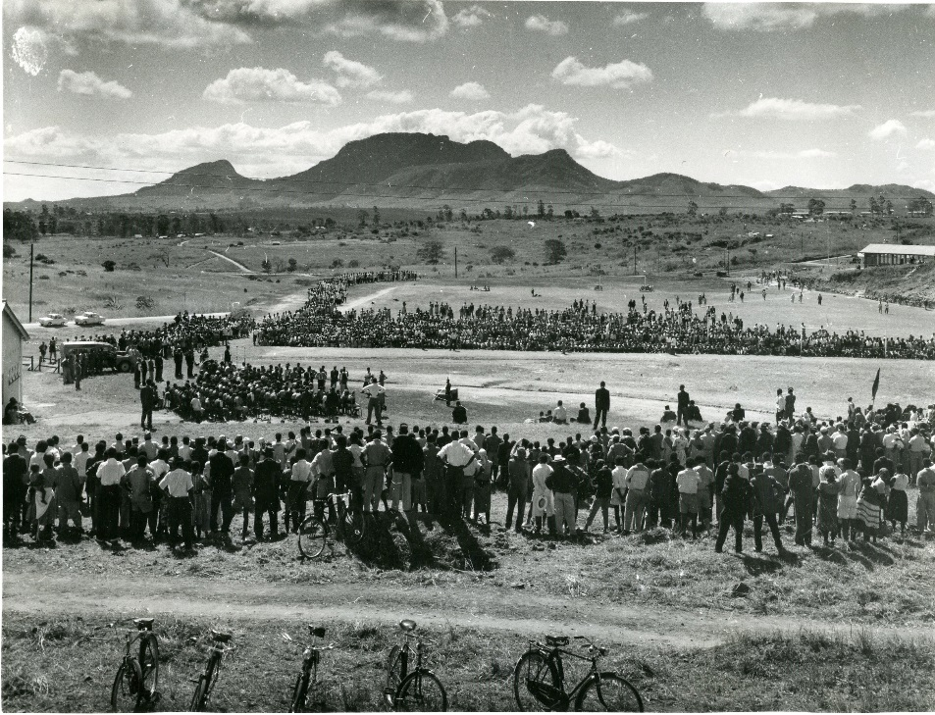
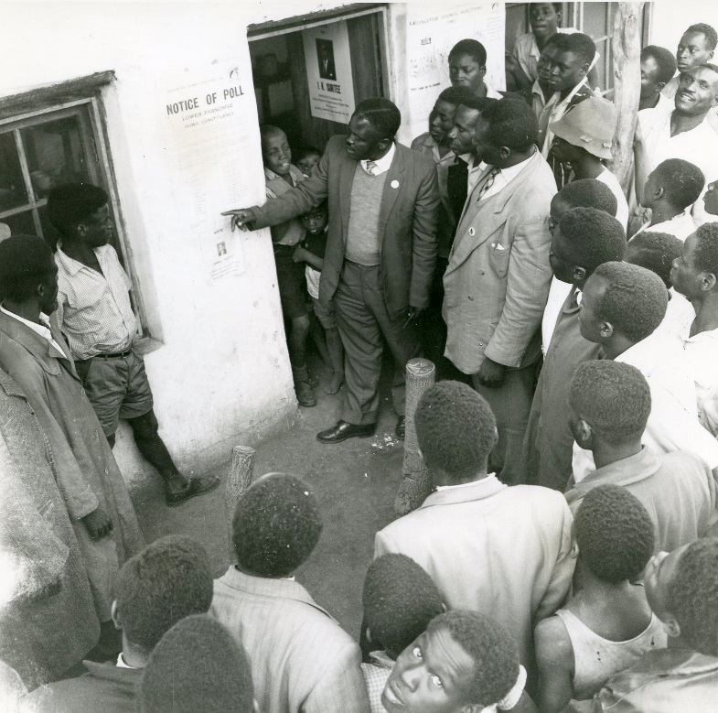

Slide 14
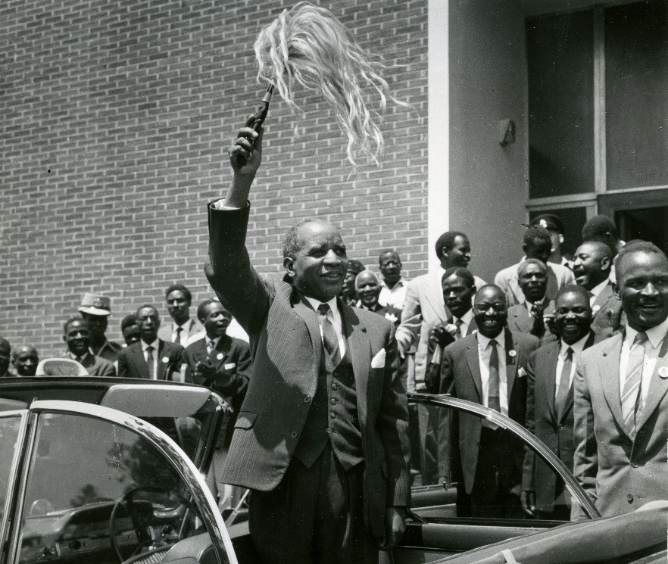
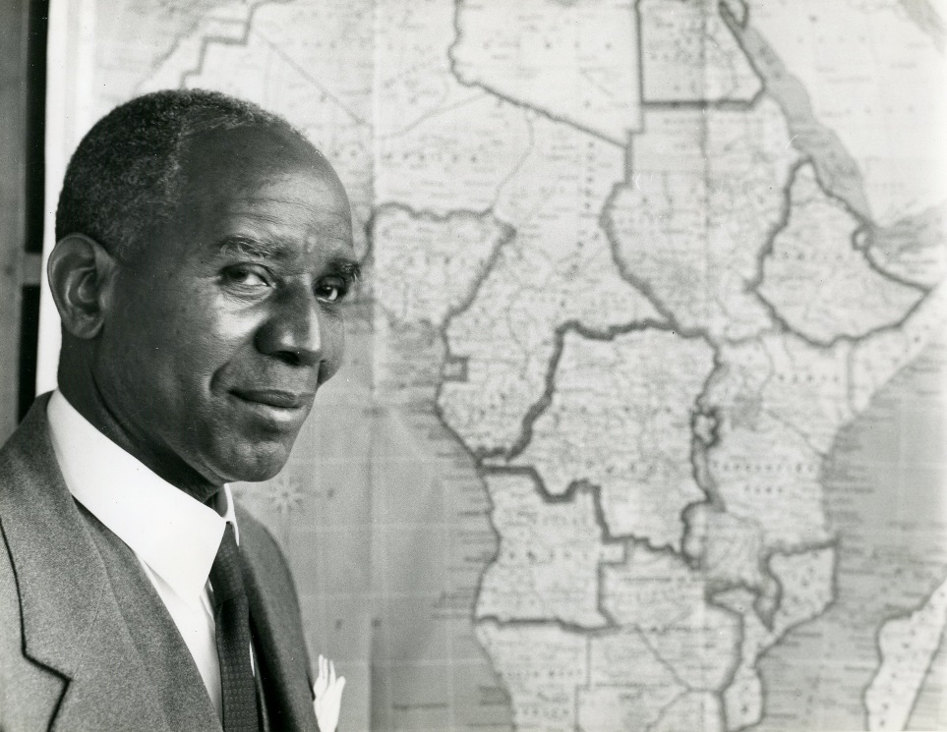

Slide 15
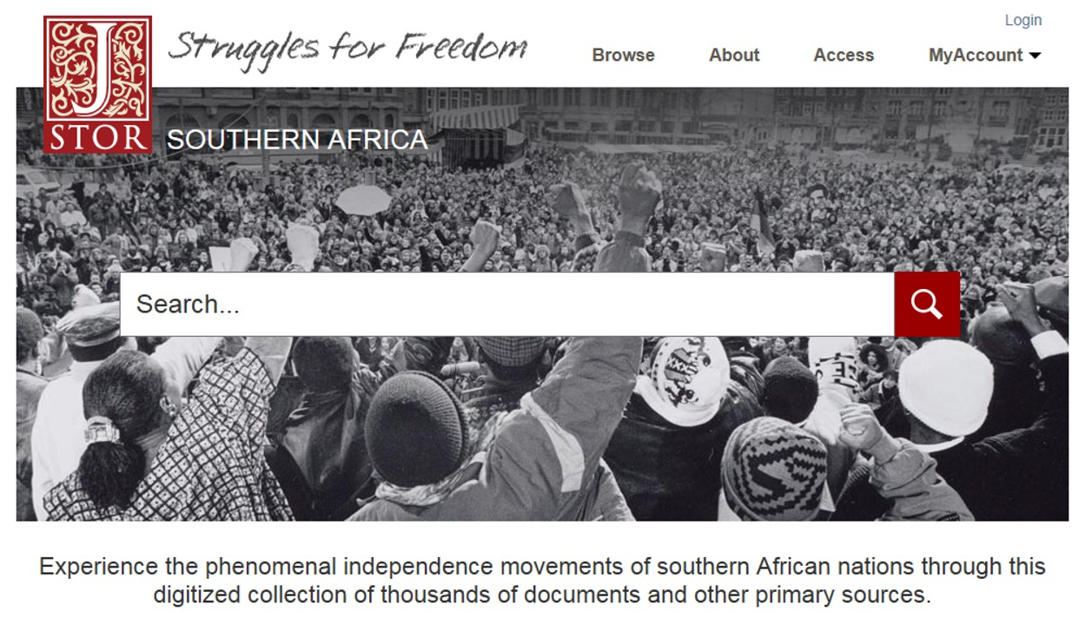
The campaign…

Slide 16
Karl Magee University Archivist karl.magee@stir.ac.uk Twitter @unistirarchives Twitter #MackayArchive
Notes:
Heritage is a distinctly modern concern – linked to modernity’s relationship with time which aims to order and classify things from the past.
But heritage in many ways has little to do with the past – it emerges out of the relationship between the past and the present as a reflection on the future.
This suggests heritage is an active process – it is linked to a set of values we may wish to take with us in to the future.
Sport heritage is particularly potent in this respect as it is loaded with value – it draws our attention on the ability to take an active role in the production of our own and collective future – which may be about health and wellbeing, equality and diversity, overcoming conflict through co-operation, or the environment and sustainability.
As I’m sure we shall hear today, sport heritage emerges from the inter-relationships between people, objects, places and practices - our experiences thus far in sharing the Commonwealth Games Archive through the Hosts and Champions exhibition is that sport heritage can be a fantastic medium for making new connections, new material ways of linking the past with the present and new dialogues between individuals and communities that did not have a voice before.

