Slide 1
“GLOBAL CITIZENSHIP:
SCOTLAND’S INTERNATIONAL DEVELOPMENT STRATEGY”

Slide 2
Ministerial Foreword
“International development is a key part of Scotland’s global contribution within the international community. It encompasses our core values, historical and contemporary, of fairness and equality. It is also about Scotland acting as a good global citizen. We are the inheritors of that tradition; it is who we are today, and it who we want our next generation to be”.

Slide 3
Our Vision
“Embedding the Global Goals, Scotland will contribute to sustainable development and the fight against poverty, injustice and inequality internationally”

Slide 4
Our Priorities
Encourage new and historic relationships
Empower our partner countries
Engage the people of Scotland
Enhance our global citizenship

Slide 5
Our Partner Countries
Malawi, Zambia and Rwanda will form our sub-Saharan project base; and
Pakistan will see a strong emphasis on education through scholarships

Slide 6
Our Ways of Working
Investing our International Development Fund - 3 funding streams:
development assistance;
capacity strengthening; and
investment
Utilising Scottish expertise
Collaborating with others:
partner countries;
civil society;
other donors

Slide 7
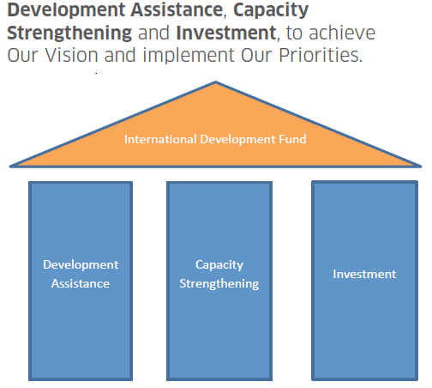
3 Funding Streams

Slide 8
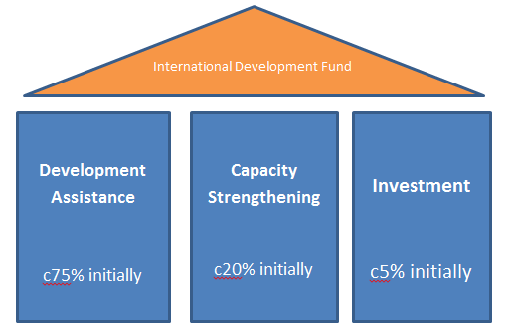
Proportions (with caveats)

Slide 9
Development Assistance: c75% of IDF (initially)
Empower our partner countries / Encourage new & historic relationships: support development assistance overseas:
majority thro competitive challenge funding models for Malawi, Zambia & Rwanda, and the Small Grants
match funding.
Engage people of Scotland, & Enhance global citizenship: support civil society in Scotland incl (non-competitive):
core funded bodies: SMP, MaSP, SFTF & The Alliance. [Total £780k for 2017/18]
Development Education Centres (DECS)
volunteering support for Scotland’s young people

Slide 10
Capacity Strengthening: up to 20% of IDF (initially)
Empower our partner countries / Encourage new & historic relationships / Engage the people of Scotland:
Pakistan: we will also continue to support education through women and children’s scholarships run by British Council Pakistan.
targeted at harnessing Scottish expertise:
capacity building & strengthening partnerships thro institutional links, e.g. Police Scotland work in Malawi or Blantyre-Blantyre project with Liverpool Welcome Trust, University of Glasgow and College of Medicine
skills sharing through professional volunteering, e.g. NHS

Slide 11
Investment: up to 5% of IDF (initially)
Empower our partner countries: our partner countries WANT investment.
We believe trade & investment is important, as is role of private sector: to support Malawi, Zambia & Rwanda move beyond aid & build sustainable economic growth domestically, in line w/ their wider govt policies.
Support too for social enterprise models.
Recent investment initiative for Malawi saw SG obtain £1M in match funding from private indivs.
We are clear that IDF spend – for devpt assistance, capacity strengthening or investment – must be to implement Our Vision, ie tackling poverty & inequality & contributing to sustainable devpt.

Slide 12
3 streams working together?
Development assistance: Malawi funding rounds opened 03 November 2017
Capacity strengthening funding stream: will then overlay, to support:
needs identified (by Malawi)
incl health “volunteering” & Police work
could include business mentoring/interns
Investment: to help grow local economy in Malawi

Slide 13
Malawi Development Programme 2018-2023
Main Changes
Two Stage application process (Concept Note and Full application)
Maximum funding available increased to £300k pa (£150k in year 1) (Max £1.35 million)
Maximum project period increased to 4.5 years

Slide 14
Malawi Development Programme 2018-2023
Main changes (cont)
Capital expenditure increased to 20% of project budget (50% for RE projects)
Scottish admin costs capped at max of 10% of project budget
Current projects can apply for funding to continue their current work

Slide 15
Malawi Development Programme 2018-2023
Application Process
For this funding round we will operate a two stage application process.
Concept Note Stage - organisations submit a concept note summarising why the project is needed and what it seeks to achieve.
Application Stage - Successful organisations will be invited to complete a full application form which will require more detail of the project plans.

Slide 16
Malawi Development Programme 2018-2023
Themes
In accordance with the existing 2005 Cooperation Agreement between the Scottish and Malawian Governments, we will only fund projects for work within the priorities set by the Government of Malawi in the areas of:
Health
Education
Civic Governance;
sustainable economic development; and
With the agreement of the Government of Malawi, we will also fund Renewable Energy projects in Malawi

Slide 17
Government of Malawi’s Priorities
Health Strand
Human resources for health system strengthening
Universal coverage of essential health services
Addressing conventional and traditional determinants of health in Malawi
Quality Assurance and Quality Improvement of Essential Health Services

Slide 18
Government of Malawi’s Priorities (Cont)
Civil Society and Governance Strand
Capacity building for the new Parliament i.e. Committee work etc.
Institutional capacity building for the Malawi Prison Service (including Young Offender services)
Support towards the fight against Corruption
Support organisations advocating for good governance and human rights
Support organisations advocating for gender equality
Support for free Paralegal services

Slide 19
Government of Malawi’s Priorities (Cont)
Education Strand General
Teacher training (including Special Needs, especially teacher training for working with students with Learning Difficulties)
Internal efficiency of the Primarily school structure
Decentralisation of education management
School infrastructure (new classrooms, teachers houses and latrines)
Provision of teaching and learning materials
Inclusive education
Curriculum strengthening at all levels
Bursaries to support vulnerable students (particularly Secondary school)
Up scaling of school feeding programme (particularly Primary school)
Upgrading of Community Day Secondary Schools
Introduction of more double shift schools

Slide 20
Government of Malawi’s Priorities (Cont)
Higher Education
Access to Higher education
Training of Higher education staff
Curriculum strengthening in Technical, Entrepreneurial and Vocational Education and Training (“TEVET”) institutions
Cost recovery mechanisms and finance mobilisation in public universities
Public Private Partnerships
Support for capacity to strengthen procurement, financial management, planning, budgeting and monitoring and evaluation systems.

Slide 21
Government of Malawi’s Priorities (Cont)
Sustainable Economic Development
Agricultural Development & Value Addition (Including irrigation elements as part of projects)
Tourism
Energy (Renewable Energy) (especially alternative sources of power from Solar)
Environment & Natural Resources Management
Finance and Investment Promotion

Slide 22
Malawi Development Programme 2018-2023
Timetable
Dates | Actions
03 November 2017 | Opening
03 November 3017 – 26 January 2018 | Concept Note Stage
29 November 2017 | Information Day
March 2018 | Concept Note Decisions
02 April – 11 May 2018 | Full Application Stage
July 2018 | Application Decisions
01 October 2018 | Projects Commence

Slide 23
Zikomo! Scottish Govt International Development Team T. @scotgovID

