Slide 1
MALSCOT continuity despite Covid restrictions
Heather Cubie on behalf of MALSCOT team in Scotland and Malawi
SMP Covid Forum 29th July 2020

Slide 2
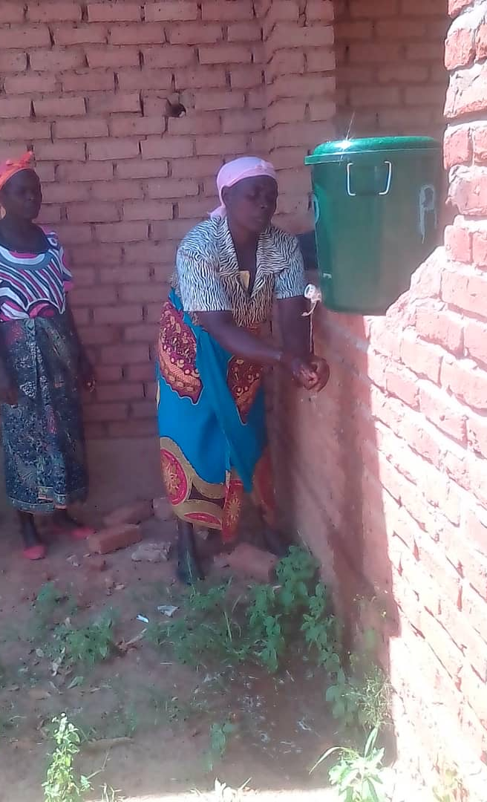
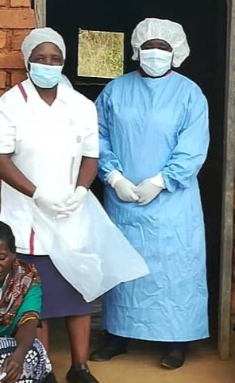
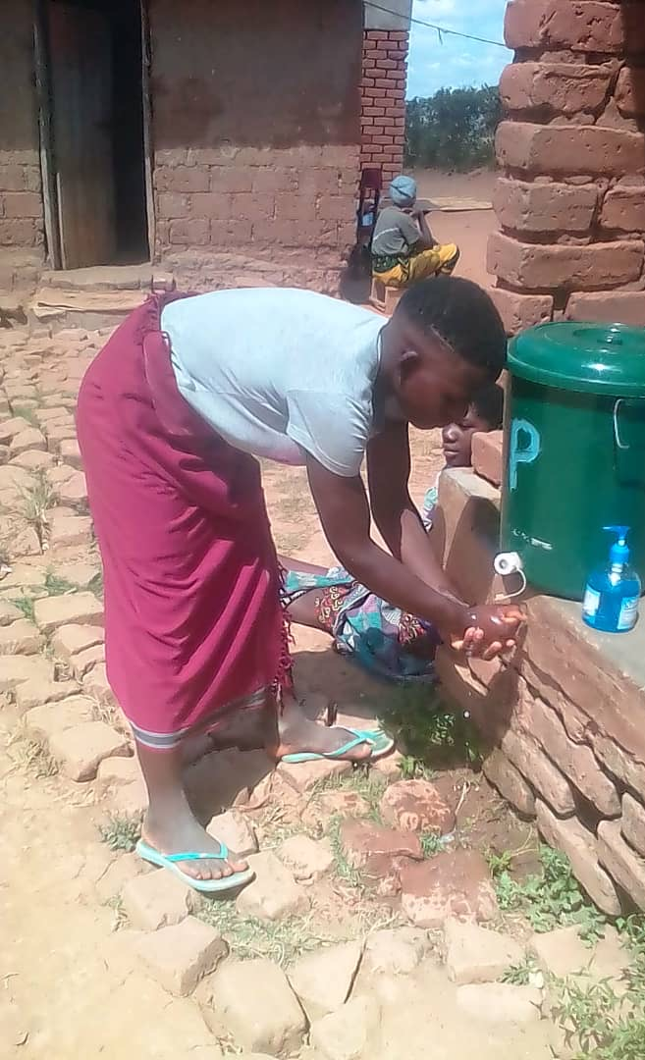

Slide 3
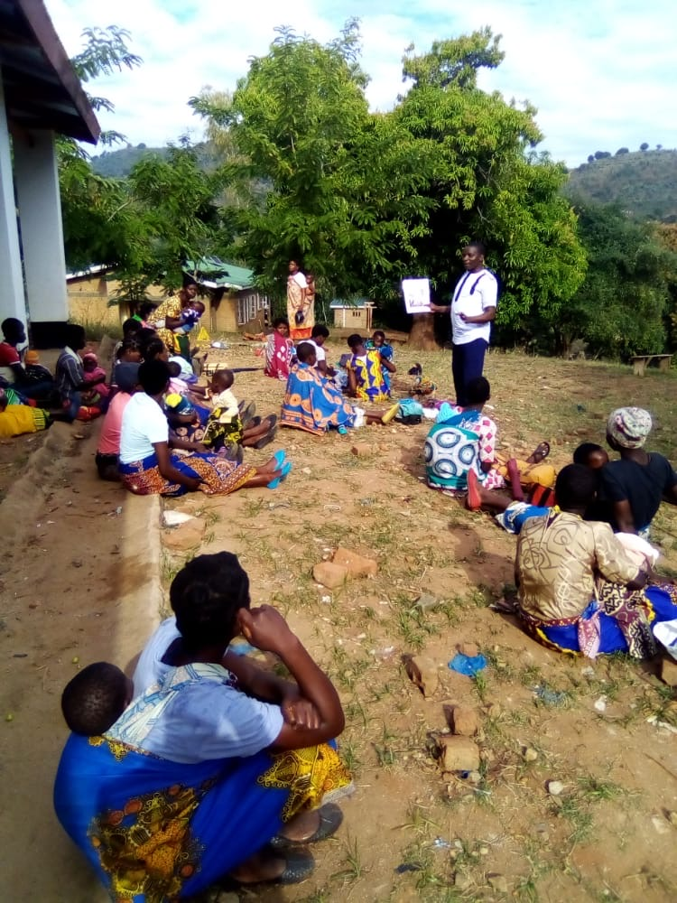
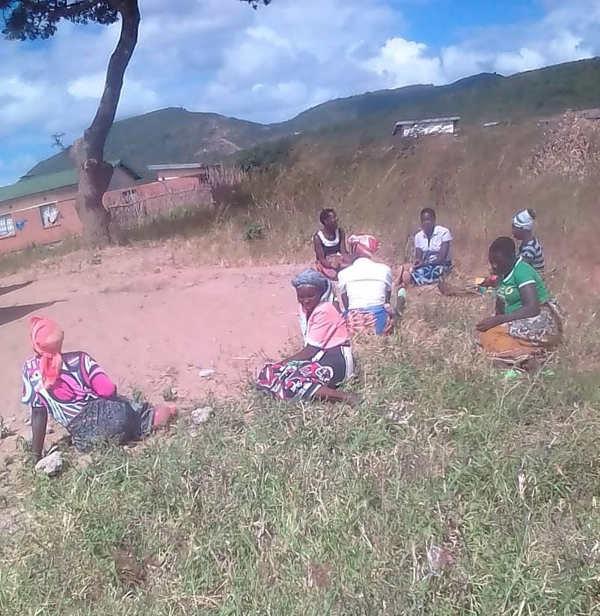
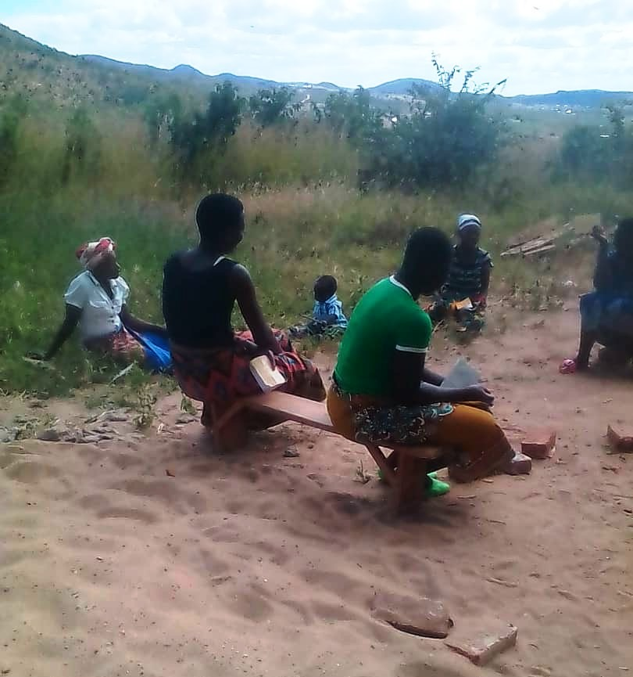
Social distancing in outreach settings

Slide 4
Monthly returns from MALSCOT hubs during first three months of Covid
Month | Total no. screened | First VIA screen | Received treatment | Suspect cancer referrals
April 2020 | 1736 | 1408 | 60 | 15
May 2020 | 1329 | 1175 | 22 | 14
June 2020 | 1725 | 1547 | 24 | 5
Q1 totals | 4790 | 4130 | 106 | 34

