Slide 1
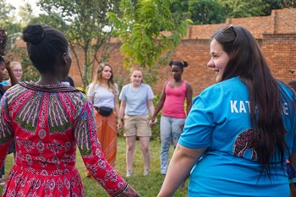
Get involved in co-creating teenage dialogue
It’s difficult for teenagers from one of the richest countries to connect on a deep level with teenagers in one of the poorest countries in the world. Our research shows that Scots pupils can worry about saying the wrong thing or feel the pressure to ‘have a laugh’ and that Malawians can feel like passive recipients of donations without the power to challenge or ask questions. So it’s easier to engage in joint activities than to sit down and talk through life experiences and insights.
STEKAskills and QMU have worked closely with Malawian young people to develop a whole new approach to creating dialogue for visiting Scottish school pupils which was piloted in June 2018 with remarkable results. We want more schools to get involved in co-producing the approach - contact ewood@qmu.ac.uk or stekaskills@gmail.com to find out more or talk to Gift Thompson or Emma Wood today.

Slide 2
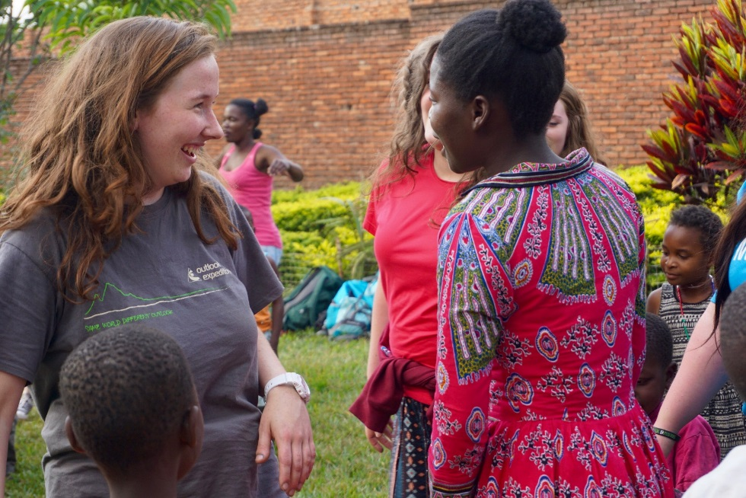
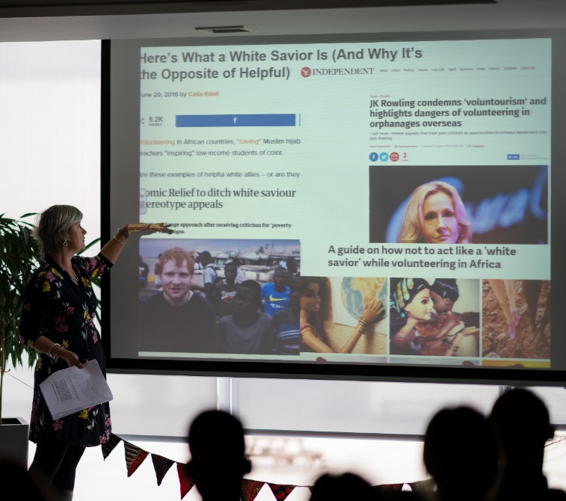
Scottish school pupils can frame their trips to vast social media audiences as going to ‘make a difference’ in Malawi (sometimes posting selfies with Malawian children). This can be seen to reinforce inequalities, as well as inhibiting solidarity, global citizenship and young people coming together to bring about change. It can also reinforce an aid framed view of international relations and contradict the Scottish Government’s rights framed agenda.
Our new dialogue model of voluntourism will maximise the power of volunteering which is deemed essential to the achievement of the Global Goals to “facilitate changes in mind-sets by raising awareness or championing those changes and inspiring others” (United Nations). It will empower young Malawians to engage with Scottish school pupils with confidence, to facilitate a two-way sharing of experience and understanding of shared concerns such as employment, gender equality, sustainability and environmental protection.
This respectful two- way approach will enable the Malawians to earn a sustainable income, and fund places for other marginalized young Malawians at the STEKA Centre for Vocational Skills & Community Enterprise. It will enable the Scots to develop new and profound knowledge and overtly challenge them to use their resources (particularly their access to mass audiences through social media) to encourage ‘communities and individuals - to adapt their behaviour in support of the Global Goals’ (UN). This would be facilitated by training in QMU’s photo-elicitation approach to encourage them to use social media in new ways to communicate solidarity and encourage behaviour change (drawing on QMU’s expertise in digital campaigning and content creation).
Feedback from Gleniffer High School pupils who took part in the pilot:
“It was such an amazing experience and it opened my eyes …They are so aware of everything and how everything works…It was insightful to meet people our own age and make connections without judgement. Such a strong sense of commitment & family made me appreciate how everyone should work together to support each other ”
Hear them speak more about what they learned and how it felt @ www.STEKASKILLS.com or https://vimeo.com/user91023748

