Slide 1
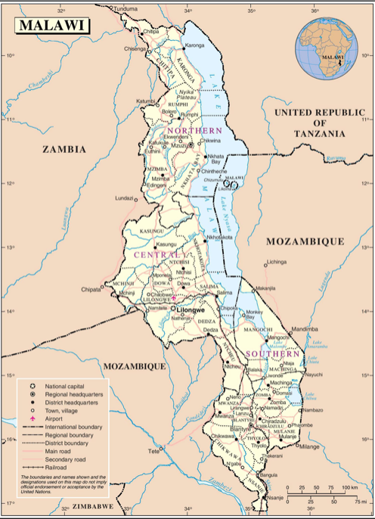
Working from the margins: Supporting trade unions in Malawi to improve disability inclusion
Funded by Scottish Research Council Global Challenge Research Fund
Justification:
There is a comprehensive literature that evidences associations between work, poverty and health; occupational inequalities go hand in hand with economic and health inequalities. This project acknowledges these associations, as well as the evidenced successes of Trade Unions across the world in agitating for improved working standards, and consequent improvements in worker health and wellbeing. We aim to work in partnership with the Malawian Congress of Trade Unions (MCTU) and academics at the University of St Andrews, to generate a sustainable project for improved working conditions and widening economic participation for disabled working age people in Malawi.
Project outcomes:
Understanding of how work and disability are defined in Malawi, legislatively, socially and domestically.
Identify examples of good practice in workplace disability inclusion.
Learn about the challenges faced by Malawi trade unions in supporting disabled people.
Knowledge exchange activities between MCTU, the Scottish Trade Union Congress (STUC) and Heriot-Watt.
Contribute toward a research and activist network exploring work and disability across Malawi and Scotland.
Develop future joint GCRF grant application focused on disability and employment.
Project activities:
Map existing data and groups working with disabled people in Malawi, and relevant organisations in Scotland and UK.
Generate a literature review pertaining to disability and employment in Malawi or similar national contexts.
Interview key stakeholders focusing on current activities to support disabled workers, gaps in current provision and the needs of trade unions & disabled people, issues affecting disabled workers’ inclusion and examples of good practice.
Meet potential research partners in Malawian universities and NGOs to identify future research strategies and priorities.
Co-author report and journal paper output.
Important dates:
May 13-17th – Malawi Trade Union Congress Networking visit to Scotland
July [TBC] – Heriot-Watt University research and workshop trip to Malawi
Sept [TBC] – Joint MCTU/HWU workshop in Scotland
HWU: Kate Sang, James Richards, Jen Remnant and Lena Wånggren
MCTU: Limbani Kachali and Denis C Kalekeni
St Andrews: Ali Watson and Sarah Huque

