Slide 1
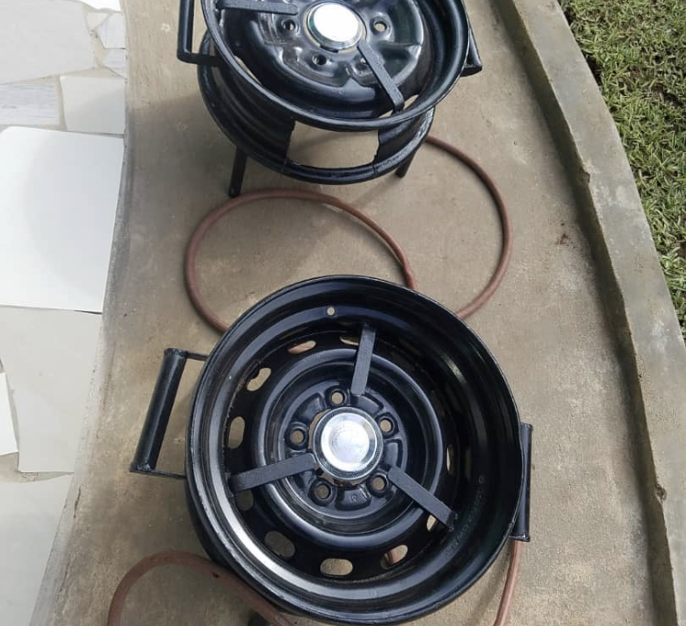
KUPHIKA KWAPWEKA COOKSTOVE
DURABLE, SAFE AND AFFORDABLE COOKSTOVES FOR LOW INCOME HOUSEHOLDS

Slide 2
CURRENT SITUATION - ENERGY POVERTY AND THE PANDEMIC
Biomass accounts for 84% dominating Malawi’s total energy supply.
The COVID-19 pandemic has caused an increase in fuel prices.
Low income household being those who have been affected the most by energy poverty.
Most poor and marginalized households have resolved to using agricultural waste.
They have a higher severity of being exposed to respiratory illnesses and COVID-19.
Women are amongst those whom have been gravely affected during the pandemic.

Slide 3
KUPHIKA KWAPWEKA COOKSTOVE
Durable, Safe and Energy Efficient Cookstoves.
Made from recycled car wheel rims and scrap metals.
Fueled by affordable and clean fuels (Biogas and LPG).
Locally fabricated which makes them more affordable.
Costs 40% less than imported cookstoves (£15).

Slide 4
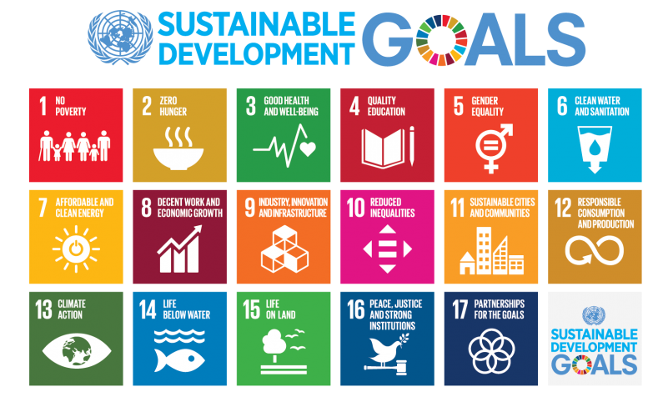
Cookstoves address :
SDGS 3,7,9,10,11,12,13

