Slide 1
Leadership Capacity Building for Malawian Midwives

Slide 2
Presentation outline
AMAMI/Edinburgh Napier University partnership
Commonwealth leadership fellowship objectives
Lessons learnt
Plans

Slide 3
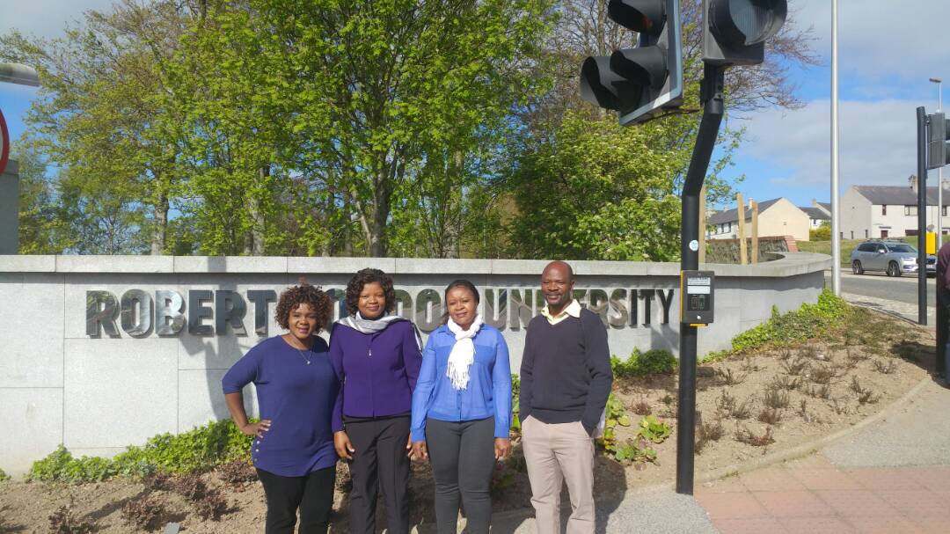

Slide 4
AMAMI\ENU partnership

Slide 5
AMAMI/NAPIER PARTINERSHIP
AMAMI/Edinburgh Napier University have been in partnership for the last three years implementing a Respectful Maternal Care/ RMC Project
Through RMC project, need for Capacity building for midwives and Midwifery leaders was identified.
The commonwealth leadership fellowship is a response to such a need

Slide 6
Objectives of the capacity building Commonwealth Fellowship
To understand Scottish priorities for maternity policy, service, research, education and practice in Scotland
To identify commonalities and differences with the Malawi context and transferable lessons
To identify own leadership qualities and areas for development

Slide 7
Activities
Met midwifery leaders at different levels in Scotland
Visited training institutions in Edinburgh and Aberdeen
Leadership training sessions
Visited Health Facilities at different levels
Participated in conferences (international week at Napier University)

Slide 8
Edinburgh Napier University Orientation

Slide 9
Visit to Aberdeen Maternity Hospital

Slide 10
Meeting with Senior Midwifery Leaders

Slide 11
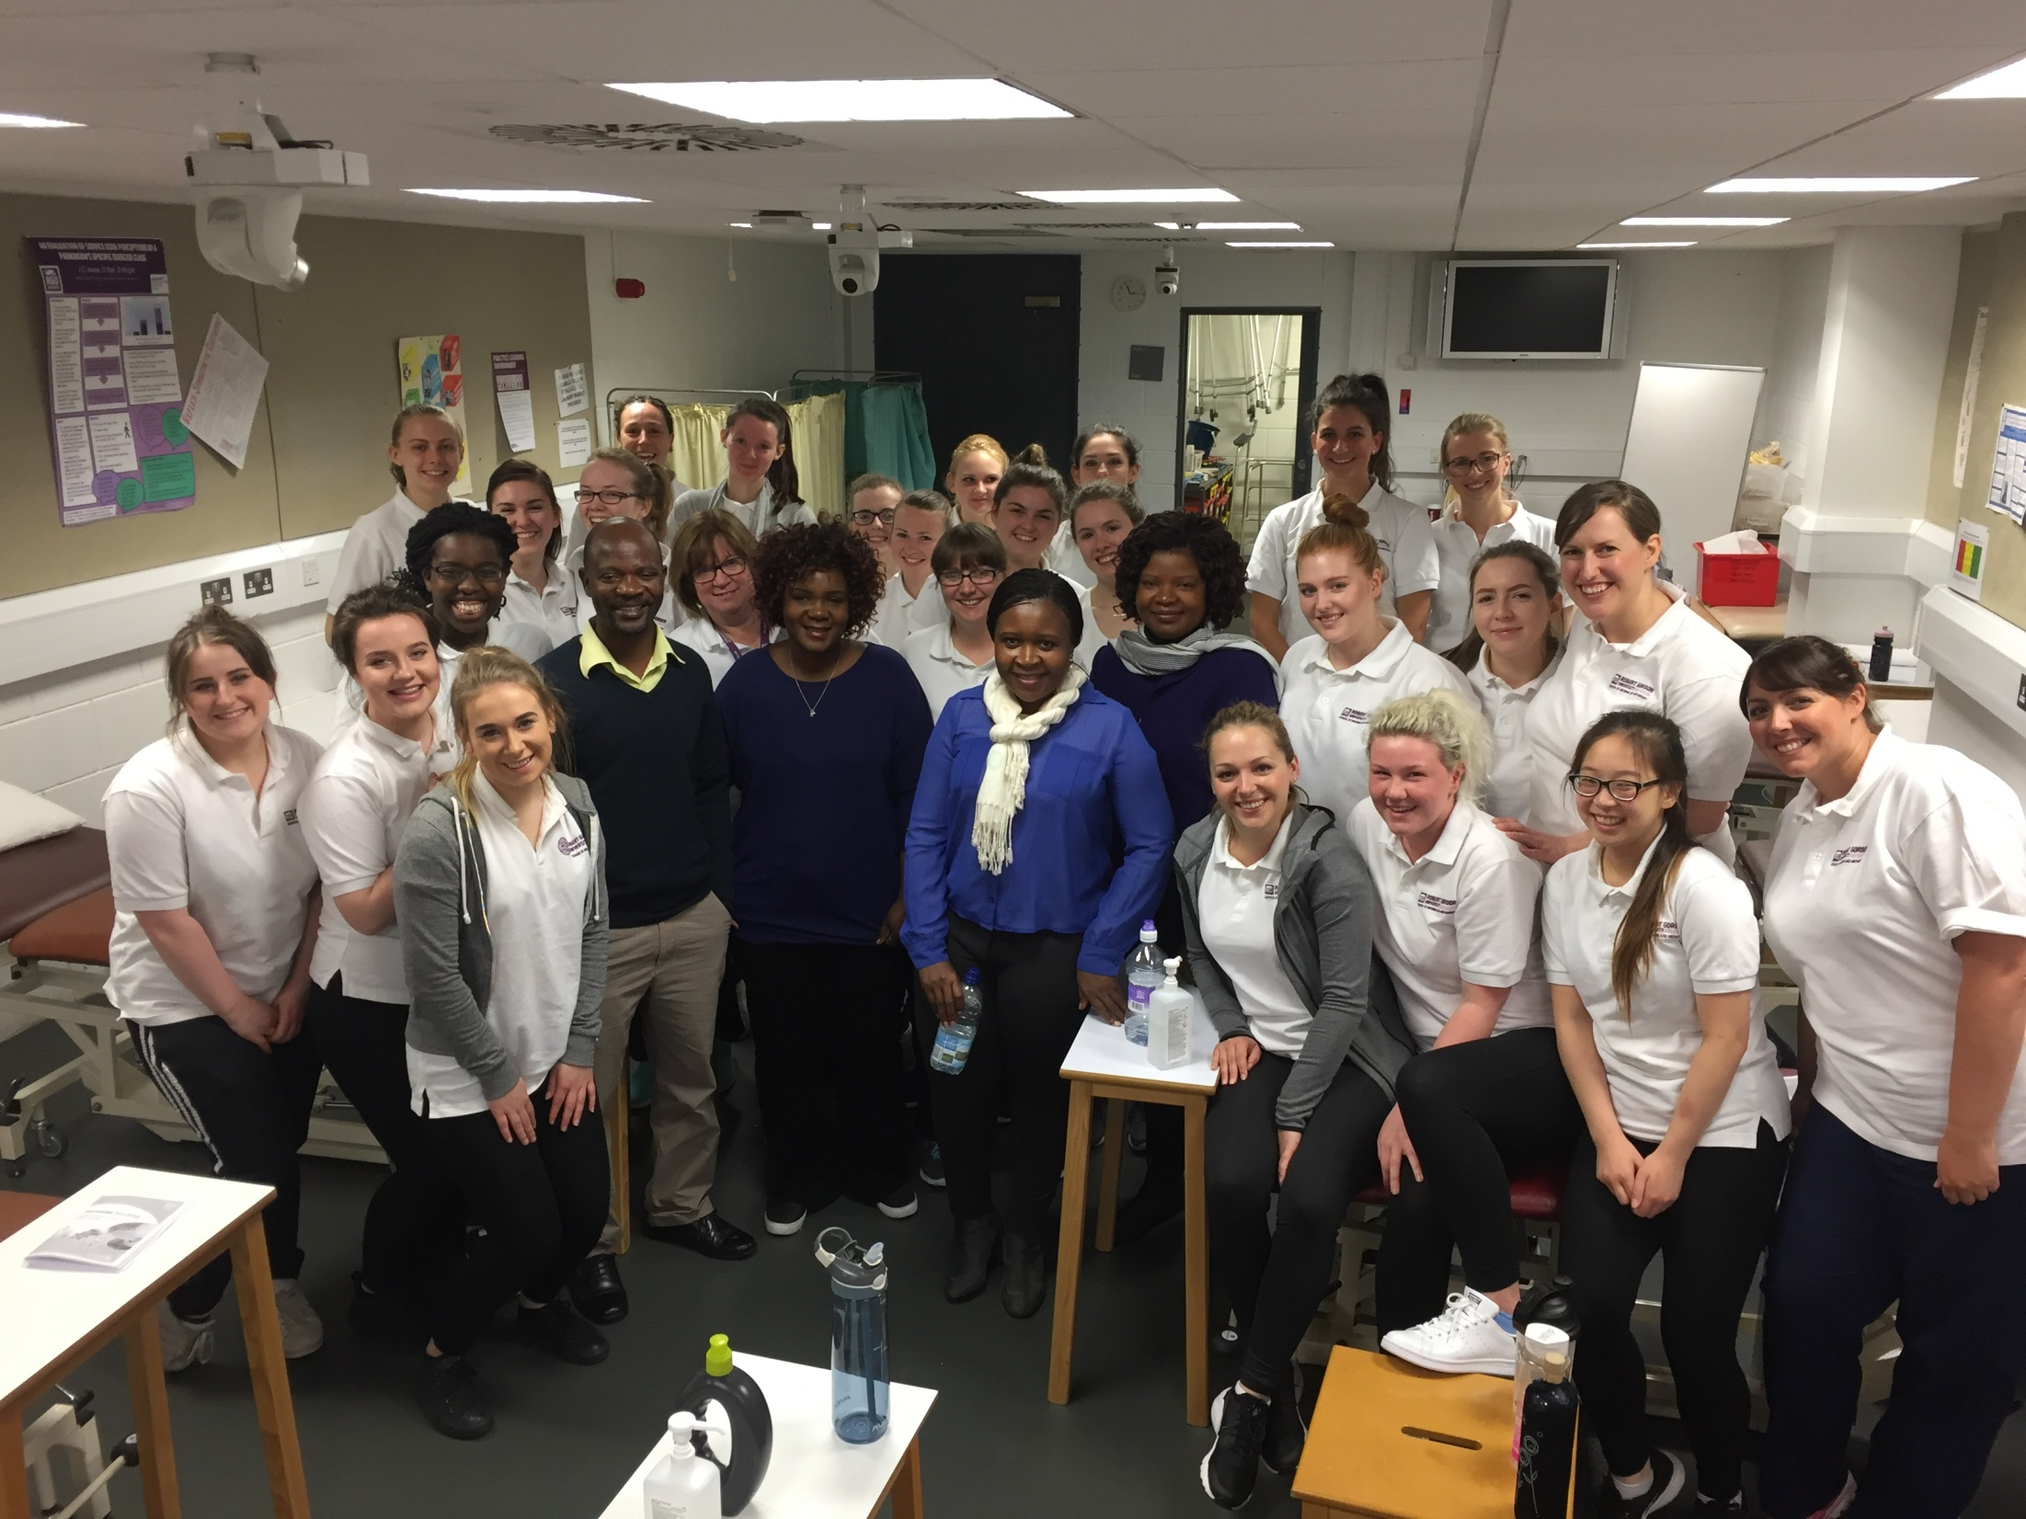

Slide 12
International Week Edinburgh Napier

Slide 13
Lessons learnt
Multidisciplinary approach to decision making
Use of authentic leadership style
Royal College of Midwives provides capacity building for its members
Senior education midwifery leaders have a task force at a national level that determines midwifery education and advises the government on midwifery education and practice

Slide 14
Lessons learnt cont..
Through the leadership training sessions, we have acquired knowledge and skills in leadership.
Have acquired an insight into researchable areas to improve health care.

Slide 15
Lessons learnt cont..
The position of mentors in the hospital is well defined, recognized and supported
Vibrant research directorate that promote evidence based practice.

Slide 16
Peterhead Health Centre

Slide 17
Plans on returning to Malawi
Capacity building for midwifery leaders at different levels
Mentorship program for midwifery leaders
Research

Slide 18
Visit to Robert Gordon University

Slide 19
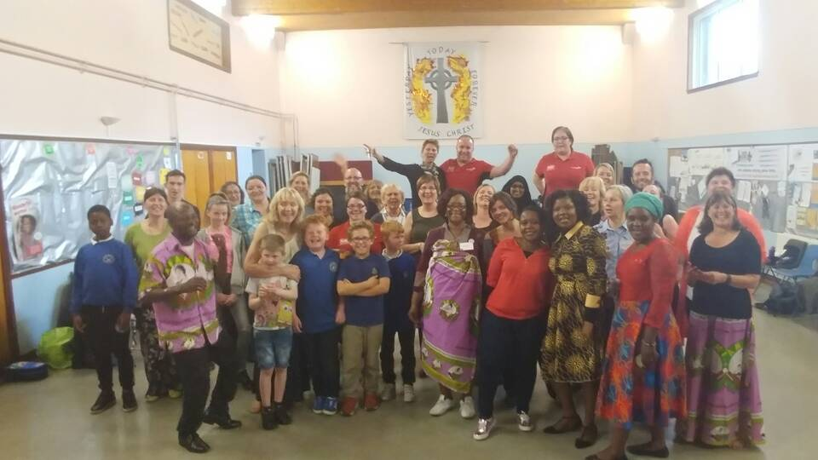
THANK YOU

