Slide 1
Enhancing Medical & Healthcare Training: Strengthening IT capacity St Andrews Medical School - College of Medicine, Malawi Collaboration
Sharing experience
University of St Andrews Medical School
Julie Struthers
Deputy Head of School
Learning Technology Consultant

Slide 2
Partnership
Over 20 years collaboration between the College of Medicine (COM) in Malawi and School of Medicine in St Andrews.
The COM was founded upon the basis of previous medical training at St Andrews and many of the graduates of Medicine and of Health Care Management now hold the highest clinical and governmental positions in Malawi.

Slide 3
COM and St Andrews Collaboration
1st SGIDF Grant 2008-2011
Enhancing Medical Training
2nd SGIDF Grant 2012-15
Enhancing Healthcare Training
Current ongoing collaboration

Slide 4
1st - Enhancing Medical Training
Aim
To increase the numbers of graduates from the College of Medicine
Develop a new integrated undergraduate medical school curriculum
Support the development and expansion of human resource and ICT infrastructure

Slide 5
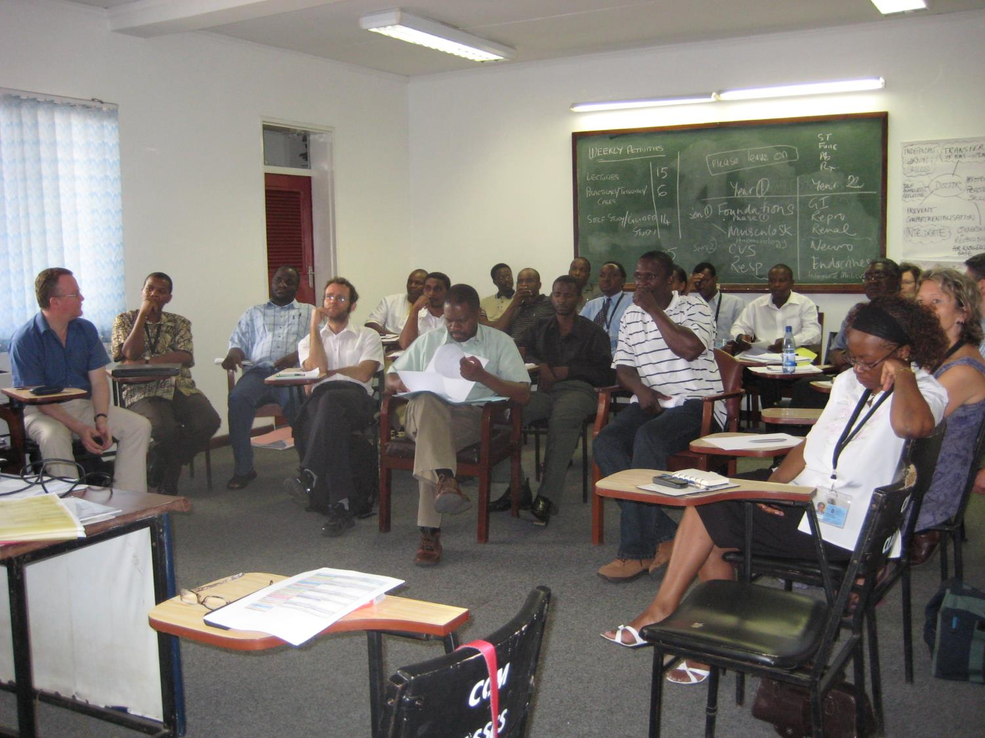

Slide 6
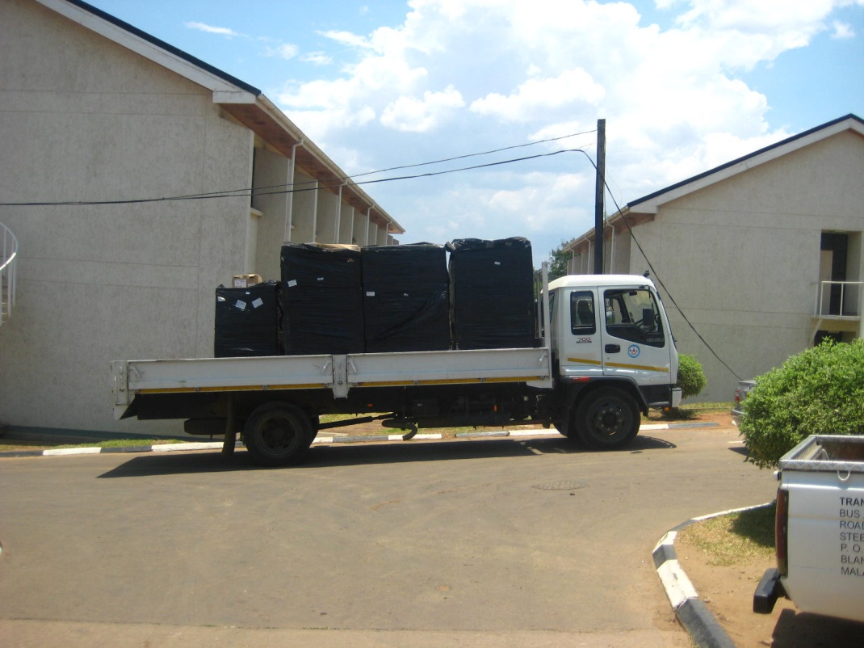
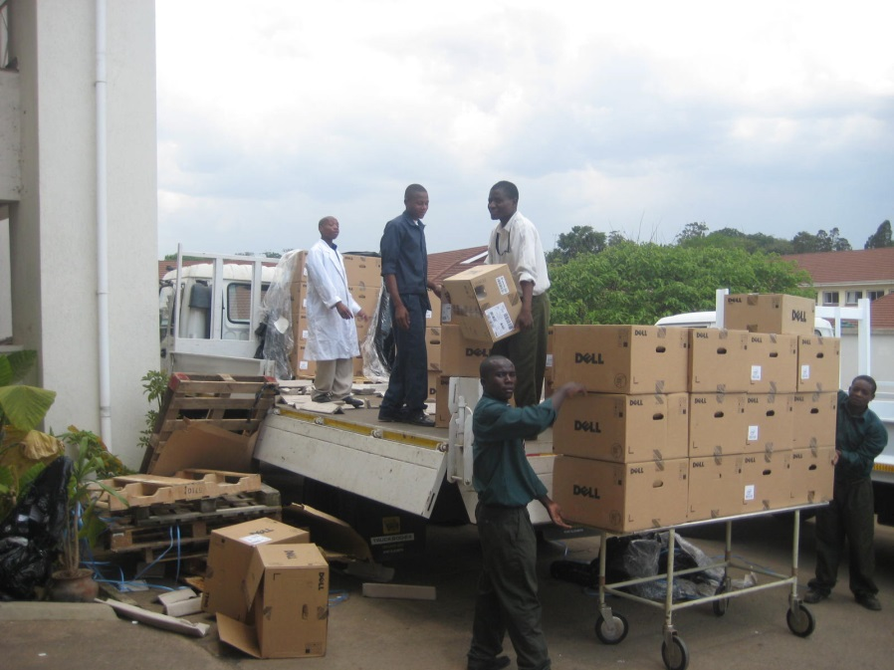
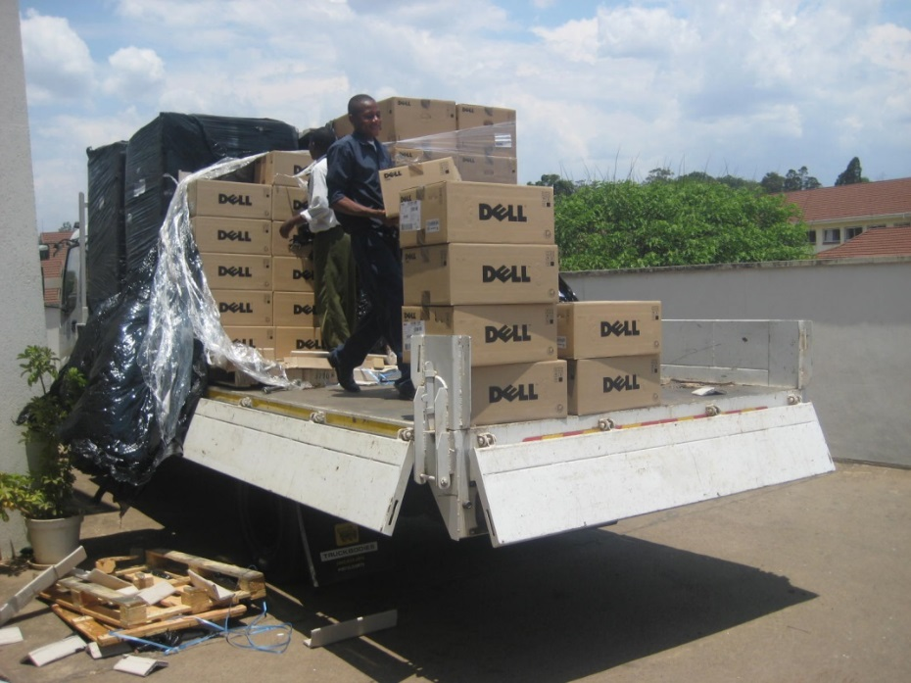
Capacity building to support the new systems
Projectors to deliver teaching
50 seater PC classrooms
Students to access resources
Server
To host and deliver resources
Run back ups
Consultancy and training for Registry and technical staff
Notes:
None of these developments would be successful unless attention and effort put into supporting the basic IT infrastructure
So within the first 2 years of the project the technical team had
Purchased projectors for the ICT team to lend out for teaching
Created a 50 seater PC classroom,
Purchased a server to run the systems
Also they provided consultancy, training and support for Registry, admin staff and the technical staff
Help them to establish protocols

Slide 7
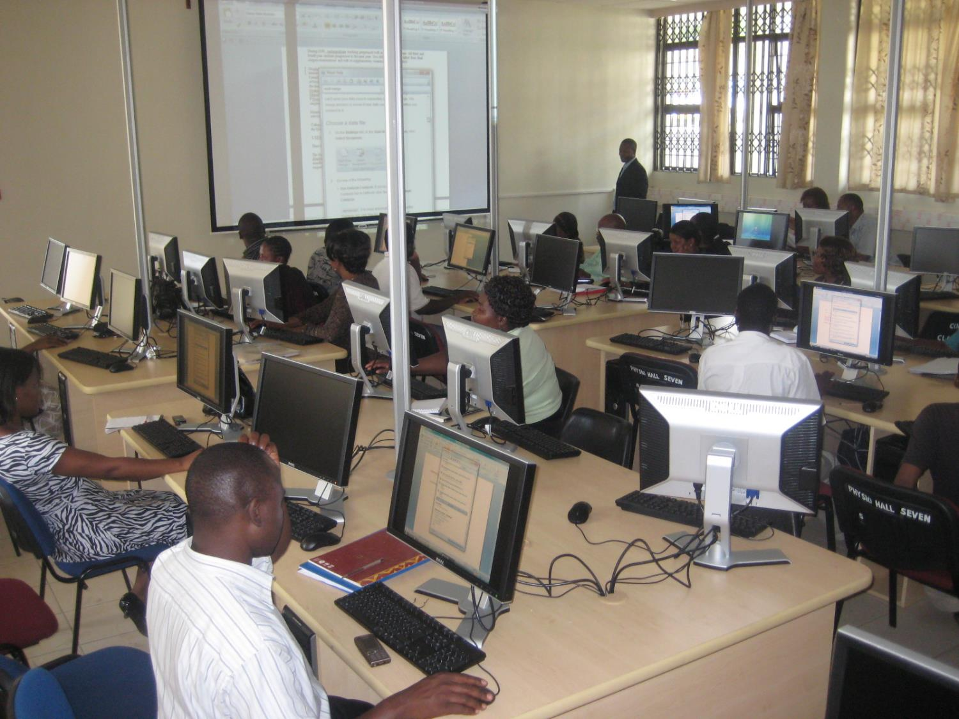

Slide 8
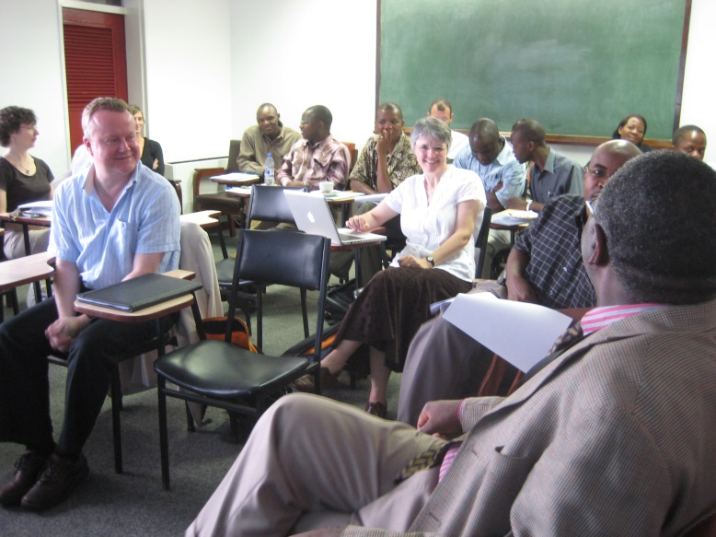
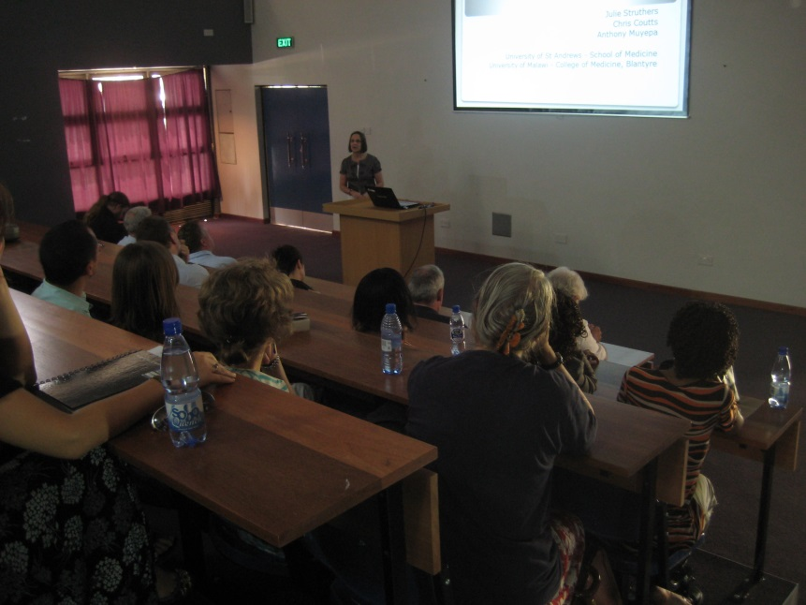
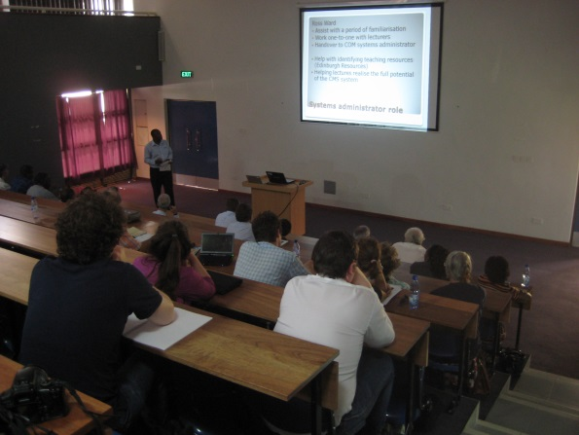
Series of consultations
With senior COM Staff
Academics
ICT staff
CMS was born
Notes:
First few visits – series of consultations.
Sampled widely. What did they want this system to do?

Slide 9
Curriculum management system (CMS) now being used by all courses in the COM
Being developed and managed by the COM ICT staff
Notes:
After a series of developments and a number of years – a number of different developers (staff turnover) in COM the Curriculum Management System or the CMS is the main system of the College and it now supports all courses.
Brief description of the home page - announcement page

Slide 10
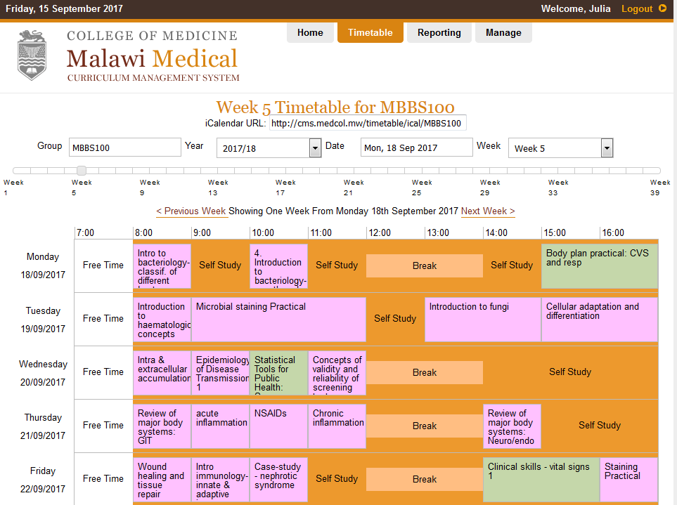
Personalised time-table staff and students across all campus courses
Notes:
Personalised time-table for all staff and students. If used properly it is a powerful tool, managing time, teaching rooms, staff and learning resources.
Click on a time-table element and it takes you to a page dedicated to the item of teaching

Slide 12
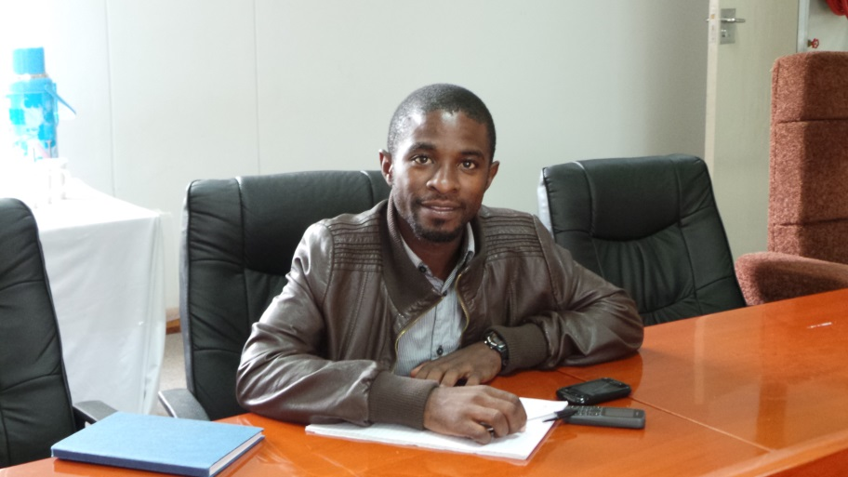
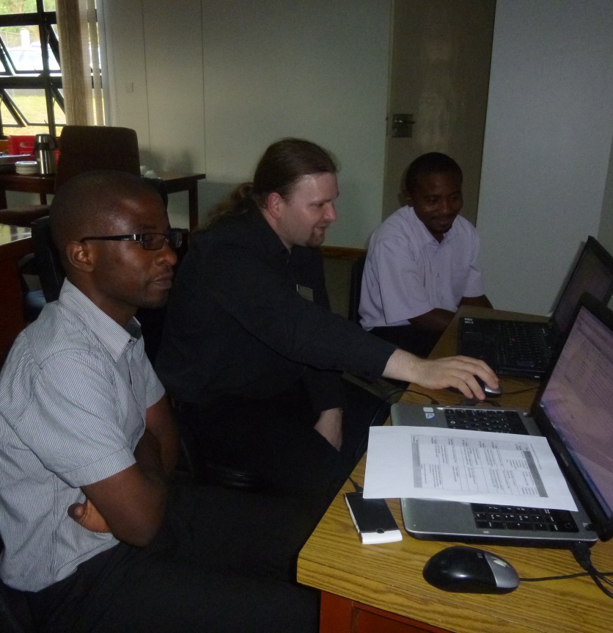
Ensuring Integration with other IT systems within the COM
Joel Kumwenda - CMS Systems Developer
Notes:
The College now have a member of staff dedicated to the development of the CMS and training of staff and students
We’ve developed a close working partnership and ensuring integration with the other IT systems within the COMS.
Chris working with the CMS developer and the SARIS developer.
It has been a success – but it is not without challenges for the College.
System is only as good as what is put into it and this is an ongoing challenge as new academic staff arrive in the college
Ongoing development needs constant attention development and especially staff training
Difficulties – network issues make it difficult for the staff to use and some staff prefer to do their own thing.
Not enough top down

Slide 13
Successes and achievements/ Take home points
New MBBS was launched in January 2009
Approximately 100 medical students graduate each year
50 seater PC classroom was established in 2009
Students are able to access their resources on line using CMS
The foundations of a stable IT system were laid

Slide 14
2nd SGIDF – Enhancing Healthcare
2 parts
Focus on Curriculum
Curriculum review
Development of new programmes
IT Capacity Strengthening

Slide 15
2nd SGIDF Grant: 2012-2015 Enhancing Healthcare Training
Develop an Honours B.Sc. in Biomedical Science, including assessment and quality assurance
Work with the School of Public Health to develop a postgraduate Masters in Global Health
Support development of the CMS across other campuses and degree programmes

Slide 16
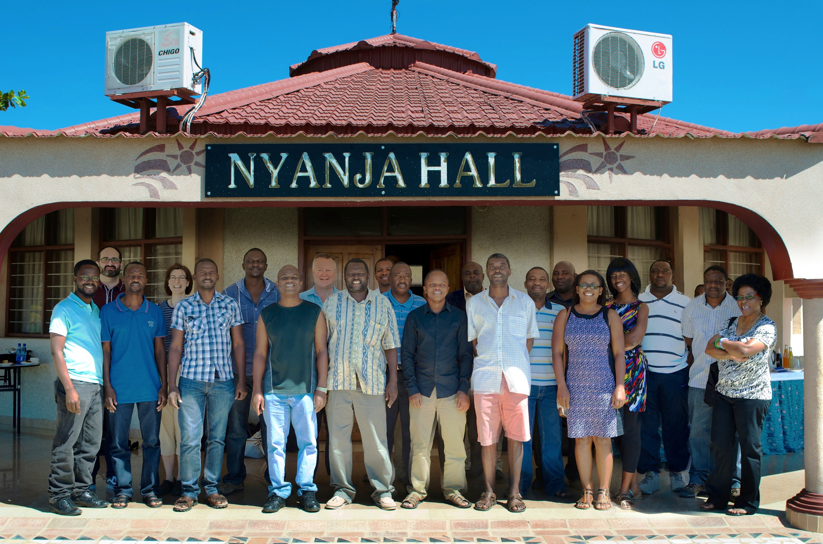

Slide 17
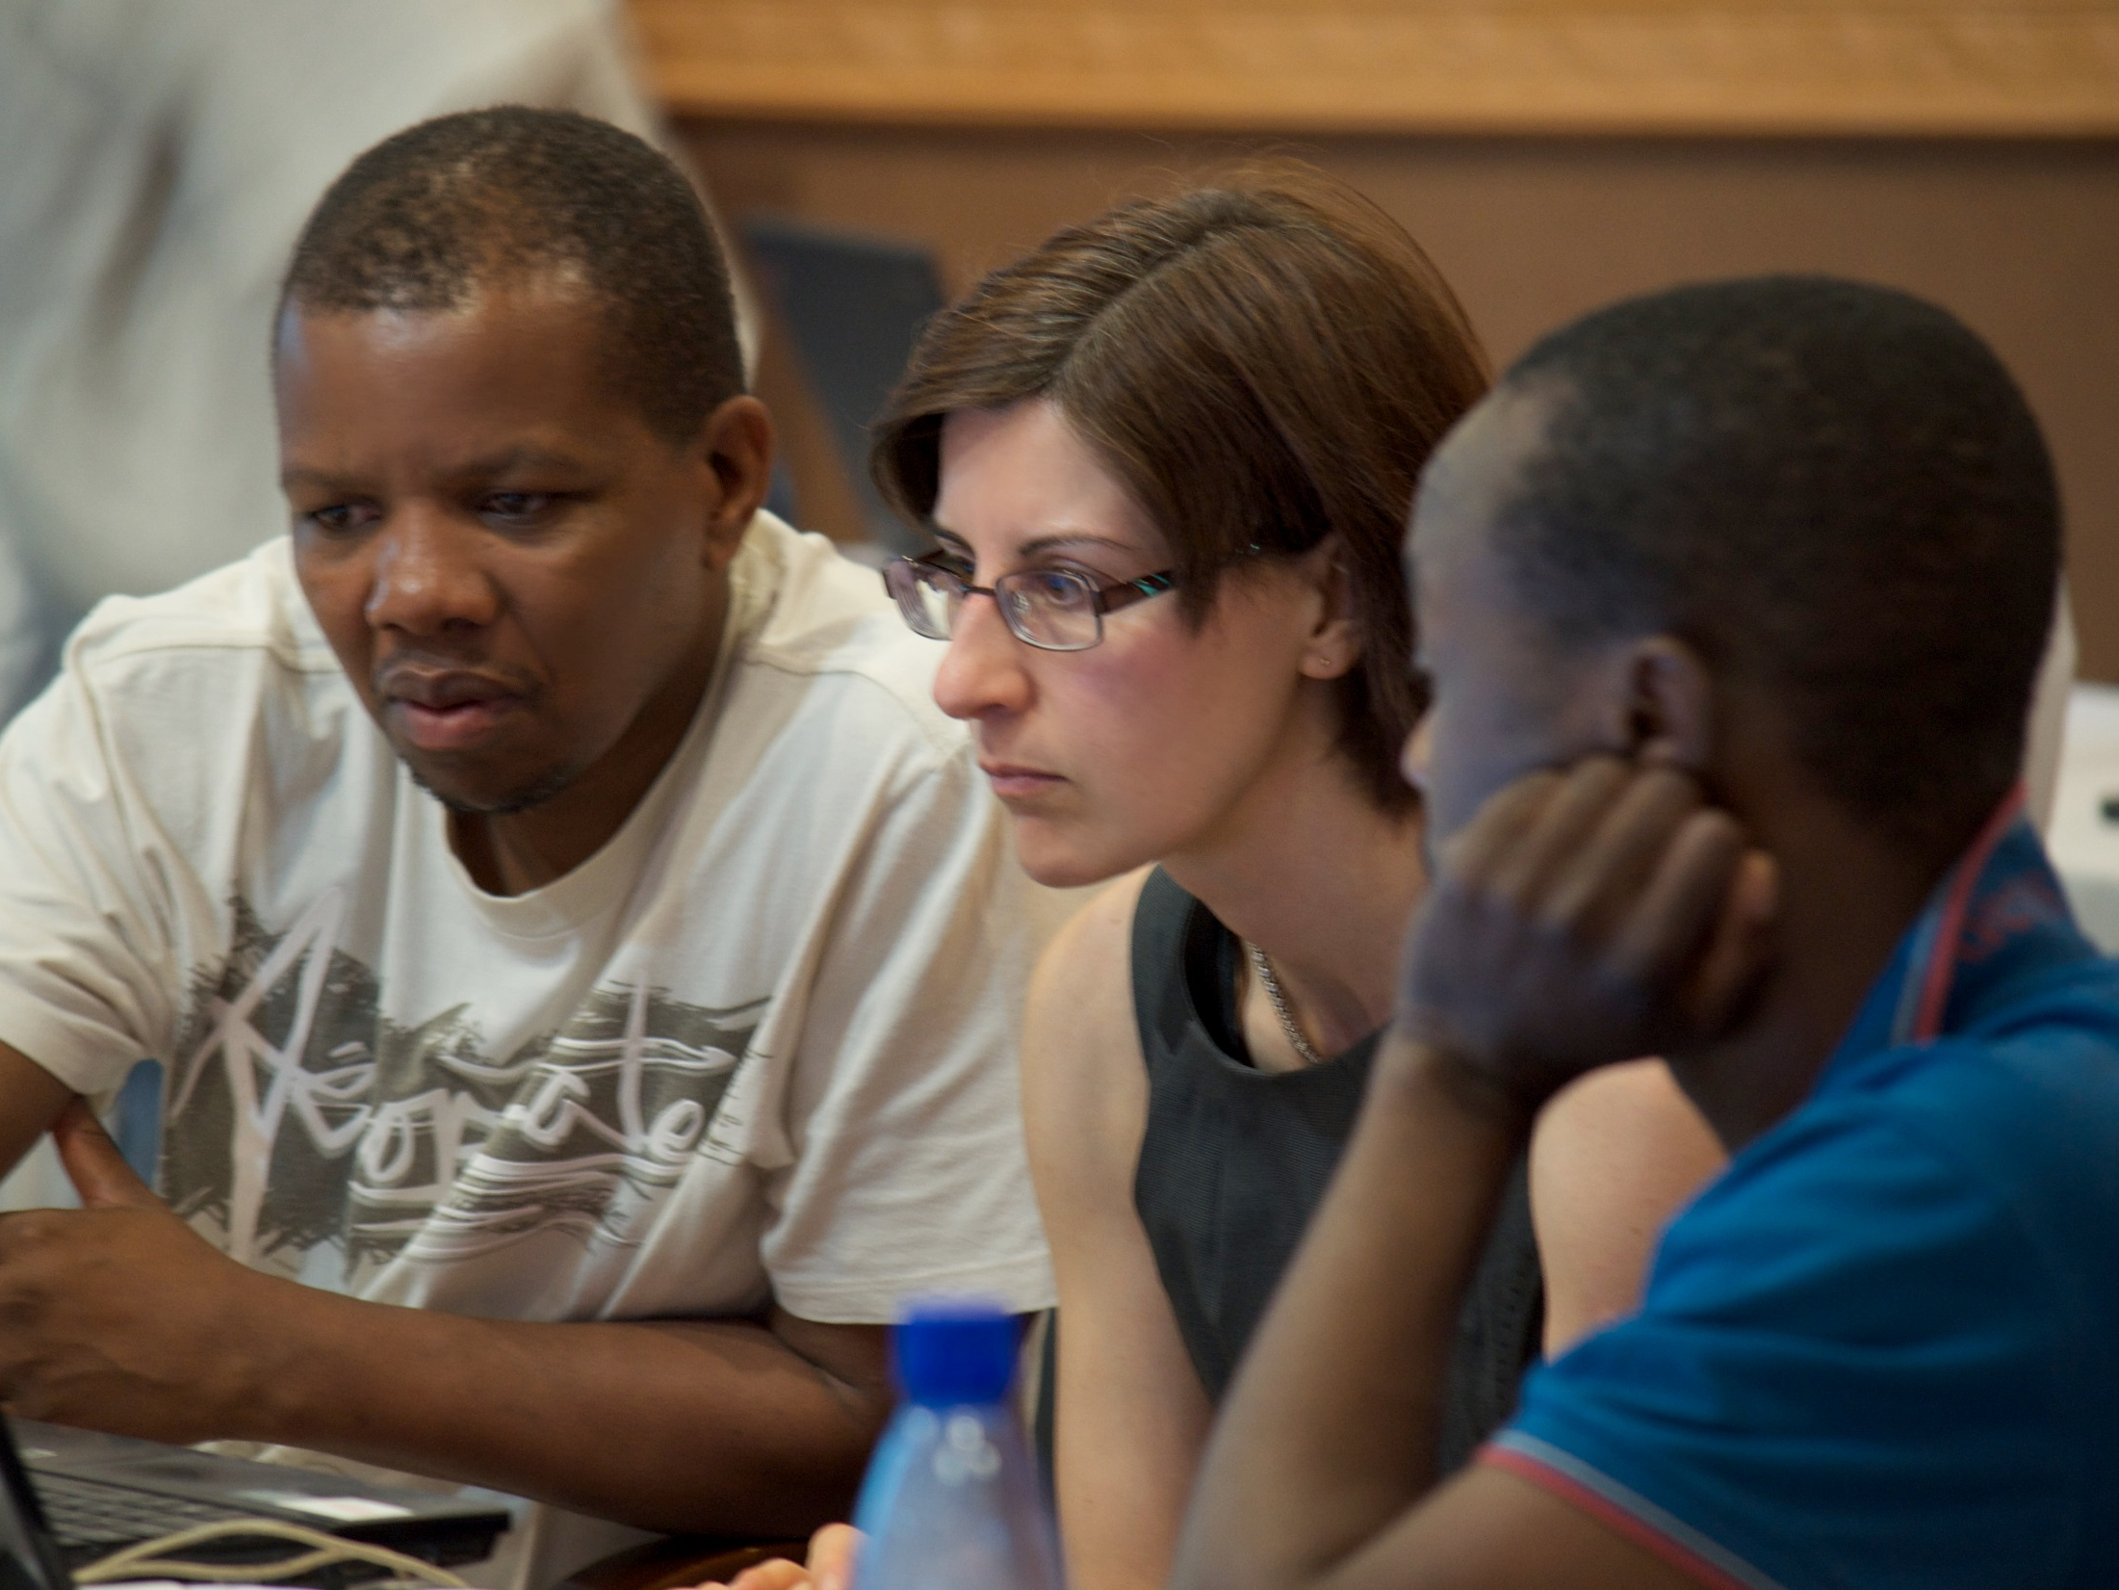

Slide 18
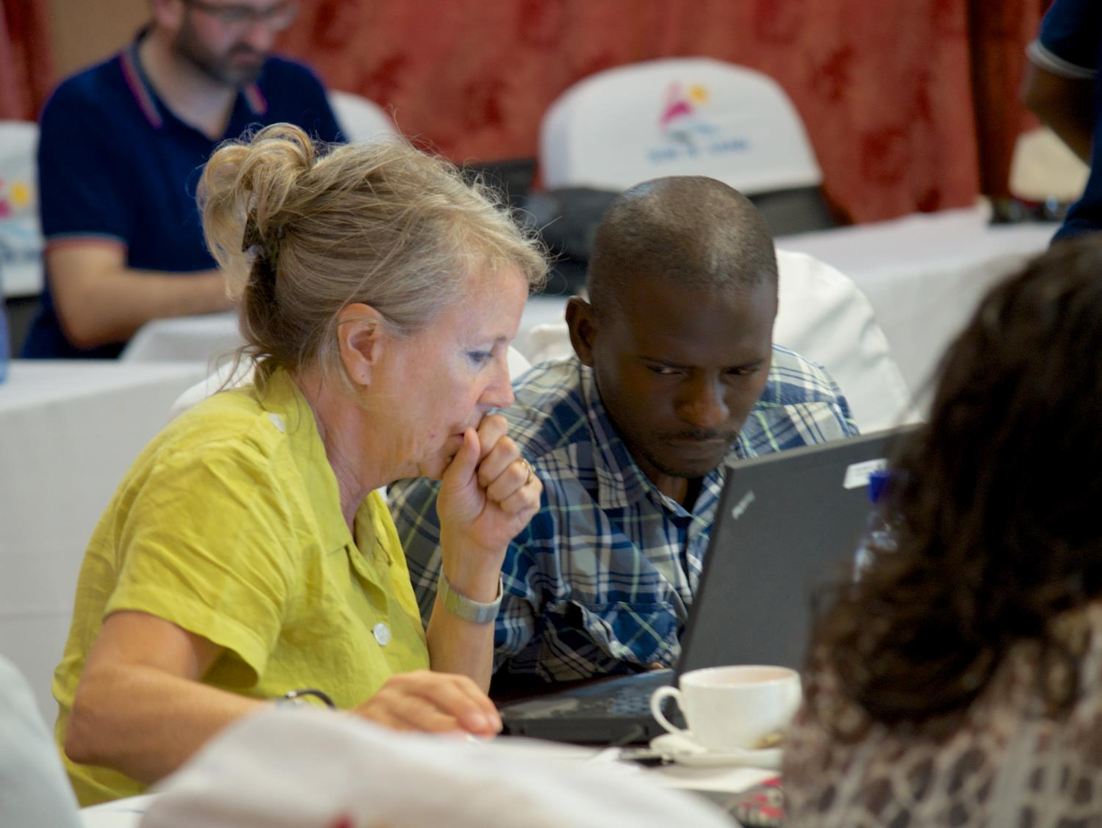

Slide 19
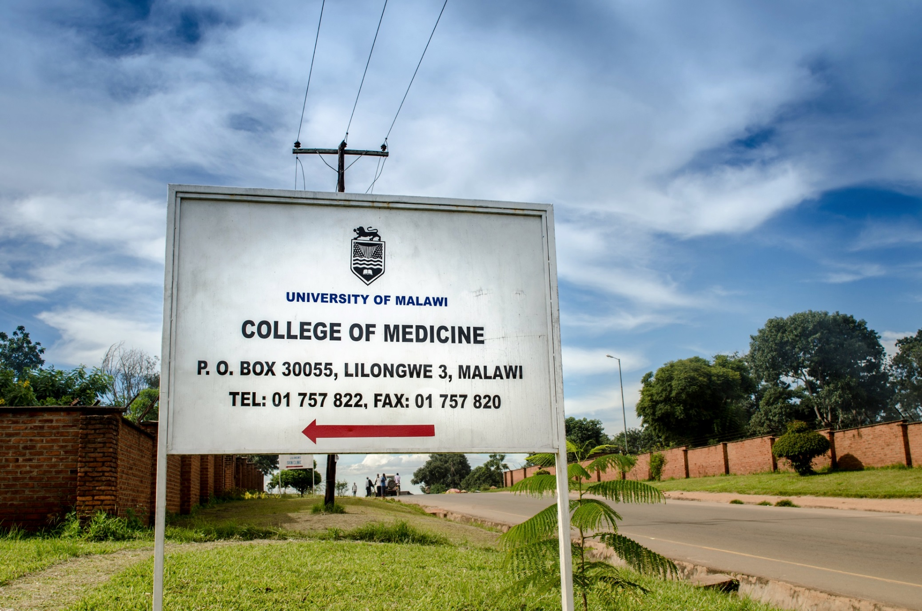
2. IT Capactiy Strenthening
Extending IT and Learning Technology support to all degree programmes
Extend IT resources to the Lilongwe Campus
Build in sustainability in IT systems
Embed the knowledge
Provide further consultancy

Slide 20
Training and Consultancy
Systems administration
Systems development
Team management
Improve management of IT processes and systems documentation

Slide 21
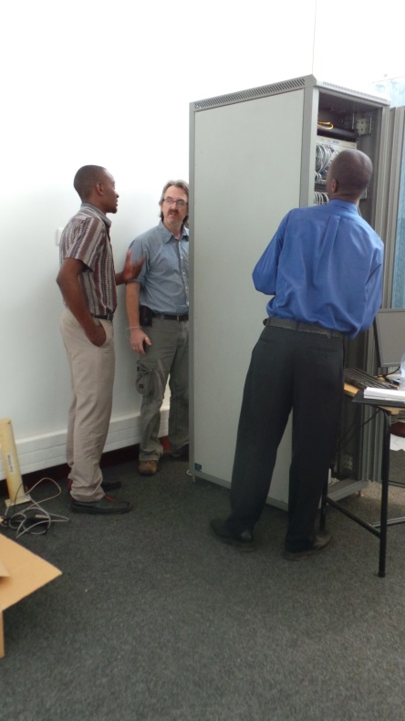
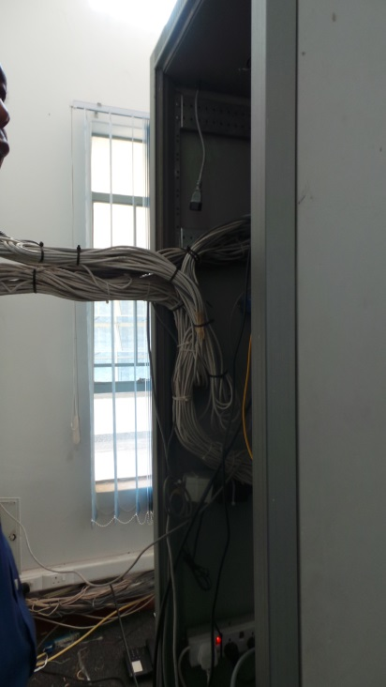
Lilongwe campus
Kitted out
1 PC classroom
Presentation facilities for 2 seminar rooms
Associated servers

Slide 22
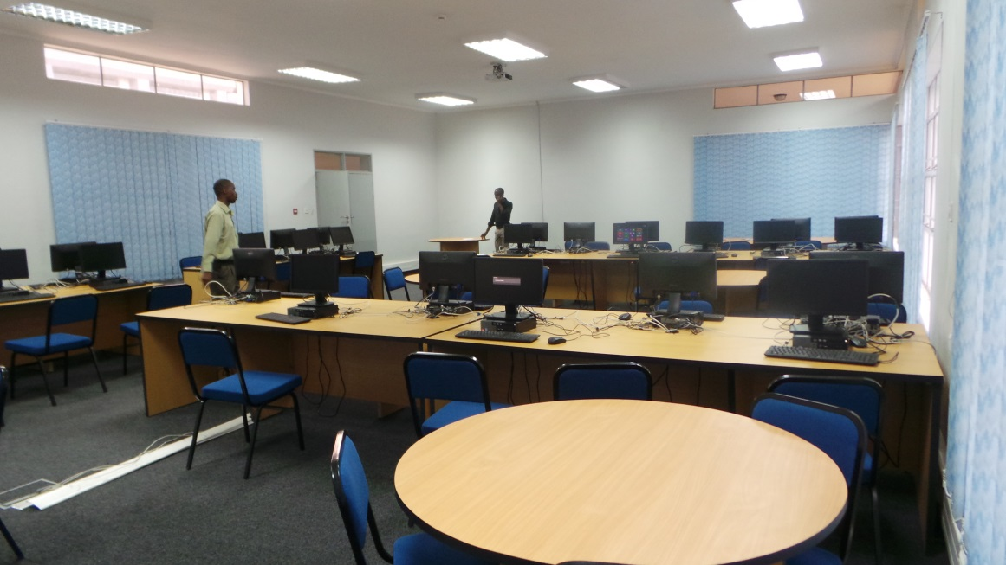
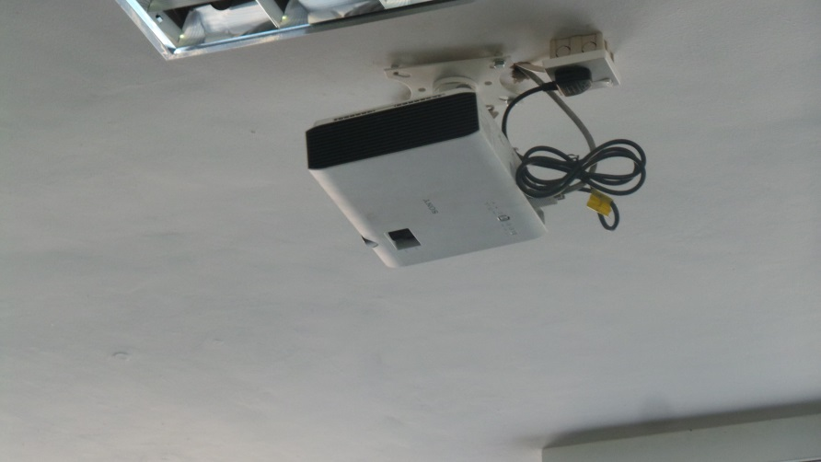
Lilongwe campus

Slide 23
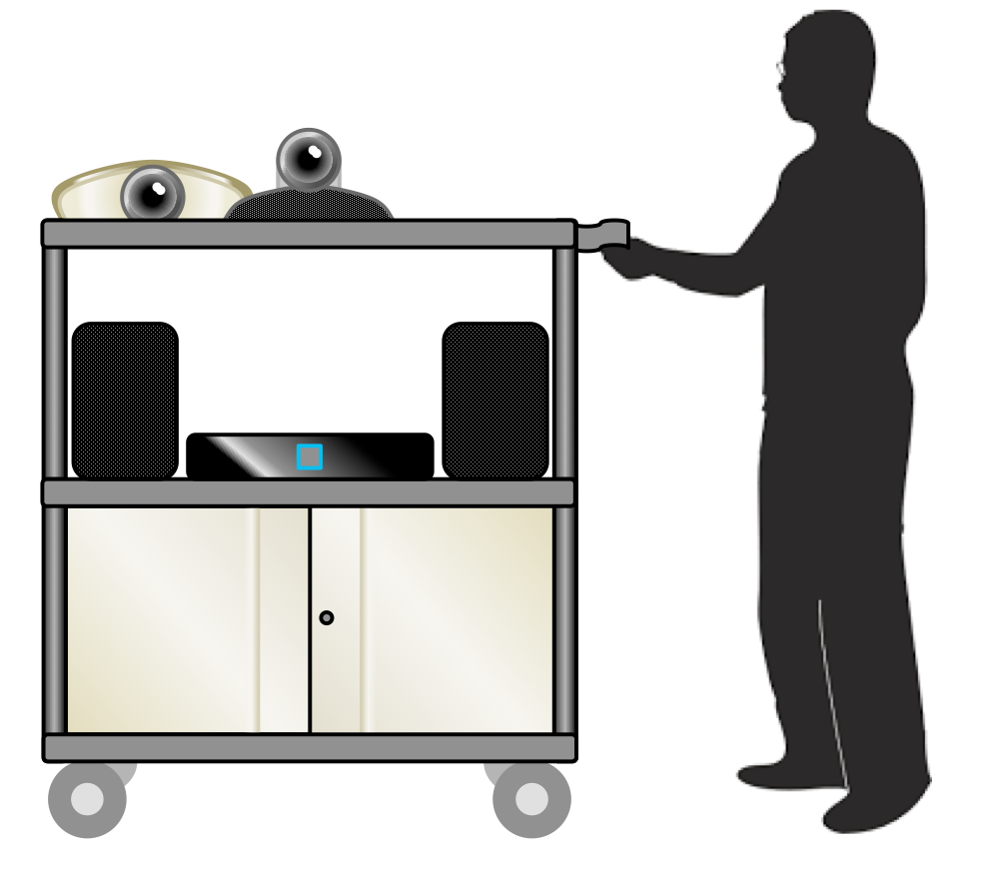
Decreasing frequency of travelling between campuses
Installation of 2 mobile video conference units
Meetings
Teaching
Tutoring
Notes:
As well as providing local resources there was a strong desire to link the campuses using a Video conference system.

Slide 24
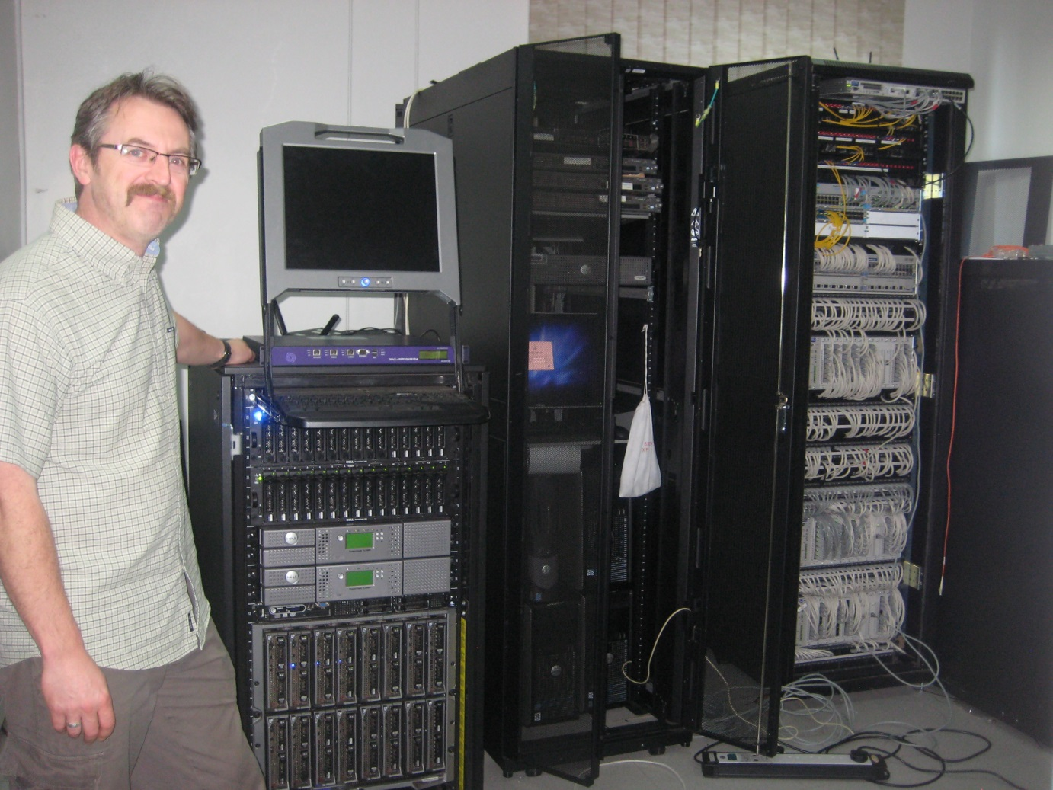
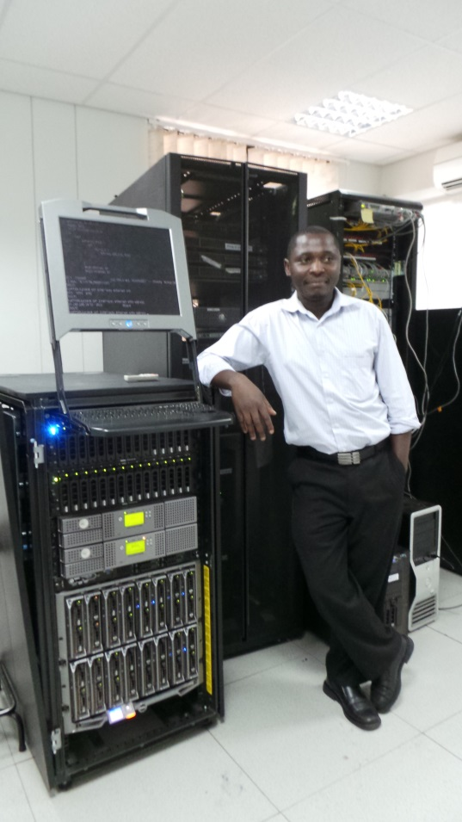
Systems administration
Arthur Mtegha
Ongoing consultancy and support in the setting up and management of the server and services being provided
Notes:
Lilongwe campus has a 50 seater PC classroom for students
All of the teaching rooms in the Lilongwe campus have presentation facilities which allow the delivery of multimedia presentations to students
The Curriculum Management System(CMS) has been adopted as the COMs VLE and is used by all undergraduate programmes
The installation of 2 mobile video conference units has Improved the communication between the Lilongwe and Blantyre campuses and are used for teaching and meetings
Training and support in IT systems administration developing skills and improving processes and practices in the ICT staff

Slide 25
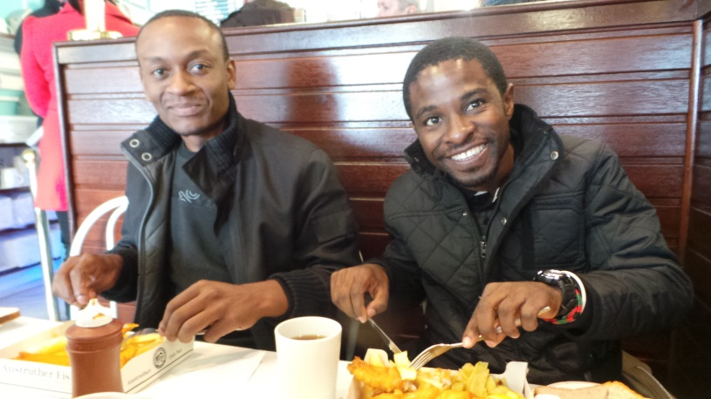
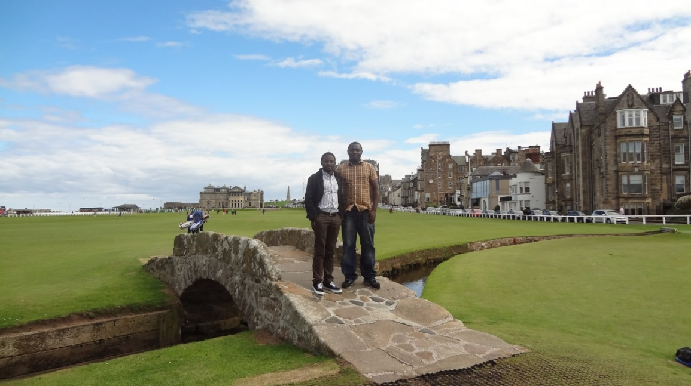
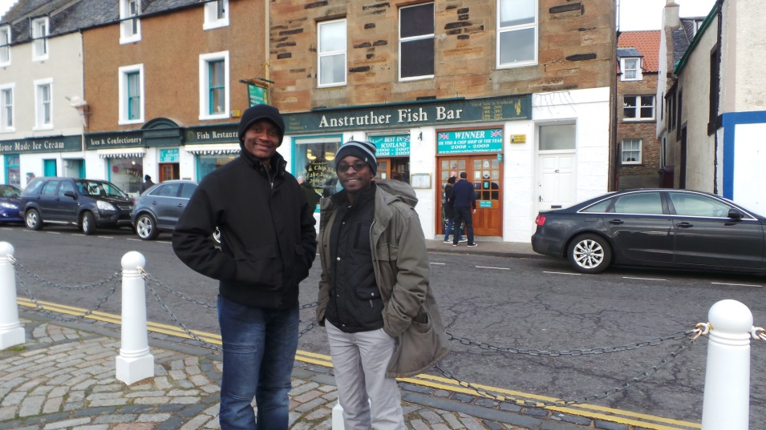
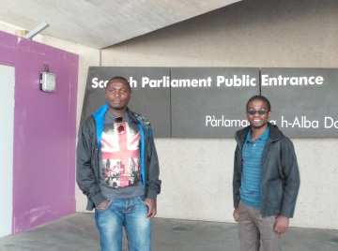
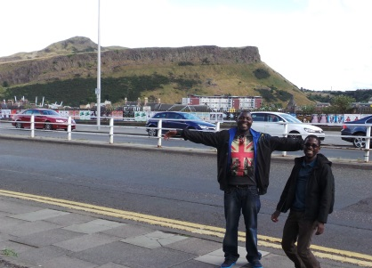
Visitors to Scotland
Notes:
As part of the training and consultancy the COM ICT team visited us at St Andrews

Slide 26
Successes and achievements/ Take home points
Self-sustaining expertise and confidence in the academics and ICT professionals has been built
Our Malawian Colleagues now have the confidence and skill set to independently design, implement and review curriculum developments
College of Medicine ICT team has gained the knowledge and experience to manage modern IT system to support the delivery of the various curricula

Slide 27
Challenges exist for the COM ICT
Sustainability
Infrastructure
PCs and screens
Servers
Wi-Fi
Purchase licenced software
Operating budget maintenance
Develop own systems for admin and curriculum delivery
To ensure their staff and students can be participants in the digital world
Internet
Intranet
multiple campuses
Reliability
network access
Notes:
As we move towards our final visits what is our exit strategy how are we leaving them

Slide 28
Ongoing Initiatives
Dorothy Miller endowment
4 students £1,000 per year bursary
Malawian Global Health Doctoral programme
Academic mentorship
3 PhDs currently on the programme
Notes:
Global citizens

Slide 29
TB test developed by St Andrews
Project led by Dr Wilber Sabiti
Novel test for rapid quantification of patient tuberculosis burden and monitor the efficacy of treatment for killing TB.
In Collaboration with St Andrews Malawi became on of the first 3 African countries to implement this test.
Trained 10 Malawian researchers in principles of molecular diagnostics at College of Medicine, Malawi and assisted them to write grant applications.
Notes:
Established the novel test for rapid quantification of patient tuberculosis burden and monitor the efficacy of treatment for killing TB. The test was developed at the University of St. Andrews and Malawi became one of the first three African countries to implement this test

Slide 30
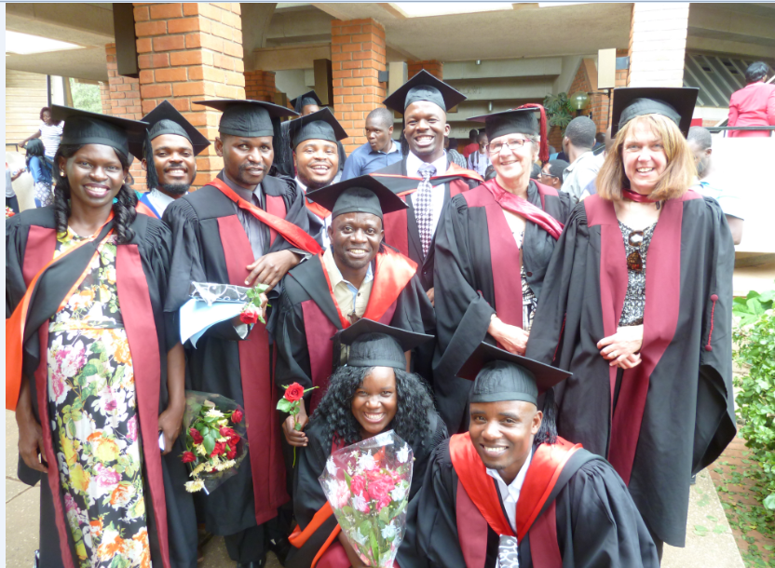
BSc Clinical Officers
The St Andrews – College of Medicine collaboration funded the training of 10 Clinical Officers to complete their BSc degree.
This was followed up with bids to GIZ and ELMA and a further 100 scholarships have been awarded.
The graduates from this programme work throughout Malawi in District General Hospitals, which brings specialist care close to where patients live.

Slide 31
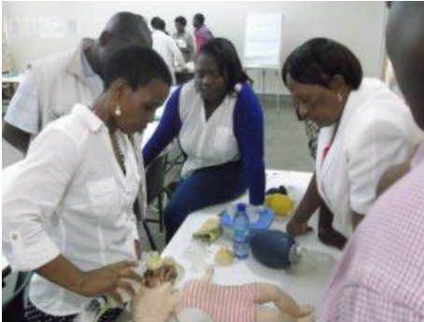
PACHA
A joint senior lecturer works in both University of St Andrews and College of Medicine and supports the ongoing collaboration.
Dr O’Hare is a paediatrician who has worked with the Malawian Paediatric and Child Association (PACHA) to roll out neonatal care in 10 districts in Malawi over the last three years.
PACHA has designed a 5 day course and 350 health care workers and 40 pre- service tutors have been trained
Neonatal mortality has been reduced by 25% in those 10 facilities supported by PACHA.

Slide 32
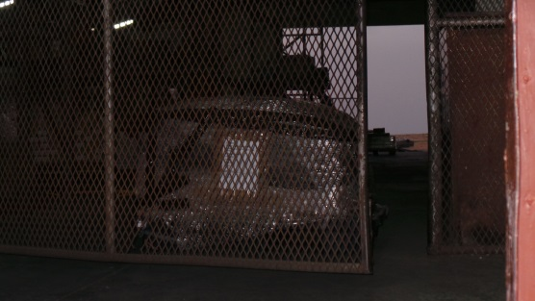
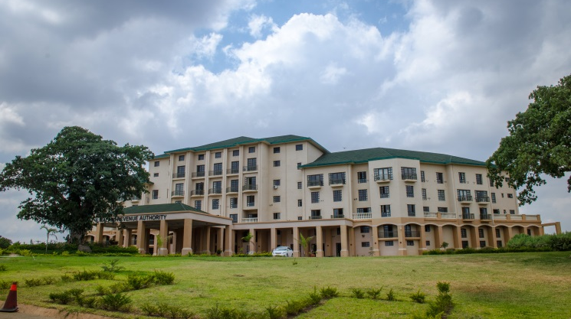
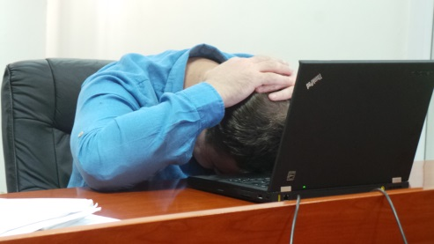
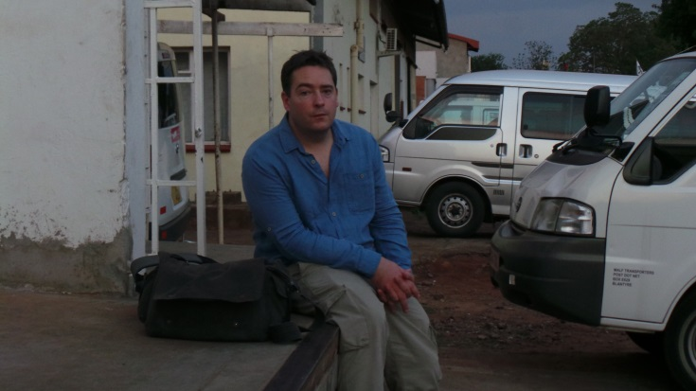
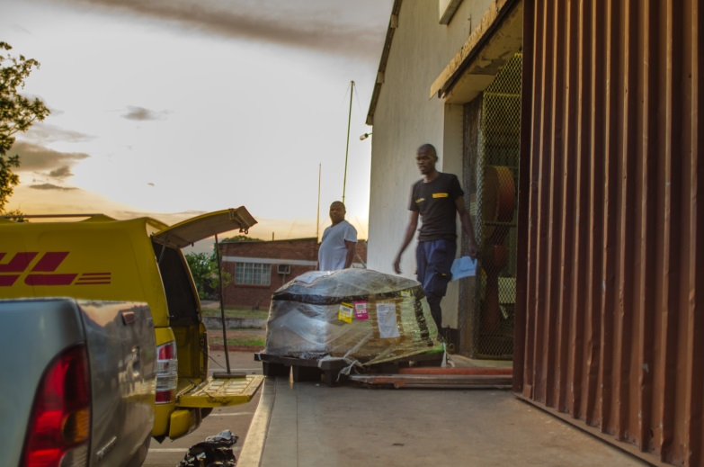
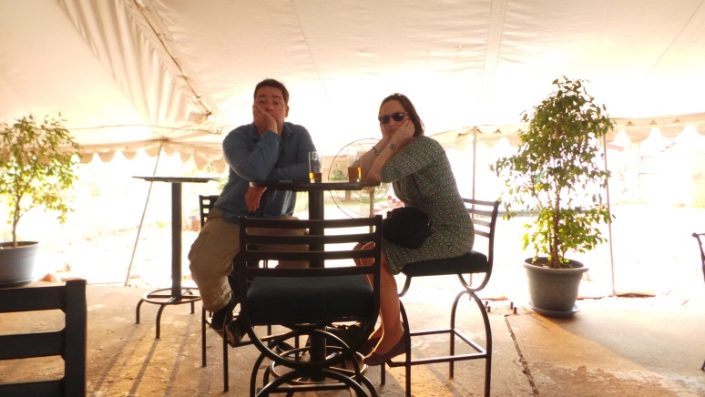
Grappling with Customs

Slide 33
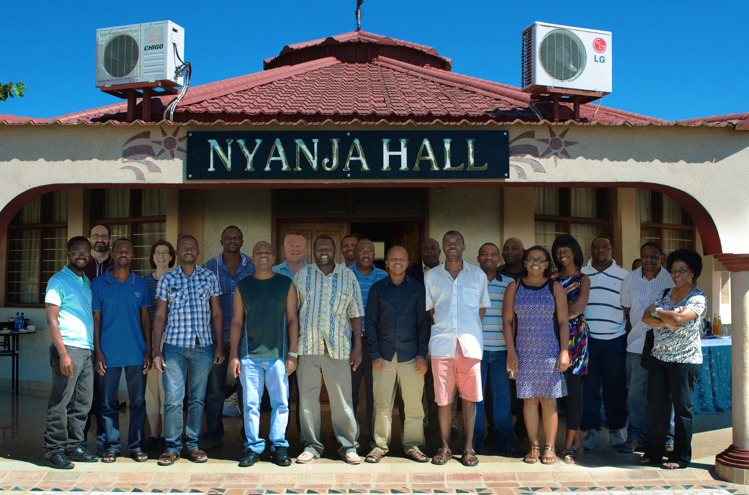
St Andrews-Malawi Partnership

Slide 34
Children’s rights to health
Dr O’Hare studies the potential impact of curtailing revenues lost from Low Income Countries on children’s right to health.
Lost Revenues include tax avoidance, tax incentives and not taxing the informal sector.

