Slide 1
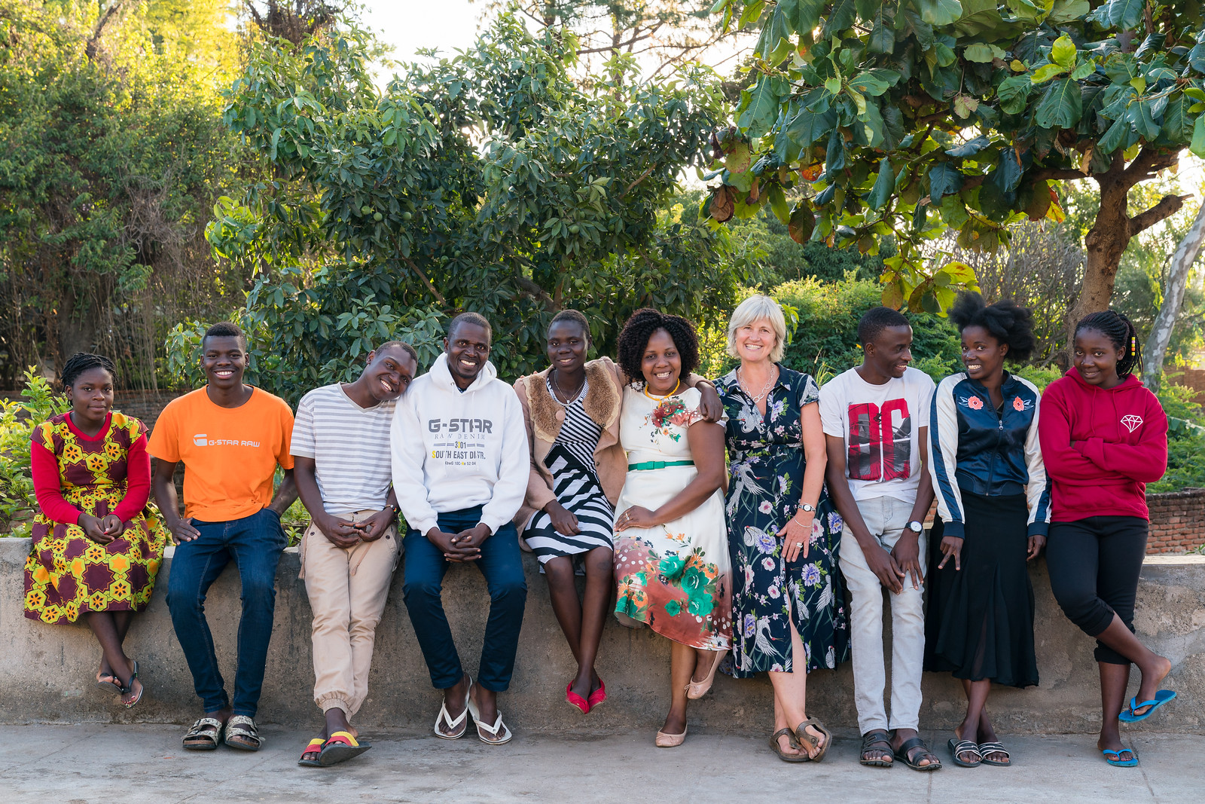
Equity, Diversity & Inclusivity
Godknows Maseko, Gift Thompson and Emma Wood
STEKAskills, MaSP and SMP

Slide 2
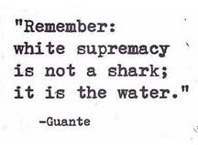
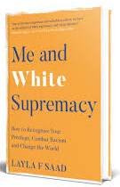
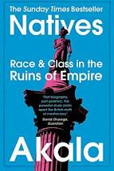
“ Decolonization is political, it’s violent, it’s about rupturing it’s not about maintaining the status quo.”
Notes:
Reclaim the word racism
Recognise it’s the water we swim in that makes us assume things about others
Actively work out a way to break down the social norms erected as a result of decades of oppression.

Slide 3
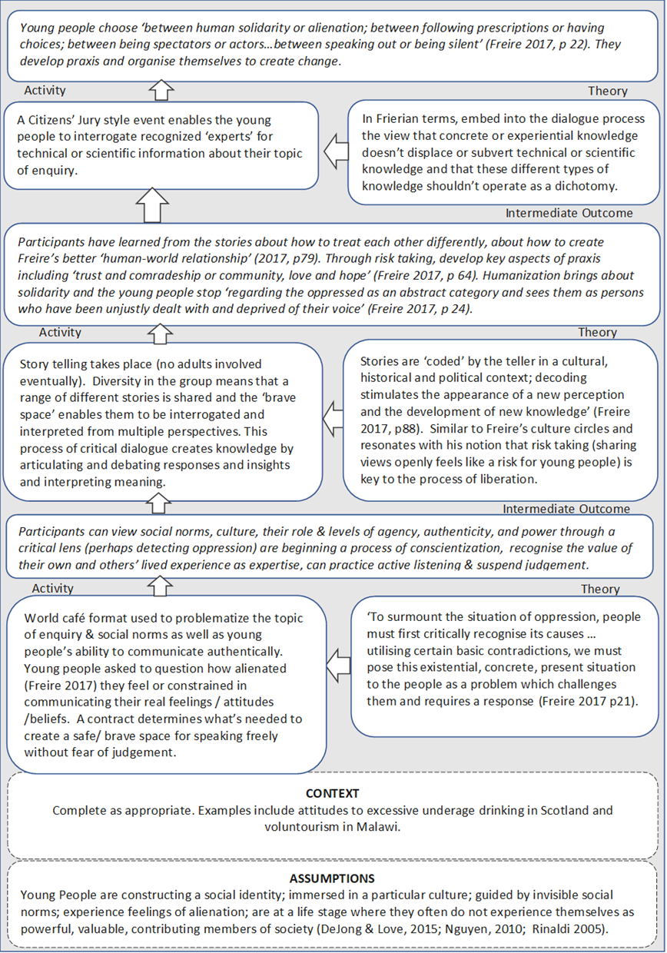
18 months co-producing a model of critical dialogue to disrupt the ‘water’
Notes:
This is how we did it.

Slide 4
“The dialogues have empowered our young people – especially our girls”.
“This never happened before, - we didn’t think like this . That we had the power to direct how things happen. Hopefully, this approach is teaching people from other countries that they should find out what Malawians want and not decide for them “

Slide 5
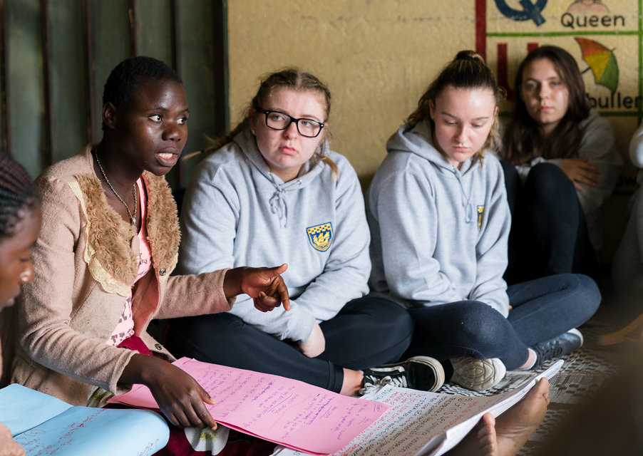
Representation Vs Inclusion
Lived experience is expertise
Racism and intersectionality
Our views count

Slide 6
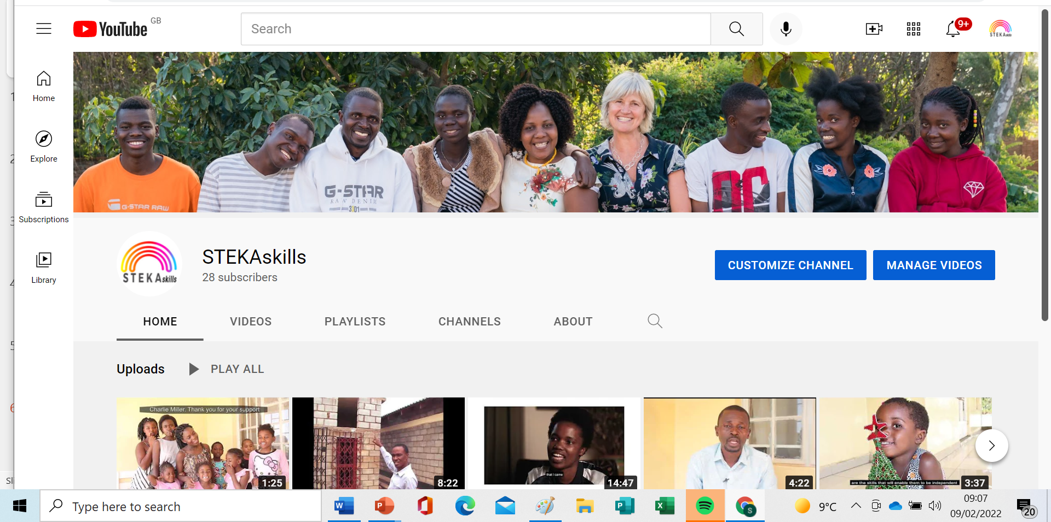
Find out more

