Slide 1
COVID-19 UPDATE FROM MALAWI TO THE
SMP AGM
Mwapatsa Mipando
Principal, College of Medicine
University of Malawi
03rd October 2020

Slide 2
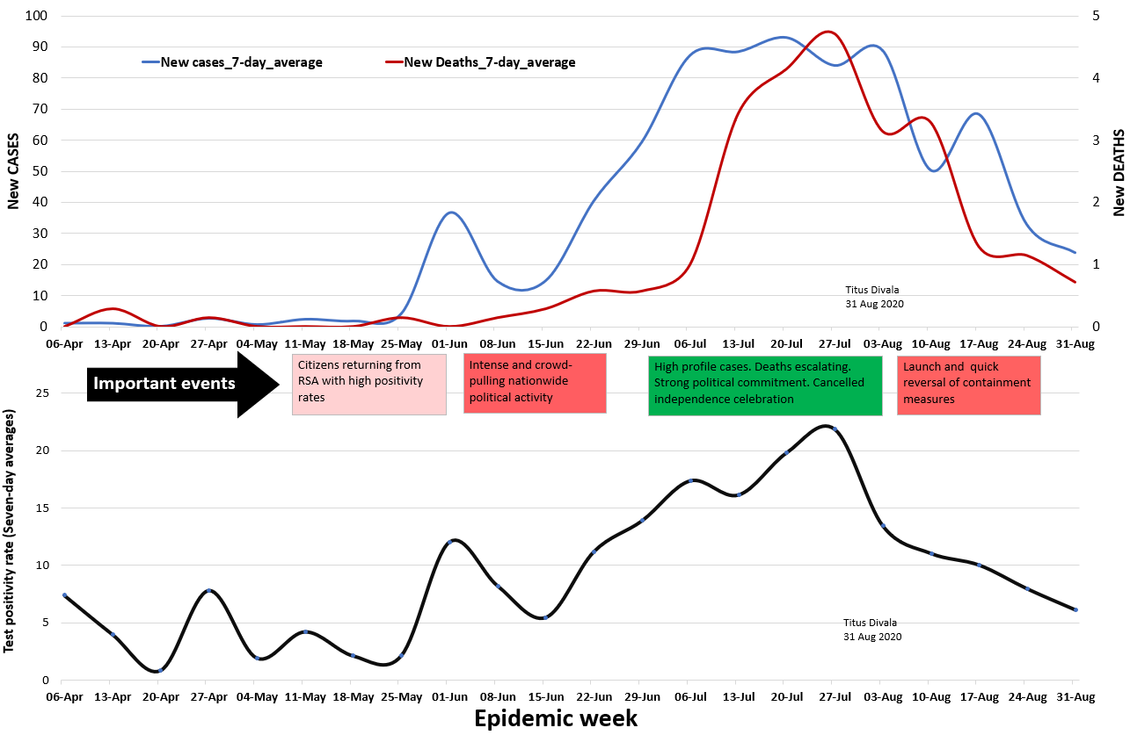
Where exactly is our Epi Curve?
Sustained downward trend for both new cases and deaths

Slide 4
THANKS
ZIKOMO

