Slide 2
CREATING ROBUST OPPORTUNITIES FOR CROP PRODUCTION AND SALE (CROPS PROJECT).
Total Funding: £998,074
Period: October 2018-March 2023.

Slide 3
Theory of Change
Goal:
Improved livelihoods of 6,200 rural farmers in communities surrounding the VACs in Nkhotakota, Salima, Machinga and Chikwawa.
Target:
10% increase in household income by the year 2023.
Caused by:
20% increase in crop productivity (yield).
10% increase in profitability of VAC processed products.
100% VAC costs covered by farmers (sustainable value addition).
Increased tonnage of VAC processed and sold products (7600 Mt).

Slide 4
Background to CROPS Project
Small Irrigation and Value Addition Project (SIVAP) – 2013 to 2018 – GoM.
Funding - $45 million.
Project sites – Karonga, Nkhotakota, Salima, Machinga, Thyolo & Chikwawa.
SIVAP achievements:
7 VACs constructed.
Installation of processing machines.
Formation of 7 farmer cooperatives.
Construction of 10 irrigation schemes.

Slide 5
Background to CROPS Project
Why Challenges Worldwide (CROPS)
VACs being dormant for over 12 months after machine installation:
Lack of cooperative and business management skills by cooperatives.
Lack of value addition and processing skills.
Lack of marketing skills and market linkages.
No capital (lack of access to finance).
Fragmented value chains.
Heavy duty machines.

Slide 6
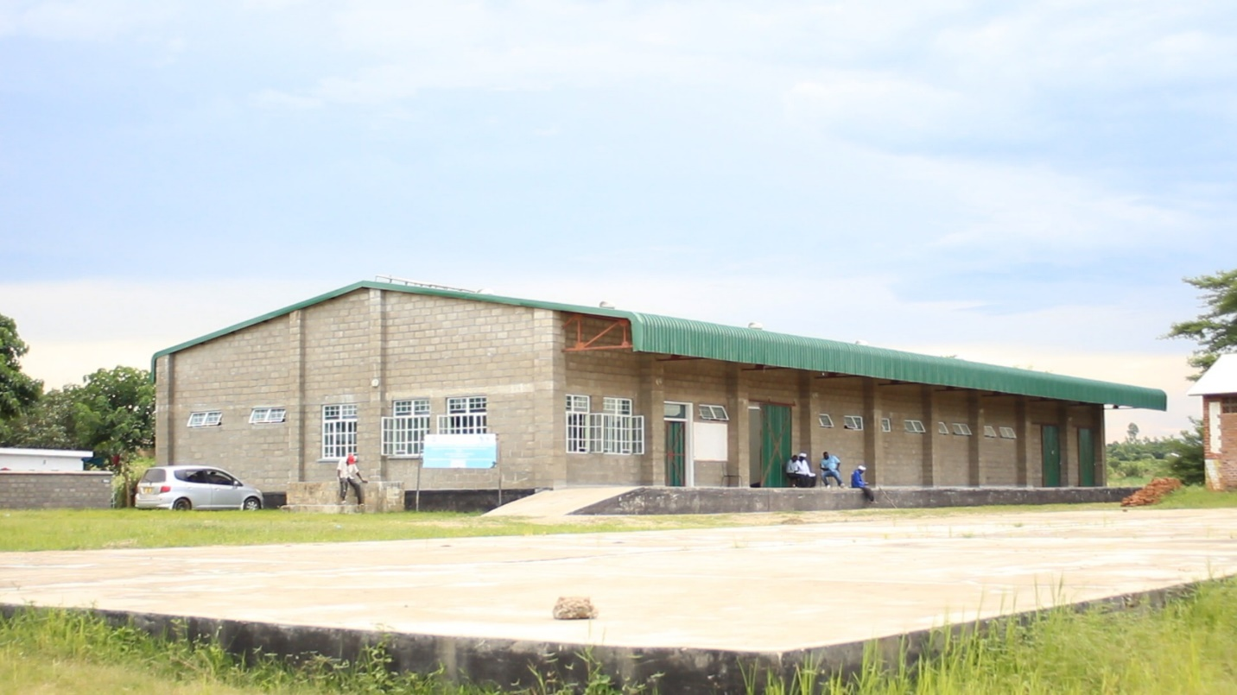
The VAC

Slide 7
Machines

Slide 8
Our approach
Business unusual approach.
Robust value chain strengthening model.
Value chain governance, reducing wastage, consumer preferences (moving backwards i.e. where, who, and how value is added)
Inclusive business and markets.
Empowerment and involvement of poor people in the supply chain.
Robust farmer extension models.
Placement of full time extension officers, farmer to farmer models, demo plots, field days.

Slide 9
Agriculture Extension Officer

Slide 10
Business Development Officer

Slide 11
Progress to date
Increased yield from 2.5 to 4 tons per hectare (60% increase in yield).
2,845 farmers trained so far (928 males, 1341 females, 550 youth, 20 elderly, 6 disabled).
190.7 tons of organic fertilizer made and applied to 63 hectares of land.
150 lead farmers trained (63 males, 52 females, 35 youth).
37 demonstration plots established.
12 field days conducted.

Slide 12
Demonstration Plot

Slide 13
Progress to date
All VACs operating on positive margins and improved working capital.
The VACs operating on an average of £1,244 gross profit and £5,473 working capital.
28 tons of processed products sold at 27% increase in price per ton.
Placement and training of 8 machine operators.
All VACs participated at district and national Agricultural Trade Fairs.
Market linkages-average of 3 sales contracts signed by each VAC.

Slide 14
National Agricultural Trade Fair

Slide 15
Sales Agreement

Slide 16
Progress to date
Improved cooperative and business management by VACs.
15 VAC Board of Directors trained in leadership & governance, financial management and cooperative management.
64 VAC executive members trained in leadership & governance, financial management and cooperative management.

Slide 17
Leadership & governance training.

Slide 18
Implementation Challenges
Frequent breakdown of machines and scarce spare parts.
Frequent power outages affected rate of processing.
Hand held power tillers and threshers to be imported from China.
Flood threats.
Delay in aggregation loan disbursement by OI & FCB.

Slide 19
Proposed solutions
Development of maintenance plans for all VACs.
Evening processing.
Need to develop alternative reliable energy sources (renewable).
Procurement of tillers and threshers shifted to year 3, and to start early.
Flood preparedness/resilience strategy implemented in all VACs.
Improve partnership management with OI to speed up loan disbursements.

Slide 20
Take Home message
‘£1 million Scottish Government funds saves $45 million from going down the drain’. A case of the 4 dormant VACs and CROPS Project.
Thank you for listening!

