Slide 1
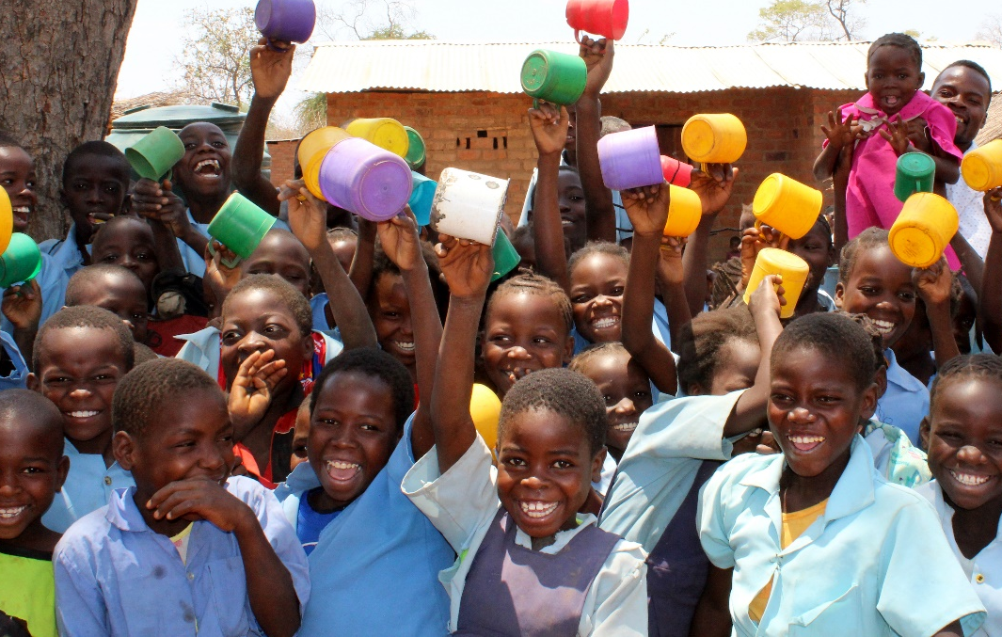
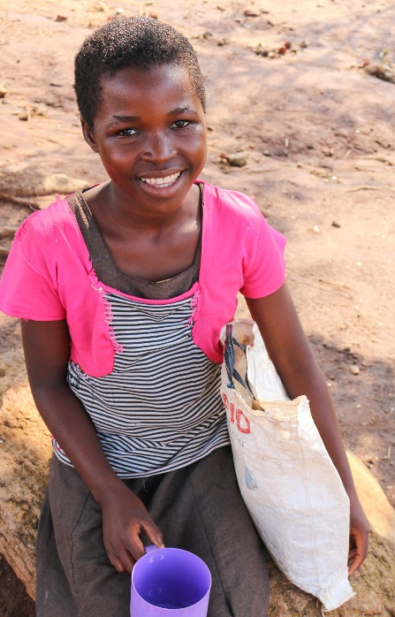
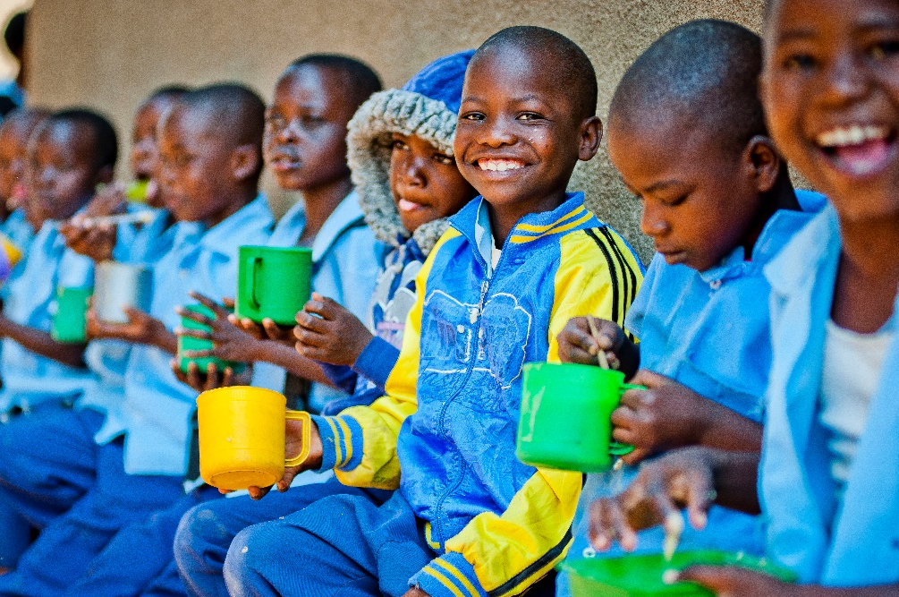
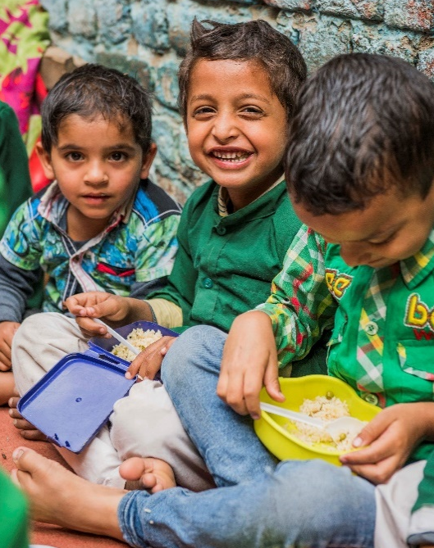
Gillian McMahon – Director of Supporter Engagement and Income

Slide 2
Mary’s Meals vision, mission and values
Our vision is that every child receives one daily meal in their place of education and that all those who have more than they need, share with those who lack even the most basic things. We believe that, working together, there is no good reason why our vision cannot be realised.
Our mission is to enable people to offer their money, goods, skills, time, or prayer, and through this involvement, provide the most effective help to those suffering the effects of extreme poverty in the world’s poorest communities.
Our values are:
We have confidence in the innate goodness of people.
We respect the dignity of every human being and family life.
We believe in the good stewardship of the resources entrusted to us.

Slide 3
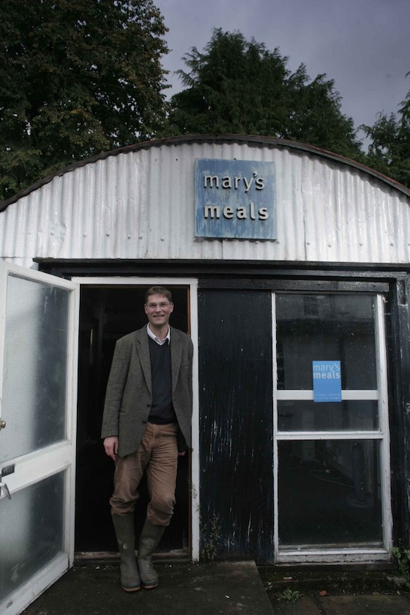
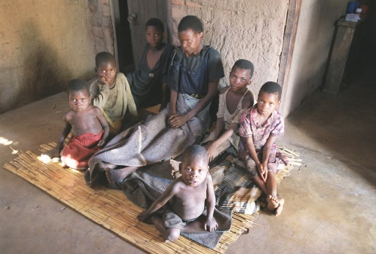
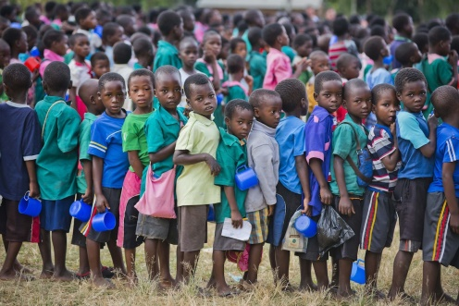
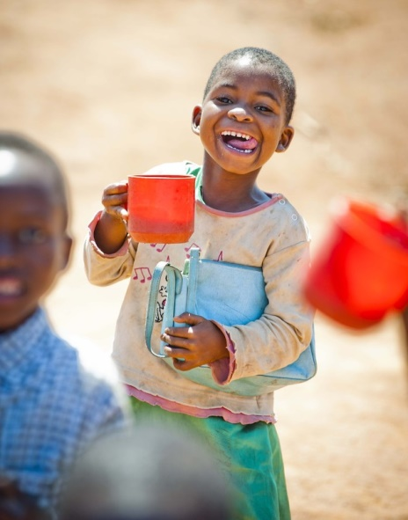
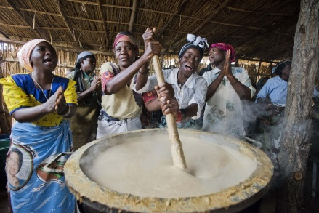
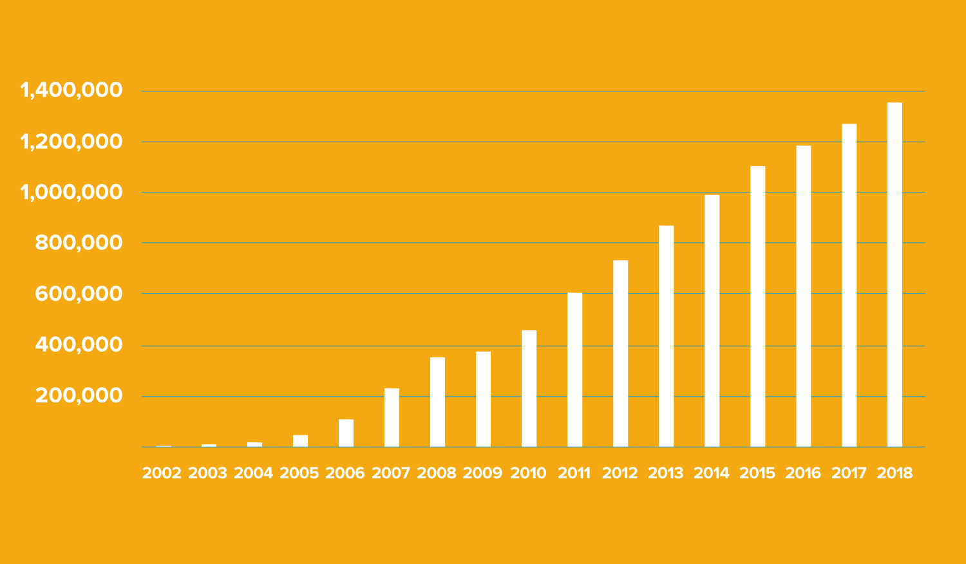
Our origins and growth

Slide 4
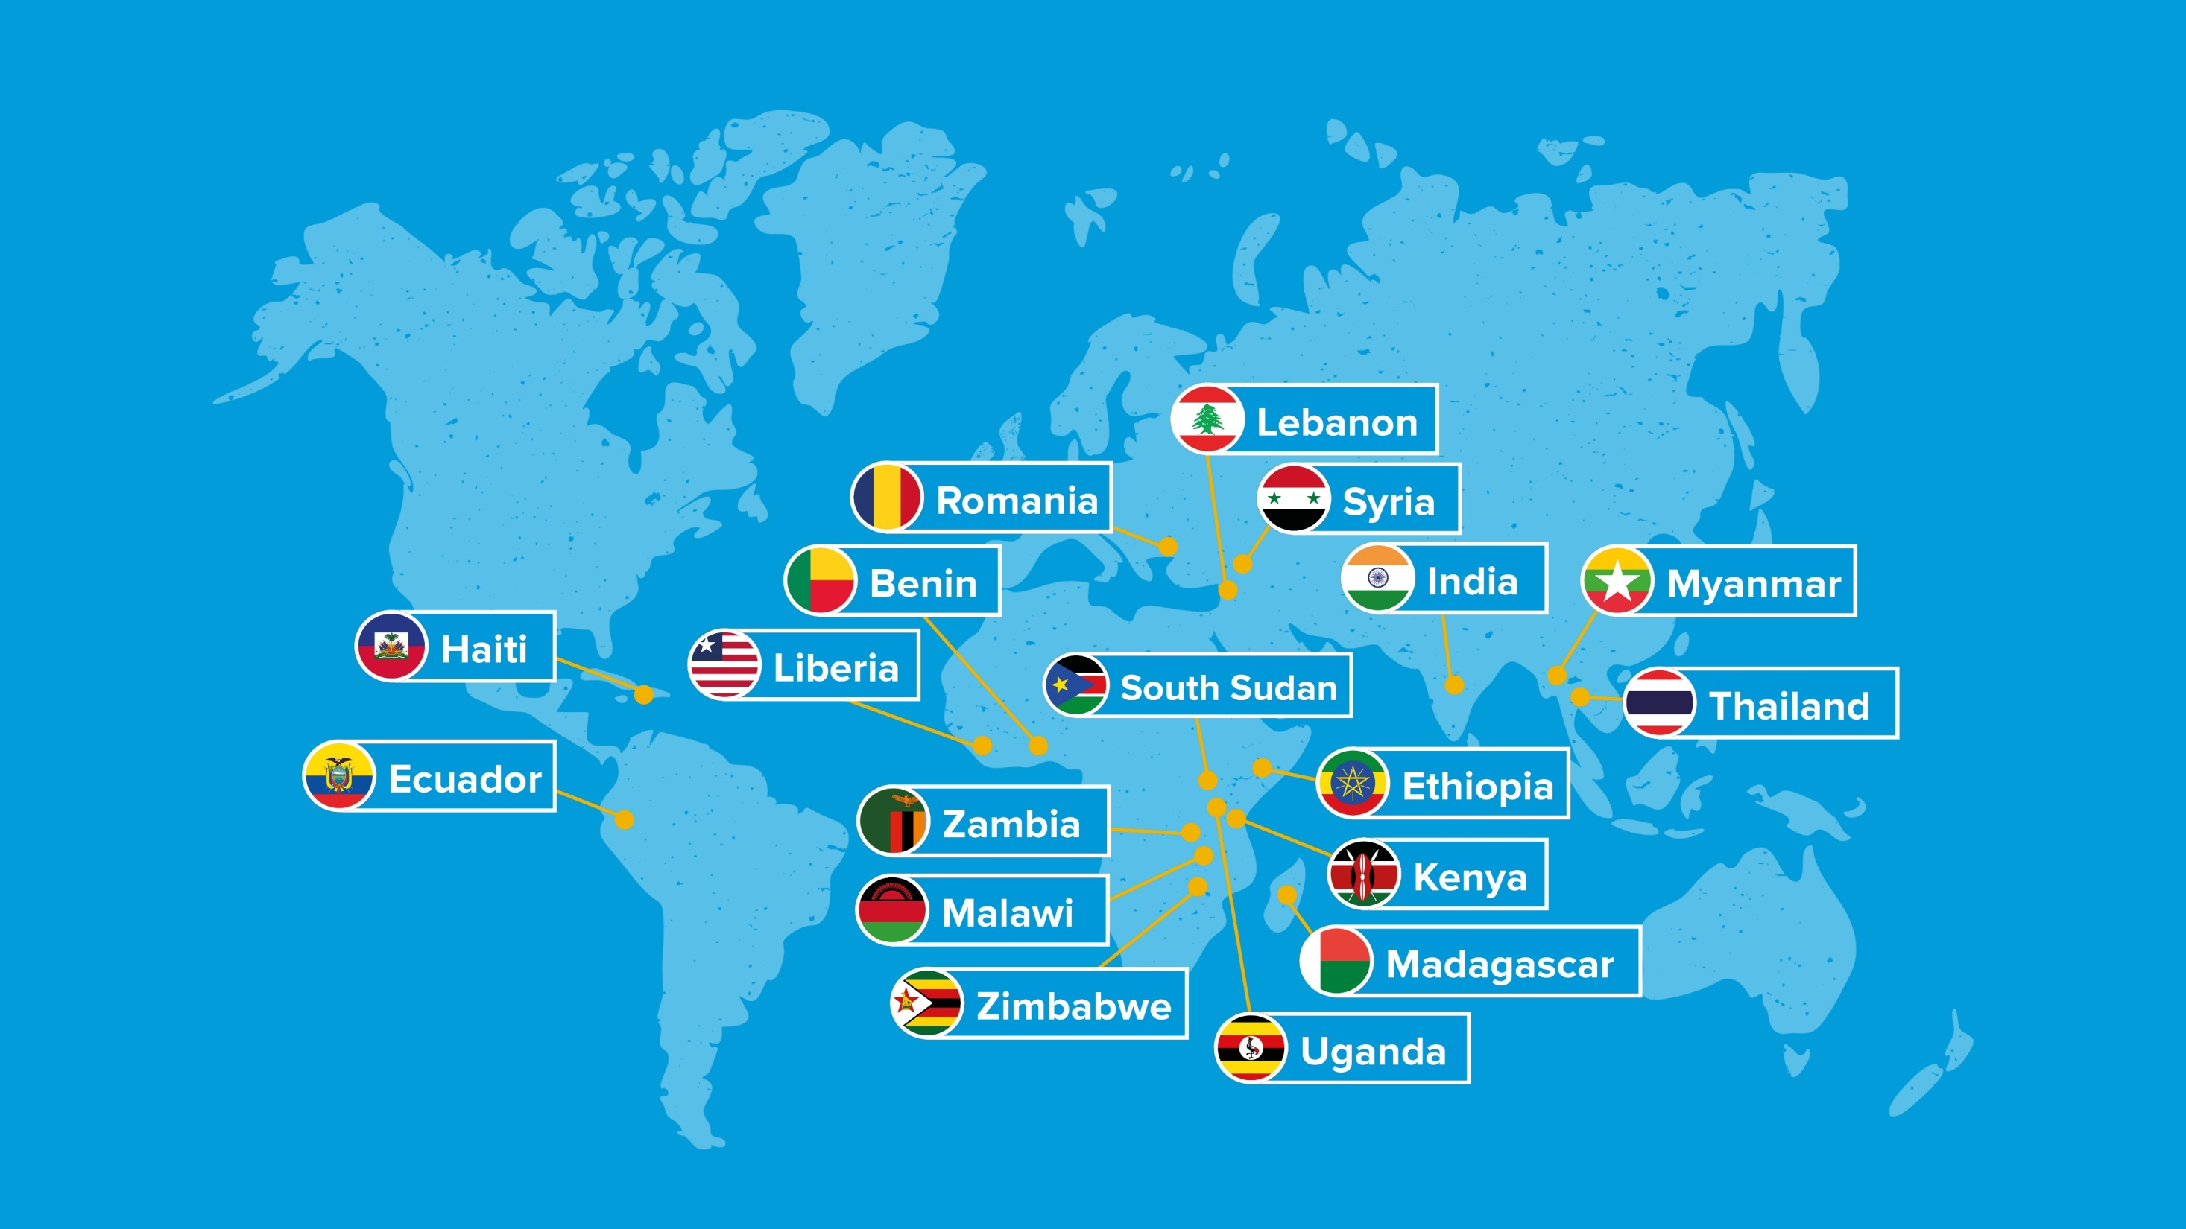

Slide 5
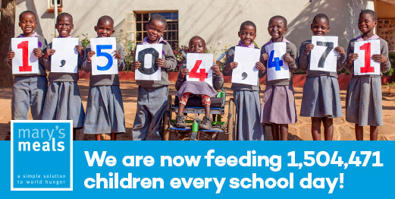
Current daily reach
Notes:
1,504,471 children in 2,358 places of education across 18 countries, delivered by 4 Programme Affiliates and 18 partner programmes.

Slide 6
Mary’s Meals School Feeding Model
Mary’s Meals’ approach to school feeding includes the following key principles:
We work with poor and vulnerable children, providing every child a daily meal in their place of education
We work with communities and schools as equal partners in the delivery of our programmes
We provide consistent, high-quality school feeding programmes
Our programmes are low cost and offer value for money
We buy locally-grown food where possible, and seek to minimise
the environmental impact of our programmes.
We make a long-term commitment in the countries where we work,
working with governments to support sustainable school feeding
programmes.
We are committed to learning and improvement.

Slide 7
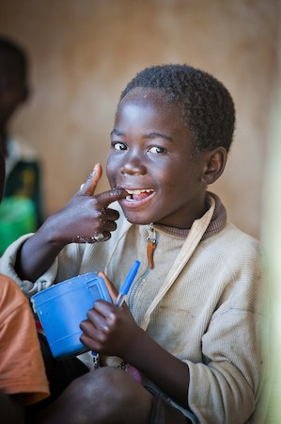
Malawi Development Programme
KEY PROJECT OUTCOMES:
Reduce classroom hunger for 34,553 children in 27 primary schools and 34 pre-schools in Zomba, Malawi
Improve access, participation and progression in education for vulnerable and marginalised children
Increase local community support for education and improved skills to deliver community based school feeding programmes
Increase capacity to deliver sustainable, inclusive, efficient school feeding programmes at community, district and national level
Scottish Government Grant
£1,080,000 over 4.5 years
October 2018 – April 2023

Slide 8
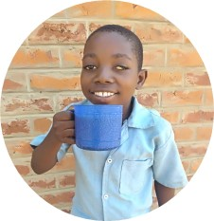
The impact of our work
Mary’s Meals is a simple idea that works. By providing a daily meal in their place of education, chronically poor children are attracted to the classroom where they gain an education that can provide an escape route from poverty for them and for future generations.
Our programmes alleviate children’s immediate hunger and encourage them to come to pre-school and school. By reducing hunger in the classroom, our meals support children to concentrate and to learn better and by encouraging children to attend school more regularly, school meals help children to remain in school for longer and progress between grades.
“It takes me about 1 hour 30 minutes to walk to school every school day and I feel tired when I arrive. Porridge helps me and my friends have energy and recover strength lost from walking. I never miss school like I used to because I’m assured of a meal and I participate in class better than before.” Happy, age 12.

Slide 9
