Slide 1
Registered Charity No. SC041743
Scottish lead:
Dr Catriona Connolly
Ninewells Hospital, Dundee
Malawi lead:
Mr Cyril Goddia
Queen Elizabeth Hospital, Blantyre

Slide 2
Overview
Synopsis
Impact
Problems with sustainability

Slide 3
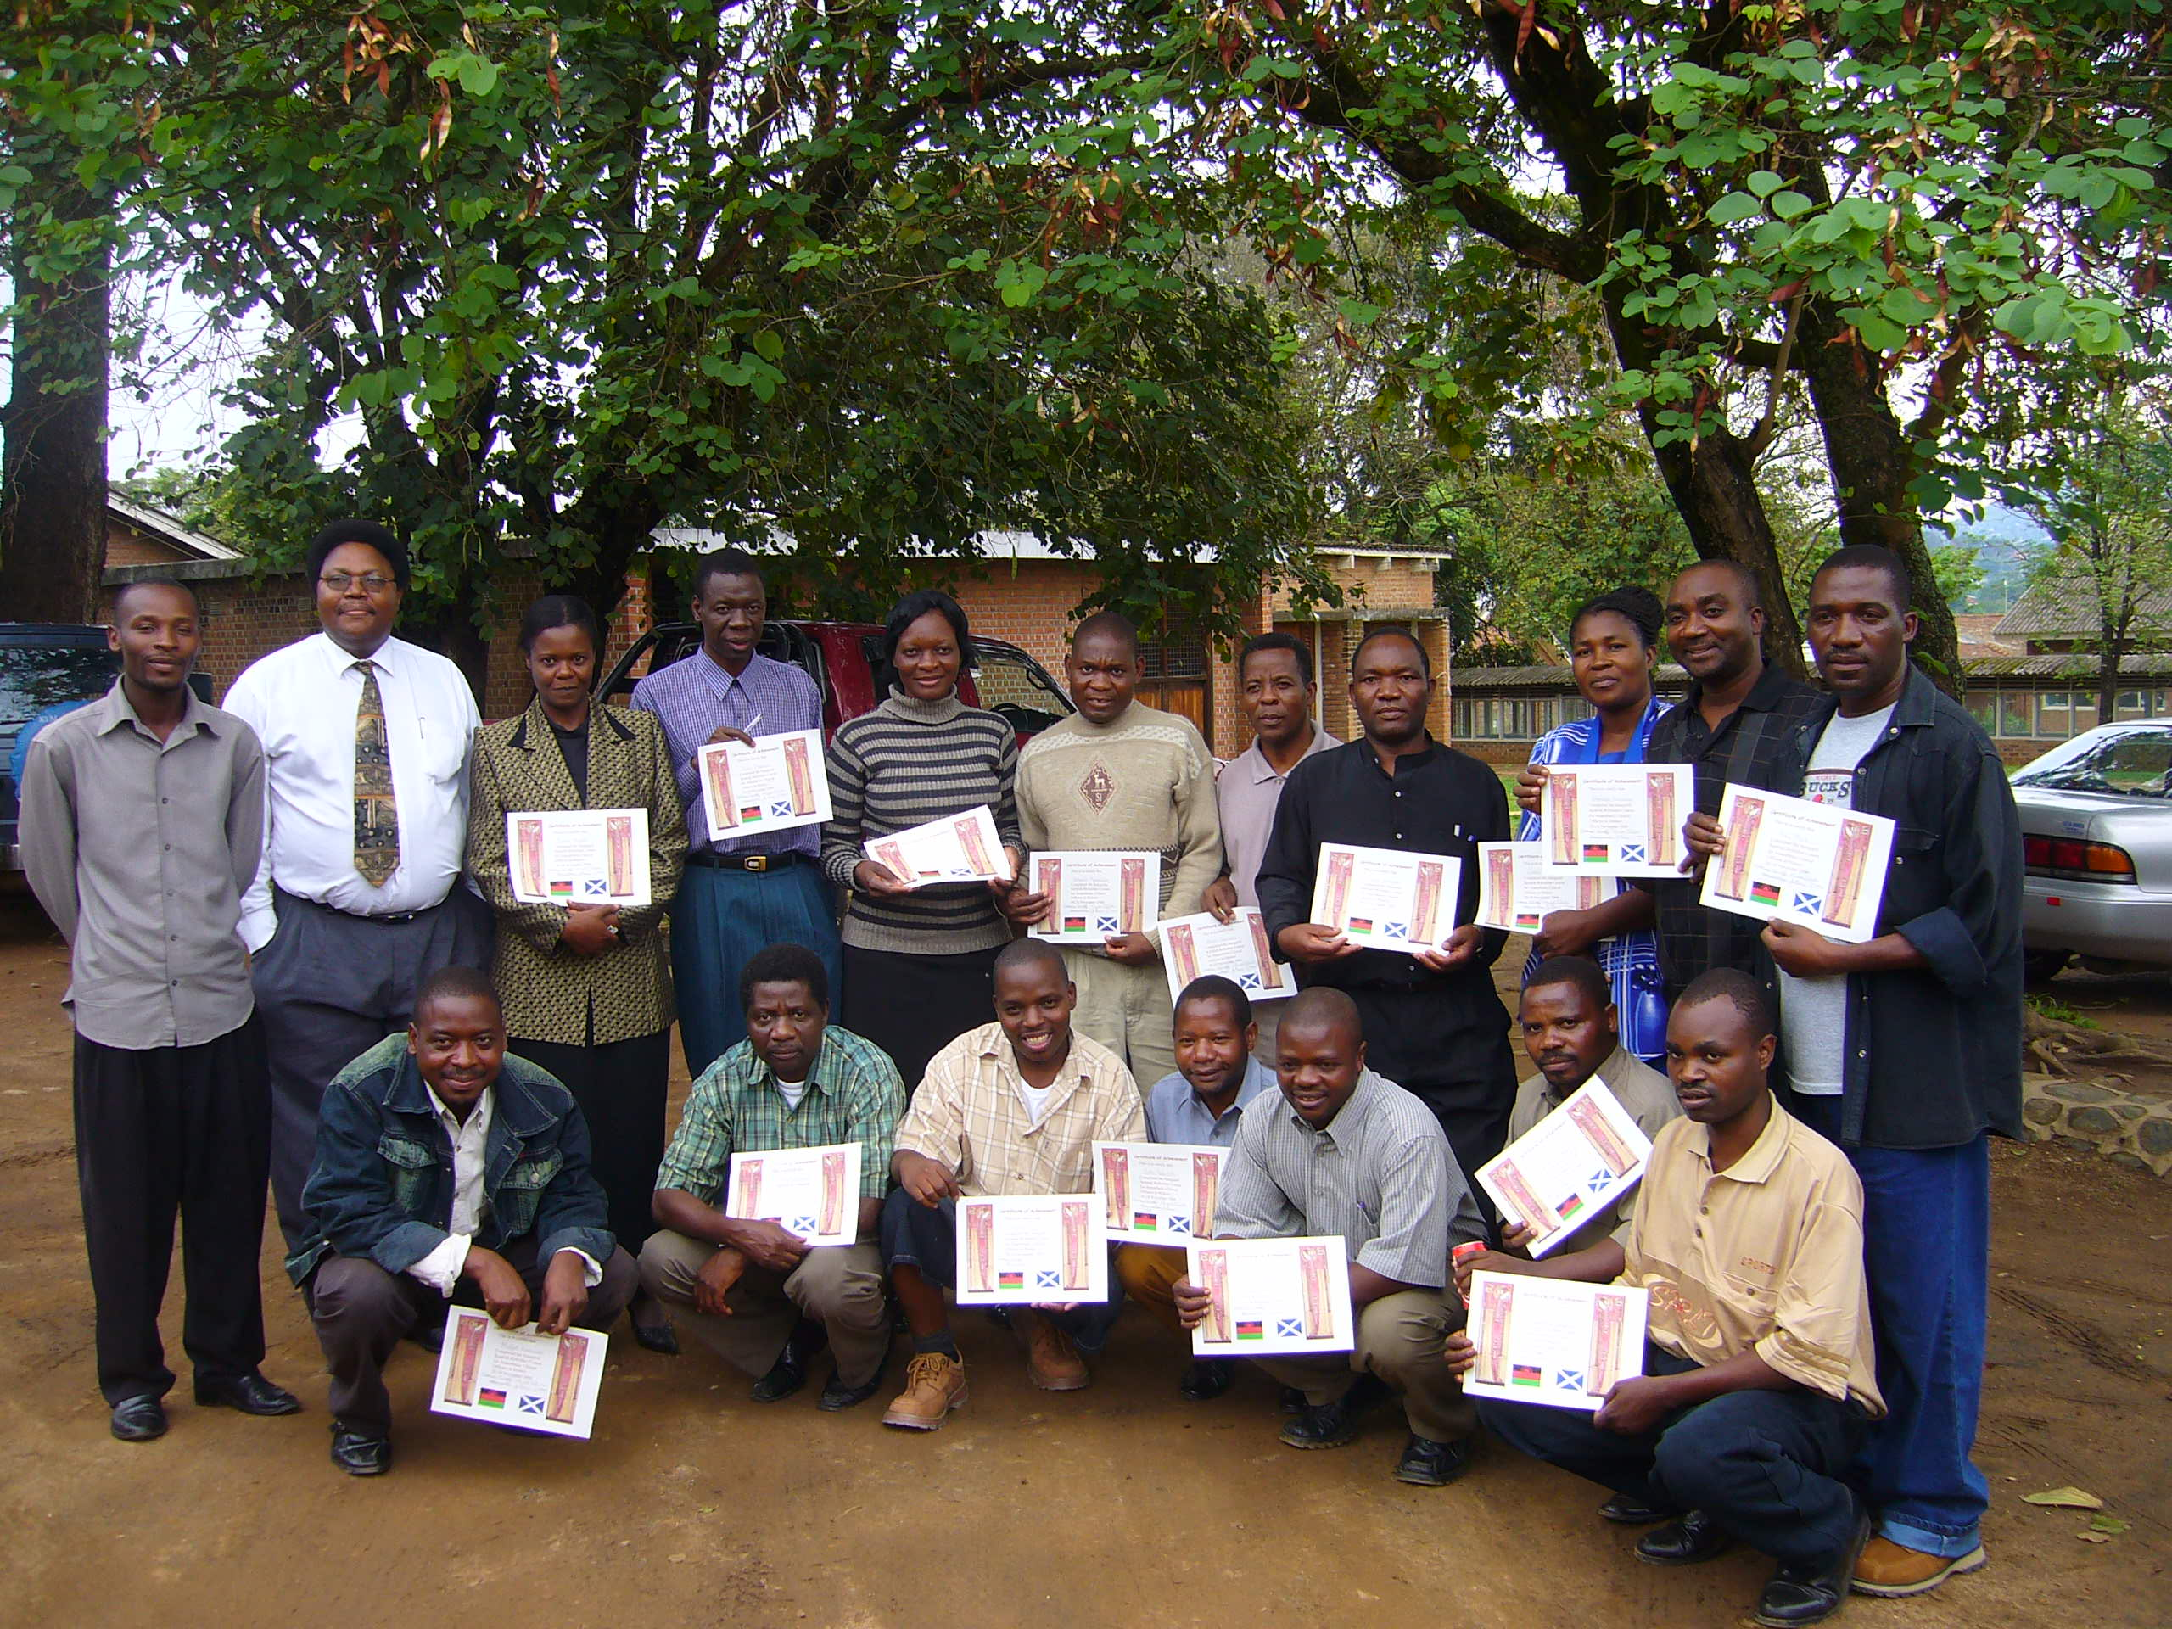
2006

Slide 4
Building Capacity
Train the Trainers.
Supervise and mentor
Eventually hand over the teaching completely

Slide 5
Teach the teachers 2007

Slide 6
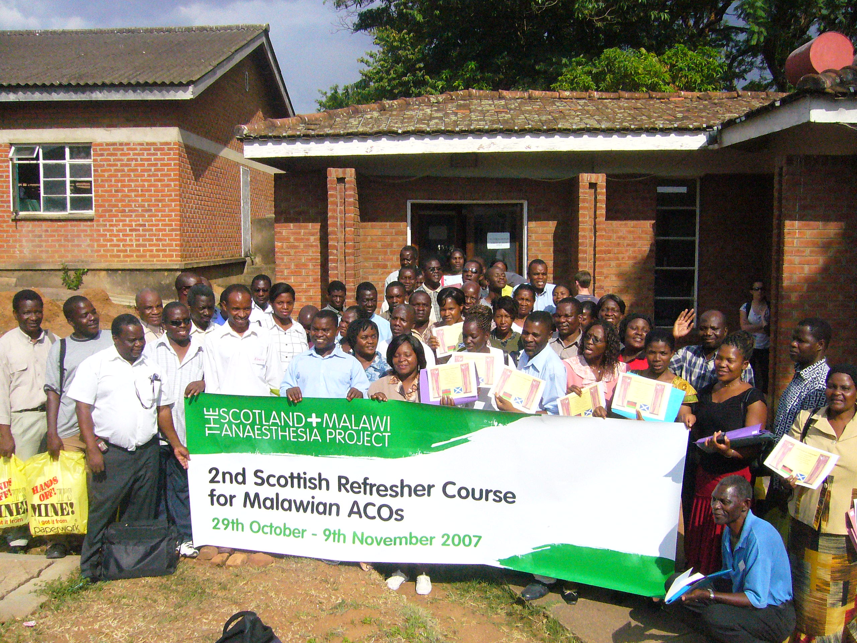
2007

Slide 7
2006-2011
43 anaesthesia courses
Critical care/transport of critically ill /pain
obstetric emergencies and trauma
paediatric emergencies and trauma
advanced life support/Communication(SBAR)
Malawi Project lead plus Five faculty
Equipment- reconditioned “condemned”
Support from ministry- establish HDUs

Slide 8
Dedza hospital
 | Pre-HDU | 2011
Transfers to central Hospital | 80% | 6%( 9/148)
Maternal deaths per month | 3-4 | 1-2
Balaka Hospital
 | Pre- HJDU | 2011
Maternal deaths per month | 3-4 | 2

Slide 9
Mangochi (8,300 deliveries)-2 HDUs 4 bedded maternity and 2-bedded general HDU
 | 2006 | 2011
HDU admissions per annum | 0 | 300
Referrals to Zomba Central Hospital |  | 30% of previous years
Annual maternal mortality (in-hospital) | 120 | 60

Slide 10
Effect of Scotland Malawi Anaesthesia courses
Pre- 2006
No critical care at district hospitals
Many deaths during transfer of unaccompanied critically ill to central hospitals
Poor communication from referring hospital
Post course
Critical care provided in district-Transfer numbers decreased by up to 74%
Of those treated locally- survival rate is 70-80%
Transfers are conducted safely- proper resus, personnel and communication
Maternal deaths decreased by 50% in the 3 centres
collecting data

Slide 11
Challenges with sustainability
Funding to cover:
Travel, accommodation, subsistence of faculty and delegates from throughout Malawi
? Wages
ACOs isolated workers

Slide 12
Phase 2: 2012-2016
Multi-disciplinary training in management of maternity emergencies/life-saving skills – “MOTTIE ” course
All staff working on labour ward
Three districts with highest maternal mortality
Guards and drivers

Slide 13
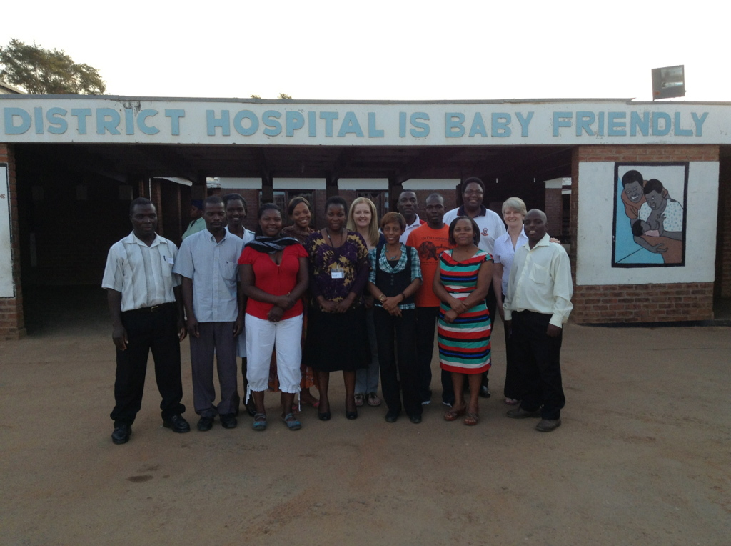
Salima: 10 instructors trained and supervised teaching on 11 MOTTIE courses

Slide 14
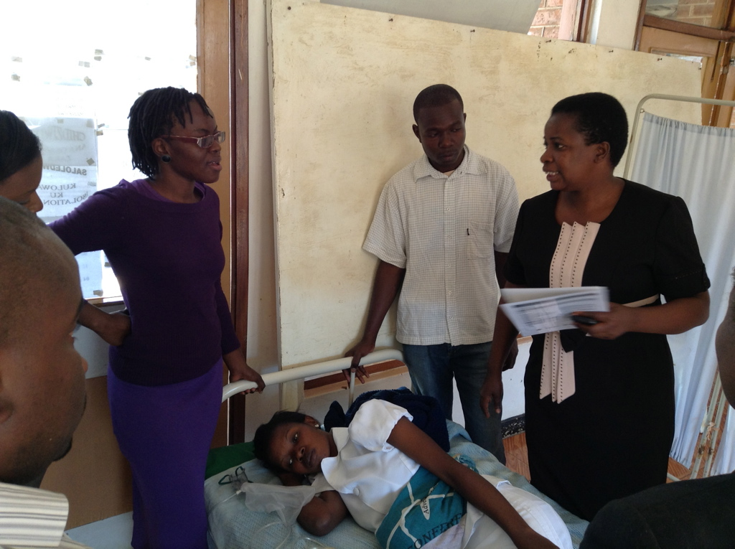

Slide 15
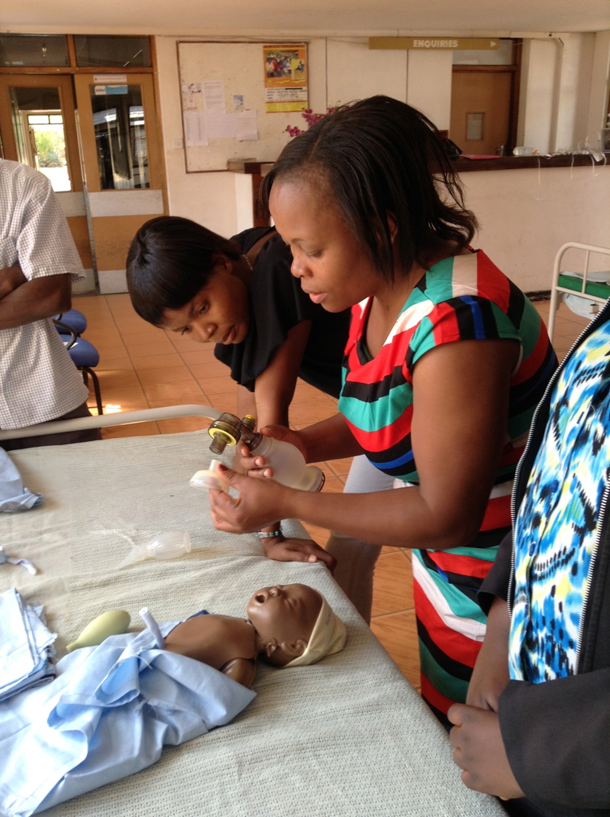

Slide 16
Salima

Slide 18
Salima

Slide 19
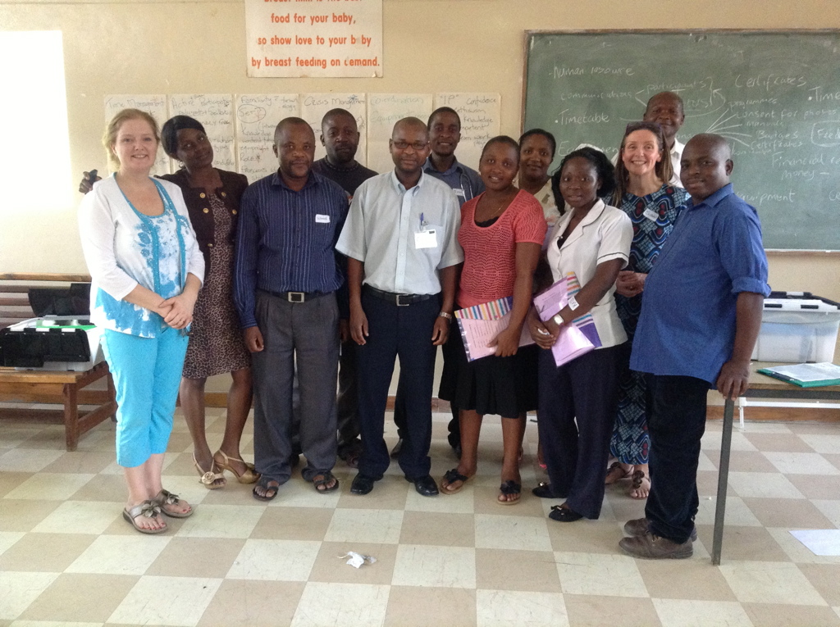
Machinga: 8 instructors trained and supervised teaching on 9 courses - 6 remain in MDH

Slide 20
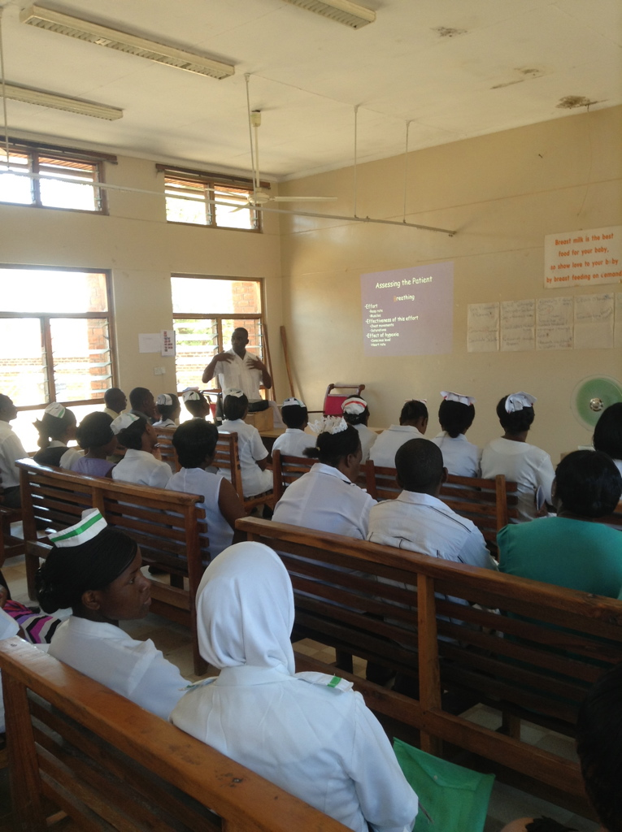

Slide 21
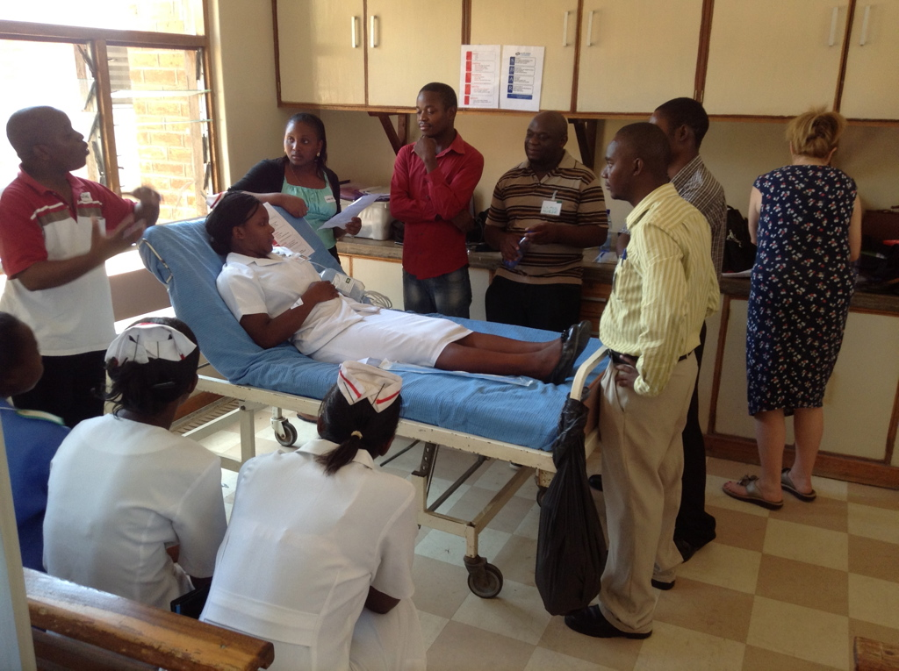

Slide 22
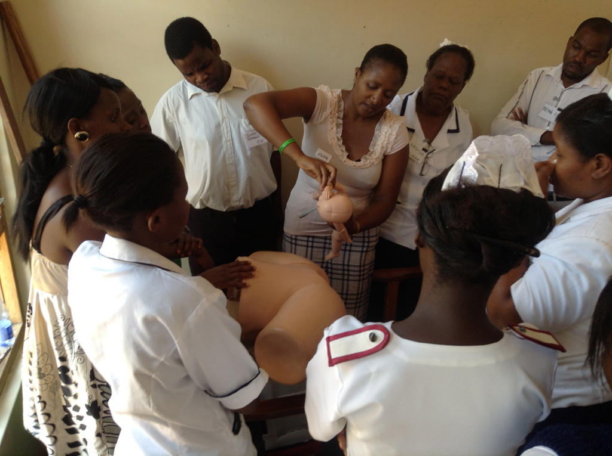

Slide 23
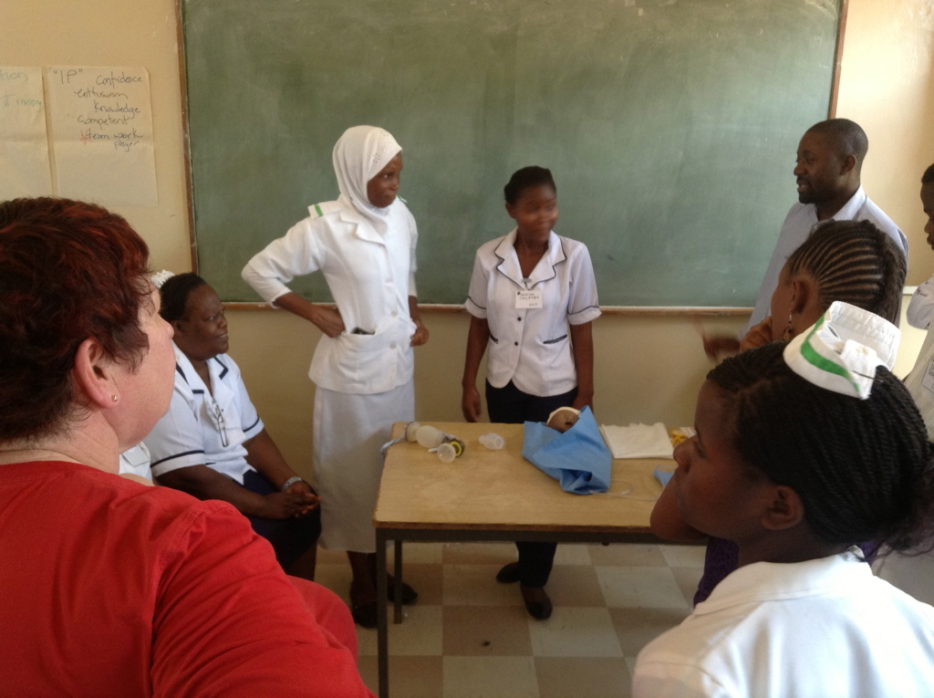

Slide 24
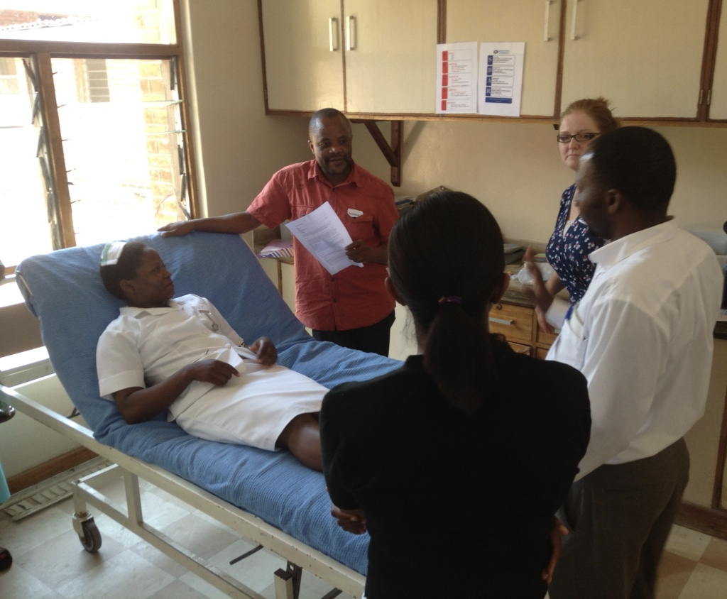
Machinga

Slide 25
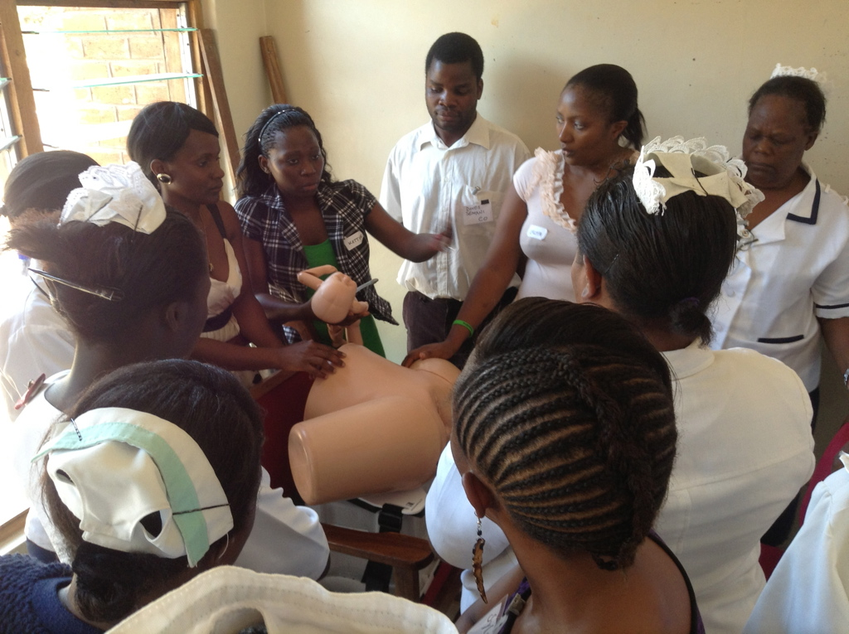
Machinga

Slide 26
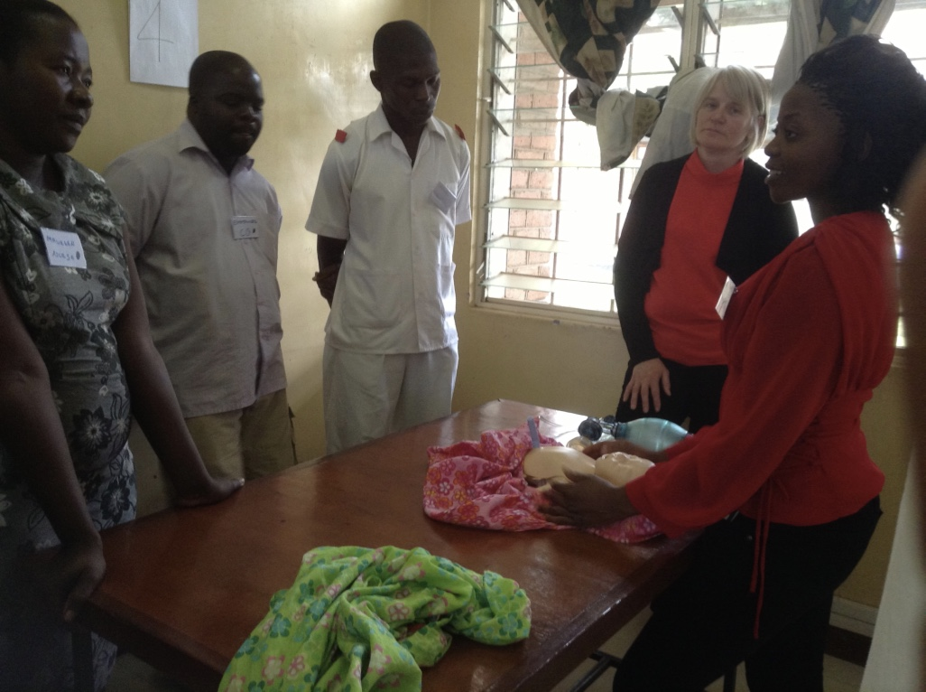
Mangochi: 7 instructors trained and supervised teaching on 3 MOTTIE courses

Slide 27
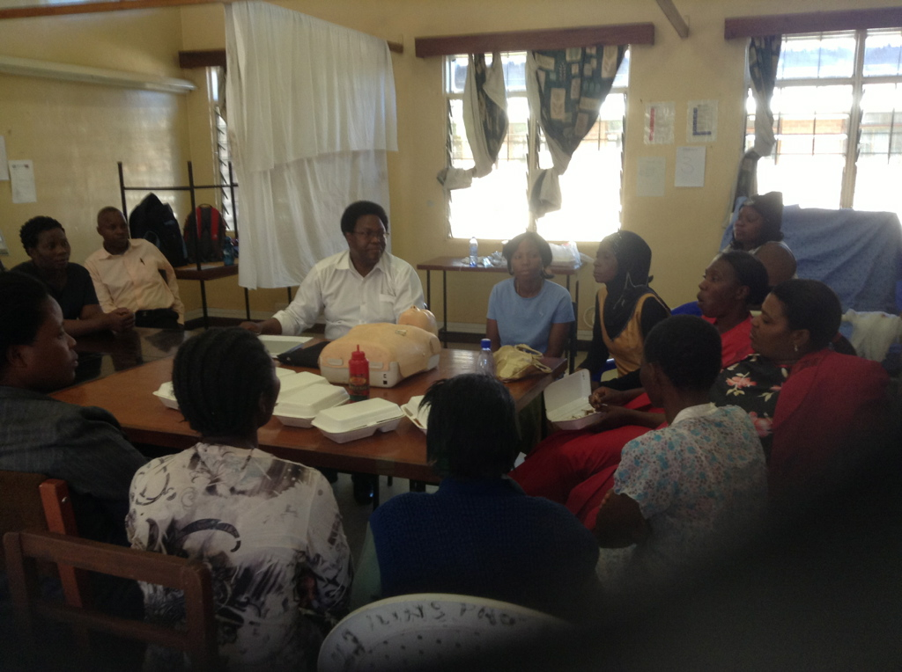
Guards and Drivers

Slide 28
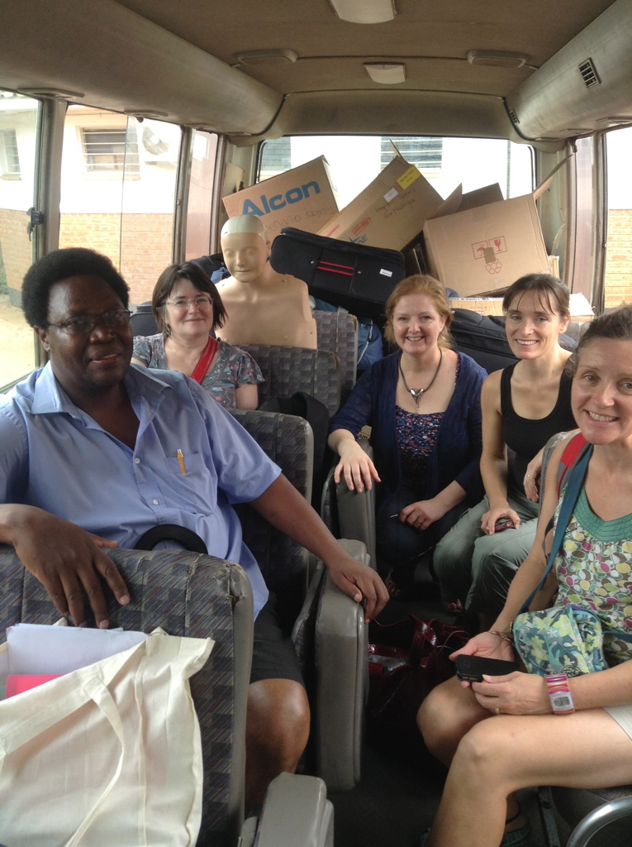

Slide 29
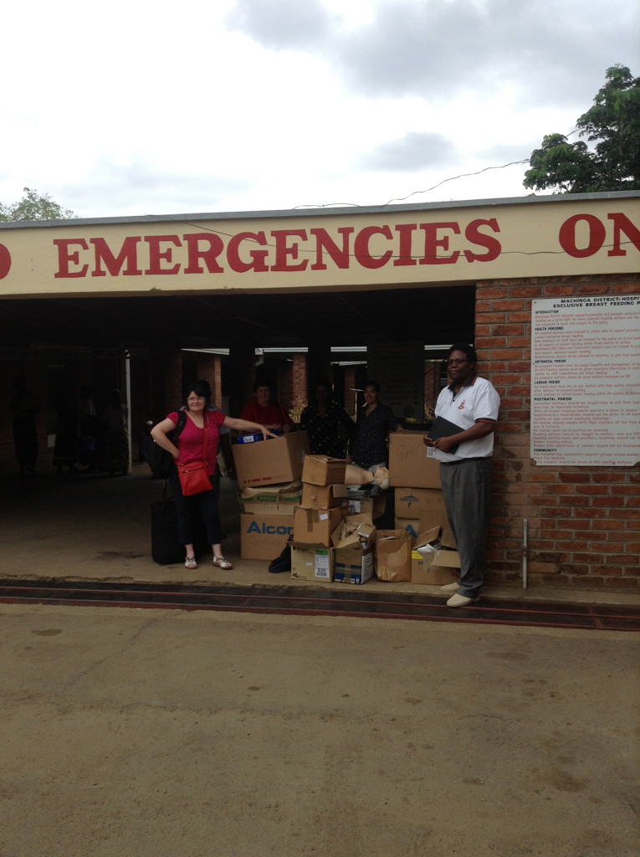

Slide 30
Total number of staff trained in each centre:
Clinical Staff
Salima: 153
Machinga: 184
Mangochi: 105
Guards and drivers
Salima: 80
Machinga: 64
Mangochi: 40

Slide 31
Maternal mortality
Pre-project data
Salima: 510 maternal
deaths per 100,000
deliveries
Machinga: 880 per
100,000 deliveries
Mangochi: 420 per
100,000 deliveries
End-of-project data
Salima: 250 maternal deaths per 100,000 deliveries (50% decrease in MM)
Machinga: 210 maternal deaths per 100,000 deliveries (75% decrease in MM)
Mangochi: 390 maternal deaths per 100,000 deliveries (7% decrease in MM)

Slide 32
Current Challenges to sustainability
Funding
Lunches and refreshments
Accommodation, travel and subsistence for
- health centre staff
- Malawi “national” faculty
Malawian instructors
Total of 24 local faculty trained and intensively supervised
3 Salima instructors have left and gone to College
1 Machinga instructor has gone to ministry of health
Machinga project lead moved to another district

Slide 33
Acknowledgements
Instructors
SMMDP/NES
ALSG
SSA
SICS
RCOA
OAA
AAGBI
SGIDF
NHS Tayside, NHS Lanarkshire, NHS Fife
NHS Scotland Colleagues who collect equipment
Medical physics, Ninewells Hospital
Fundraisers and donors
Avian graphics, Dundee
ASCO shipping, Aberdeen
Senergy Oil, Aberdeen
The Raven Trust

Slide 34
09.15 – 09.30 | Welcome, Introduction, Aims of the course | Worried (Catriona to mentor)
0930 – 10.10 | Human factors | Msaya (Cyril to mentor)
10.10 – 10.40 | Structured Approach Early Recognition of a sick woman- with demonstration of ABCDE (stage 1-3 of the 4 stage approach) | Lecture Sheliter (Catriona to mentor)Demo: Mkwezalamba/Thandie/Worried/New instructor E/ Susan
10.45 – 11.00 11.00 – 13 15 | Break Skill Stations (4 x 30 minutes) – 5 minute break between each for circulation of candidates. Kate to do timekeeping- mentored by Susan

Slide 35
Station | 11.00-11.30 | 1135 – 12.05 | 12.10 – 12.40 | 12.45 – 13.15
Breech | Red | Green | Black | Blue | Msaya/new instructor A Alison
Eclampsia & HELLP | Blue | Red | Green | Black | Sheliter/ Dr Mtibo/ new instructor B/Stella
Recognition of the sick woman (Stage 4 of the 4-stage approach) | Black | Blue | Red | Green | Worried/ Thandie /NI C and F Paul/Catriona
Neonatal Resuscitation ( 4-stage approach) | Green | Black | Blue | Red | Mkwezalamba / NI D/ Lorna

Slide 36
14.00 – 14.30 | Sepsis lecture | Dr Mtibo (Catriona to mentor)
14.30- 15.10 | Maternal resuscitation and BLS demo (stage 1-3 of the 4 stage approach) | - lecture Mkwexalamba (Catriona to mentor) 30 minutes Masaya to do timekeeping for this lecture and the demo Demo: Susan, Kate, Worried, Sheliter, Stella, new instructor F 10 minutes FOR DEMO
1315-1400- LUNCH

Slide 37
Note : Midwa, new instructor A to teach drivers / guards- Cyril to mentor
15.10 - 1715 scenarios 30 minutes each with 5 minutes to circulate
Kate to do timekeeping with an administrator, if available.
Station | 1510-1540 | 1545-1615 | 1620-1640 | 1645-1715
Resuscitation, BLS | Red | Green | Black | Blue | Kate, new instructor E, Susan
Shoulder dystocia | Blue | Red | Green | Black | Msaya, new instructor B and F, Lorna
Sepsis | Black | Blue | Red | Green
PPH- uterine condom tamponade | Green | Black | Blue | Red | Mkwezalamba,, new instructor D, Stella, Paul
Dr Mtibo, new instructor C, Alison
1715- End course. Award Certificates
1730- Faculty meeting- or defer faculty meeting to early next morning

