Slide 1
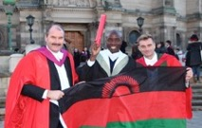
‘Online surgical training - going global’
Professor James Garden
Professor Emeritus, Clinical Surgery
Dean International, University of Edinburgh
Director, Edinburgh Surgery Online
Known conflicts of interest:
I was born in Carluke, Lanarkshire
I trained in Edinburgh, Glasgow and Paris as a liver surgeon
I am employed by University of Edinburgh
I am a Fellow of the Royal College of Surgeons of Edinburgh
I travelled for the first time to Malawi in October 2019
Notes:
Delighted to be presenting in York to the Society in such historic surroundings. I am going to talk about modern methods of supporting the professional and academic development of surgical trainees but it is worth reflecting on why Edinburgh has traditionally been a centre of surgical education. I don't believe that I have any conflicts of interest - trained - I make no apologies that I may have a bias towards Edinburgh and surgery in the next half hour!

Slide 2
University of Edinburgh – Medical School origins
Medicine taught at Edinburgh since beginning 16th century
formation dependent on Incorporation of Surgeons and Barber Surgeons (1505) and Royal College of Physicians (1681)
University of Edinburgh (1582) modelled on University of Bologna
medical teaching based on Universities of Padua and Leiden (founders studied, Scots treated)
anatomy was primary facet of medical teaching
1000 students studying in Edinburgh (extra-mural school)
Alexander Monro appointed RCSEd Professor of Anatomy (1720)
4 chairs appointed to create faculty allowing UoE to award Doctor of Medicine (MD) - 1726 (including Monro)
Notes:
Campbell (1682-1761) duke of Argyll, Scotland's most influential political leader.[8] Its formation was dependent on the incorporation of the Surgeons and Barber Surgeons, in 1505 and the foundation of the Royal College of Physicians of Edinburgh in 1681

Slide 3
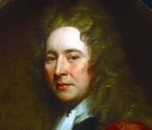
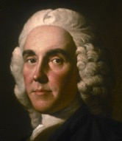
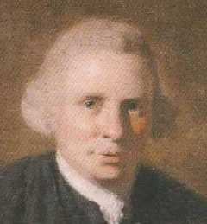
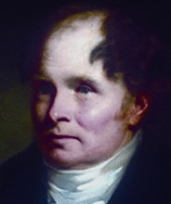
Monro Dynasty
John Monro
(1670 – 1740)
Roll number 137
Alexander Monro
Primus
(1697 – 1767)
Roll number 173
Four generations of the Monro family
The three Alexanders Monro between them occupied the chair of anatomy at the University of Edinburgh for 126 years
Alexander Monro secundus
(1733 – 1817)
Alexander Monro tertius
(1773 – 1859)

Slide 4
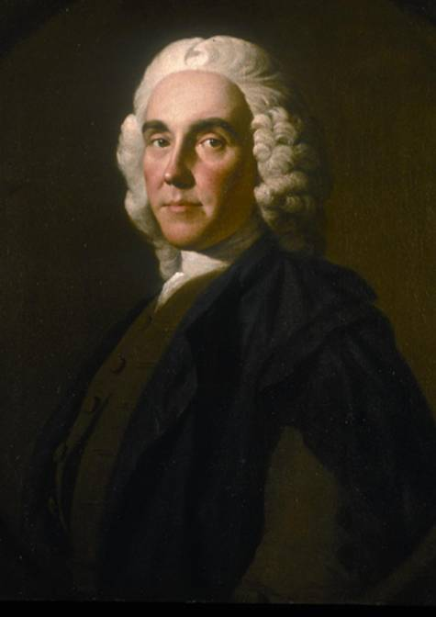
Alexander Monro primus (1697-1767)
Surgical apprentice to his father (1712-13)
Attended wounded at Battle of Sheriffmuir aged 18 years (1715)
Anatomy in London under Cheselden (1717)
Surgery, midwifery in Paris (1718)
Medicine in Leiden under Boerhaave
Freeman of Incorporation of Surgeons by examination aged 22 years (1719)
Surgeon, Anatomy teacher, Surgeons’ Hall
Foundation Professor of Anatomy Edinburgh University, 1726 (age 29)

Slide 5
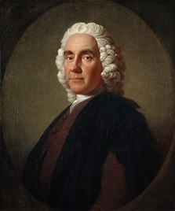
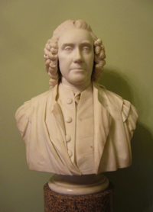
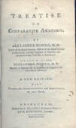
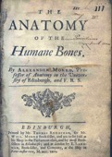
Alexander Monro primus
- an Enlightenment figure
A communicator, inspiring teacher
lectured in English
Published
- Medical Essays and Observations (1737)
- Anatomy of the Human Bones
(not illustrated until 1760 ed)

Slide 6
Edinburgh Medical Enlightenment
Graduates of the Edinburgh Medical School have founded medical schools and universities globally
Ivy League medical schools
Pennsylvania (Philadelphia - 1765)
Yale
Columbia
Harvard
Dartmouth
University of Vermont College of Medicine
University of Sydney Medical School
University of Melbourne Medical School
McGill University Faculty of Medicine
Université de Montréal Faculty of Medicine
London School of Medicine for Women (now UCL Medical School).
Willian Shippen
John Morgan

Slide 7
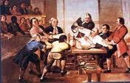
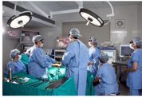
‘Online surgical training - going global’
Notes:
Scotland played a key role in the medical enlightenment of the 18th and 19th centuries. Both Glasgow and Edinburgh nurtured some of the greatest medical practitioners and scientists of that era. This presentation will reflect on the relationships and contributions of some of the key figures of the time including Cullen, the Monro dynasty, the Hunter brothers, Smellie, Liston, Lister, Black. These individuals ensured that Scottish medicine carried considerable influence on the development of medical and surgical science. Their specific impact on medicine and history at a national and international level will be explored.

Slide 8
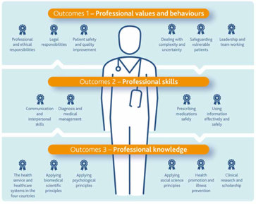
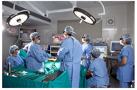
Training a Surgeon
Surgical knowledge
in-the-work-place
self-directed/structured (variable)
Clinical skills
preoperative and postoperative care
Technical skills
live surgery
simulation
Non-technical skills in surgery (NOTSS)
situation awareness
decision making
communication
teamwork

Slide 9
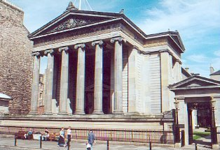
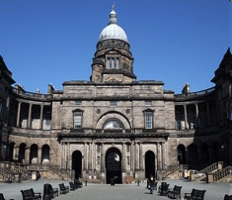
Uniting Professional and Academic Excellence
Memorandum of Understanding - 2006
The Royal College of Surgeons
of Edinburgh – 1505
professional development
MRCS, FRCS
The University
of Edinburgh – 1582 (1726)
academic development
MB ChB, MD, PhD
Notes:
We now move on to the present time and wish to demonstrate how the two rivals have now combined
2 ancient institutions, the RCSEd which is responsible for the professional development of training surgeons and the University of Edinburgh which is responsible for undergraduate education and is focused on postgraduate research opportunities rather than training. These institutions have combined in the last 7 years to deliver the innovative programme about which I will talk.

Slide 10
UK Surgical Training Structure (2007) - masters online programmes
SURGICAL
TRAINING
Consultant Surgeon
Academic Surgeon
ACADEMIC
DEVELOPMENT
48 hour week had reduced clinical opportunities
Study for prof exam often unsupported
Research required time out of programme
Minority commit to academic career but need for evidence-based practice
FRCS
Specialist Surgical Training (ST7/8)
ChM Year 2
Specialist Surgical Training (ST5/6)
ChM Year 1
Specialist Surgical Training (ST3/4)
Academic Training
MSc, MD, PhD
MSc -Year 3
Masters
MRCS
Early Years Surgical Training ( CT1/2)
MSc - Year 2
Diploma
Foundation Year 2
(FY2)
MSc - Year 1
Certificate
Foundation Year 1
(FY1)
Undergraduate
Medical School
Notes:
So this is about supporting the trainee in a way two key professional examinations towards the beginning of training, the MRCS and at the end, the FRCS. This is normally undertaken by the trainee in an unsupported way. What we have done is to take the content of the MRCS and FRCS curricula and delivered that in modular distance learning programmes, the MSc in Surgical Sciences and the Master of Surgery.
Adds value to in the work place experience

Slide 11
MSc Surgical Sciences - modular/flexible
Year 1
Applied anatomy, radiology, physiology, pathology and bacteriology
Certificate
Case-scenarios (n~90)
MCQs (10%)
Discussion Boards (15%)
end of year exam (75%)
Year 2
Assessment and care of the surgical patient, research and communication skills
Diploma
Case-scenarios (n~10)
Discussion Boards (20%)
MCQs (5%)
Mini-essays (15%)
end of year exam (60%)
MRCS
Year 3
Research dissertation
Master of Science (MSc)
Independent research
Supervisor
Project outline (15%)
e-poster (25%)
Dissertation (60%)
Discussion Helpdesk
Notes:
the programme is delivered with a focus on virtual cases using the discussion boards and MCQ to drive the student learning in year 1.
In year 2 , the trainee progresses into modules that are more related to the application of the basic sciences in the peroperative assessment of the surgical patients. There is less emphasis on the case scenarios but greater interaction on the discussion boards with submitted mini-essays ensuring engagement in these.
At this stage, the trainee is well prepared to negotiate the MRCS examination and has begun the preparation for the research dissertation year which forms the key content of the third year

Slide 12
MSc in Surgical Sciences (online learning) - the rationale
Support surgical trainee in early years of surgical training
Acquire understanding of applied basic surgical sciences
consolidate knowledge base for MRCS curriculum (UK) - relevant to early years of training (global)
support professional development (values, skills)
complement in the work place training (address deficiencies)
Opportunity for ambitious trainees to acquire additional qualifications which would
enhance portfolio and promote career development
provide trainee with essential ‘academic tools’ to support life-long learning
Opportunity for prospective academic surgeons to acquire qualification which would
identify career intentions
provide possible academic base for career development
Equity of access (global)
Notes:
The concept of our first MSc (in Surgical Sciences) was to ….
The same is also true for our advanced ChM programmes

Slide 13
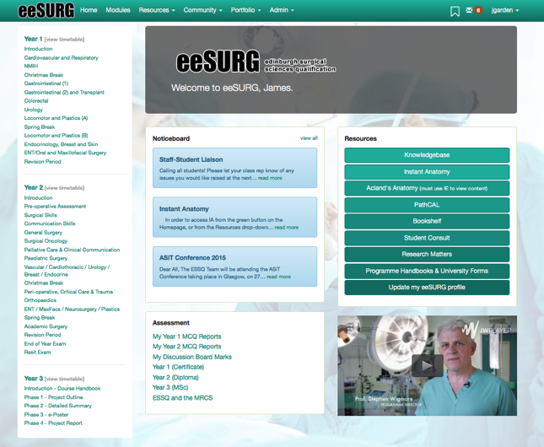
Dedicated VLE
Notes:
Programmes delivered on dedicated VLE’s

Slide 14
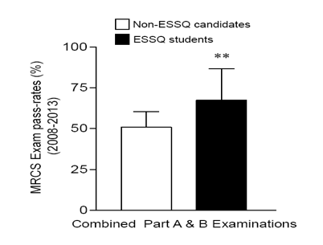
Contextual
SURGICAL
TRAINING
Consultant Surgeon
FRCS
Specialist Surgical Training (ST7/8)
Specialist Surgical Training (ST5/6)
Specialist Surgical Training (ST3/4)
MSc -Year 3
Masters
MRCS
Early Years Surgical Training ( CT1/2)
MSc - Year 2
Diploma
Foundation Year 2
(FY2)
MSc - Year 1
Certificate
Foundation Year 1
(FY1)
Undergraduate
Medical School
Notes:
If we look at the performance of trainees in the UK who put themselves forward for the MRCS examination, we can see that our MSc/ESSQ students have a 20% higher pass rate than those not enrolled in our programmes.

Slide 15
Why the model works globally
Students can study flexibly:
Anywhere…
Anytime…
Any device…
Notes:
Our programmes work because students can study on our bespoke VLE’s anywhere, anytime and on any device.

Slide 16
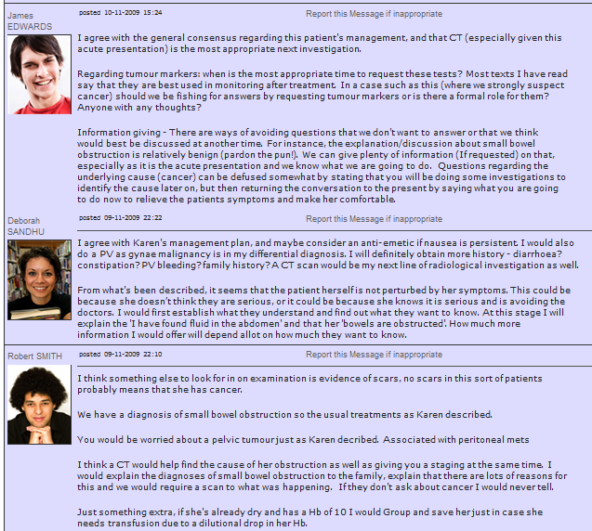
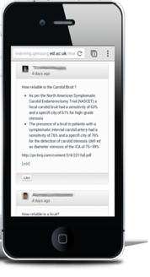
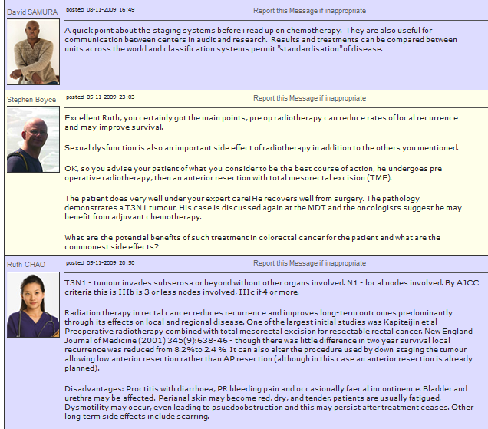
Learner collaboration is encouraged and facilitated
Assessed Discussion Boards and Helpdesks
Personal Profile Pages
Notes:
We have endeavoured to develop and maintain a sustainable and supportive community around the surgical trainee with liberal use of asynchronous discussion boards and support of tutor groups form senior trainees and consultant surgeons.

Slide 17
Enjoyable and engaging … our student feedback
“Very enjoyable and stimulating content. Thank you ESO team.”
“I have really enjoyed the course and think it is a fantastic opportunity. I like the way that continual participation in discussion boards makes you learn as you go along, rather than leaving everything until 2 wks before the exam!”
“I have enjoyed it a lot and would strongly recommend it. In fact, I already have.”
“This is one of the greatest innovations in terms of surgical education. It is a revolution.”
“I am constantly talking about it to everyone. Looking forward to year 2.”
“The tutors have been great and post regularly, sharing their expertise without making us feel uncomfortable about mistakes.”
“Very interesting and academically challenging”
“I found the online course material really helpful and find the course to be very well organised with help available at every opportunity.”
“I have been able to remain in Malawi to learn, while continuing to treat those who need me most.”
Notes:
Feedback has been positive and students feel engaged. Enjoyment, innovation, challenging and fit for their purpose.

Slide 18
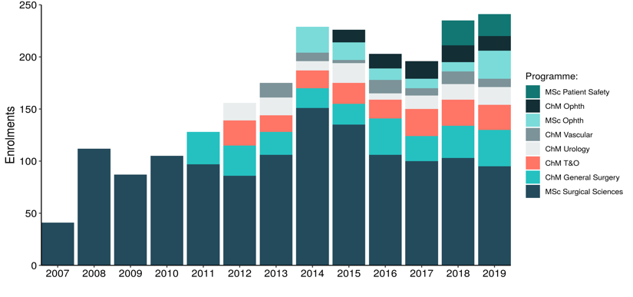
Enrolments to Programmes
MSc in Surgical Sciences - launched Sep 2007
8 Surgical Masters programmes ~ 550 currently on programme
Over 2,500 have enrolled in 12 years
MSc in Patient Safety & Clinical Human Factors - launched Sep 2018

Slide 19
Global reach
Over 2500 students enrolled since 2007
from 76 countries

Slide 20
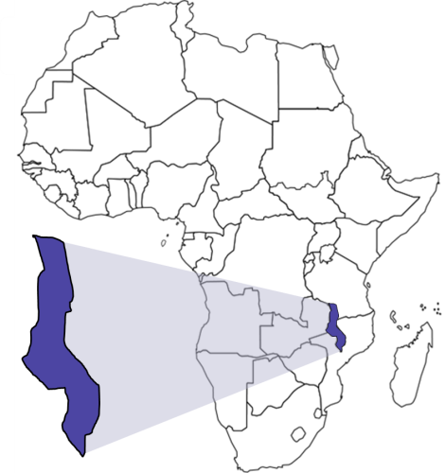
Malawi: a case-study
In 2004, Malawi had the lowest doctor staffing levels in southern Africa, 2.03/100K in 2010 (cf. Greece, 620/100K)
Malawi has the world’s lowest physician to patient ratio - 1 surgeon per 1 million people (Quershi et al., 2013).
15 qualified general surgeons for a population of 17 million
Doctors who pursue further training overseas may fail to return, further contributing to the shortage in healthcare workers.
Notes:
Malawi is one of the poorest nations in the World, and has only 14 qualified surgeons for its entire 16 million population.
Trained doctors frequently leave the country to further themselves but do not return.
We and other developed countries have been ruthless in using international medical graduates to fill gaps in our own health services
The Lancet Commission requirement by 2030 is projected at 60 specialists per 100,000 population. It is difficult to imagine where the additional 10,000 or so specialists will emerge for Malawi without substantial investment.

Slide 21
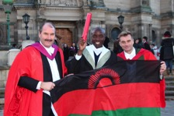
Malawi Capacity Building - MSc in Surgical Sciences
- Scholarship programme (2010 to present)
Malawian students enrolling on the MSc between
2010/11 and 2019/20
n = 30
Currently in Year 1
n = 2
Currently in Year 2
n = 3
Currently in Year 3
n = 1
Graduated with Masters
n = 18
Withdrew during
Year 1
n = 4 *
Left Malawi after
Year 1
n = 1 **
Graduated certificate
n = 1
* 1 student changed career (no longer pursuing surgical training), 2 exited without award, I interrupted study.
** Relocated to South Africa to take up a training post (continued without scholarship).
14/30 students – female

Slide 22
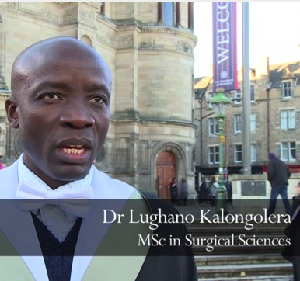
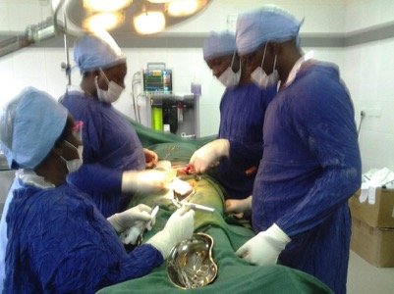
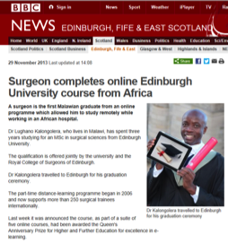
First Malawian MSc Surg Sci Graduate 2013
“I have been able to remain in Malawi to learn, while continuing to treat those who need me most.”

Slide 23
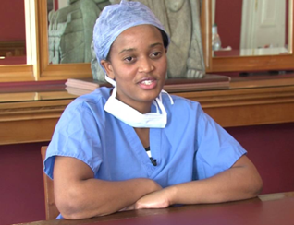
Wone Banda (MSc Surgical Sciences, 2011-14)
Wone received a J&J scholarship to undertake her MSc studies during her plastic surgery residency training in Blantyre, Malawi.
'The online content was very relevant and helped tremendously to prepare for my MCS exams in 2013.
My final research year, equipped me with the basic knowledge of how to conduct research projects.
I am currently a Plastic Surgeon working at Kamuzu Central Hospital. Lilongwe, and would highly recommend this programme to all trainees.
I recently attended an alumni retreat which provided a great platform to network and through this I am in talks to engage in research collaboration in burn care within the region.'

Slide 24
Vanessa Msosa, Malawi (MSc 2014-17 and ChM GenSurg 2019-20)
Enrolled on MSc Surgical Science programme in 2014 - recipient of Johnson & Johnson bursary - worked concurrently as a trainee surgeon in Malawi, graduating in 2017.
Subsequently enrolled on ChM General Surgery (2019) (ESO Global Scholarship) following her appointment as a junior consultant.
“The programmes opened up a door to high quality learning on surgical sciences. Interaction with other international trainees through discussion boards has been an eye- opener. It has encouraged me to be competitive to reach my full potential.
Malawi is participating in GlobalSurg 3 this year. This randomized controlled trial will study measures to reduce the risk of surgical-site infections in low- and middle-income countries. I am proud to be a part of this collaboration and to contribute to high-quality studies and to fill gaps in knowledge related to surgery worldwide. This will have a huge role in strategic development of tackling disparities in global surgical care delivery.“

Slide 25
50 Fully Funded Scholarships in 2020
Fees: £13,500 ($17,500) per programme: MSc (3 years) and ChM (2 years)
Edinburgh Surgery Online Global Scholarships – 25 scholarships awarded to applicants each year from LMICs to study for the MSc Surgical Sciences & ChM programmes (General Surgery, Urology, Trauma & Orthopaedics, Vascular & Endovascular Surgery)
Commonwealth Scholarship Commission - 5 Scholarships (full tuition fees, contribution towards cost of internet access and project costs)
2 Johnson and Johnson Scholarships
2-3 NIHR GlobalSurg Scholarships
10 Caledonian Heritable Scholarships (surgery)
5 Pyott Scholarships (ophthalmology)
https://www.edinburghsurgeryonline.com/scholarships

Slide 26
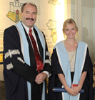
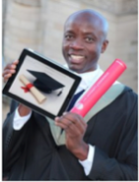
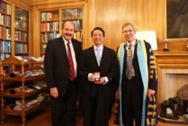
Surgical Training and Distance Learning
- Why has it worked?
Edinburgh ‘brand’
global reach (bursaries and fellowships)
VLE
flexible, ready access
fits with modern learning methods
Trainee engagement
academic credit – MSc or ChM (CV)
preparation for professional milestones
increased experiential learning
access to academic opportunity
avoidance of financial loss of full-time PG study
Contained cost
Tutor engagement
CPD/CME development
Capacity Building
Notes:
So why has this model of academic support worked?

Slide 27
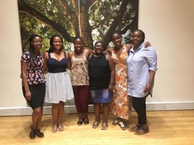
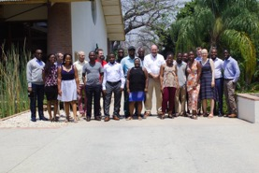
‘Online surgical training - going global’
Notes:
Scotland played a key role in the medical enlightenment of the 18th and 19th centuries. Both Glasgow and Edinburgh nurtured some of the greatest medical practitioners and scientists of that era. This presentation will reflect on the relationships and contributions of some of the key figures of the time including Cullen, the Monro dynasty, the Hunter brothers, Smellie, Liston, Lister, Black. These individuals ensured that Scottish medicine carried considerable influence on the development of medical and surgical science. Their specific impact on medicine and history at a national and international level will be explored.

