Slide 1
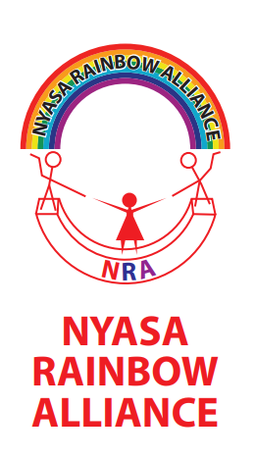
NRA is an LGBTI led organisation established in 2014.
The Alliance was established after realising the implementation gaps within the existing LGBTI organisation and their scope of work.
28 August 2021

Slide 2
NRA Registration case
Denied registration in 2017
Membership practices were considered illegal
Silence of the courts since then
Consolidating the case with other decriminalization cases
The decision by the Respondents to refuse to incorporate and register the Registered Trustees of Nyasa Rainbow Alliance is bad at law

Slide 3
Activities
Engagement with Human Rights International Mechanisms and advocacy at National level for policy reforms and awareness raising
Capacity building
Training and support to actions on crisis management and security for LGBTI HRDs
Strategic litigation for the rights of LGBTI people
Continued Health Care worker’s orientation on KP friendly services
Formation and strengthening of KPLHIV support groups
Media engagement
KP Peer Education System with respect to HTS
Emergency response

Slide 4
Achievements
The awareness of LGBTI in the country has been improved
Visibility
Frontline defenders award
Recognition by government authorities
Synergies with like minded organizations and authorities

Slide 5
Out & Proud Southern Africa is a group of activists who promote the rights of the LGBTI community in Eswatini, Malawi & Zimbabwe, train the media on LGBTI engagement and advocate for the protection of the rights of the LGBTI community at large.
Introduction.

Slide 6
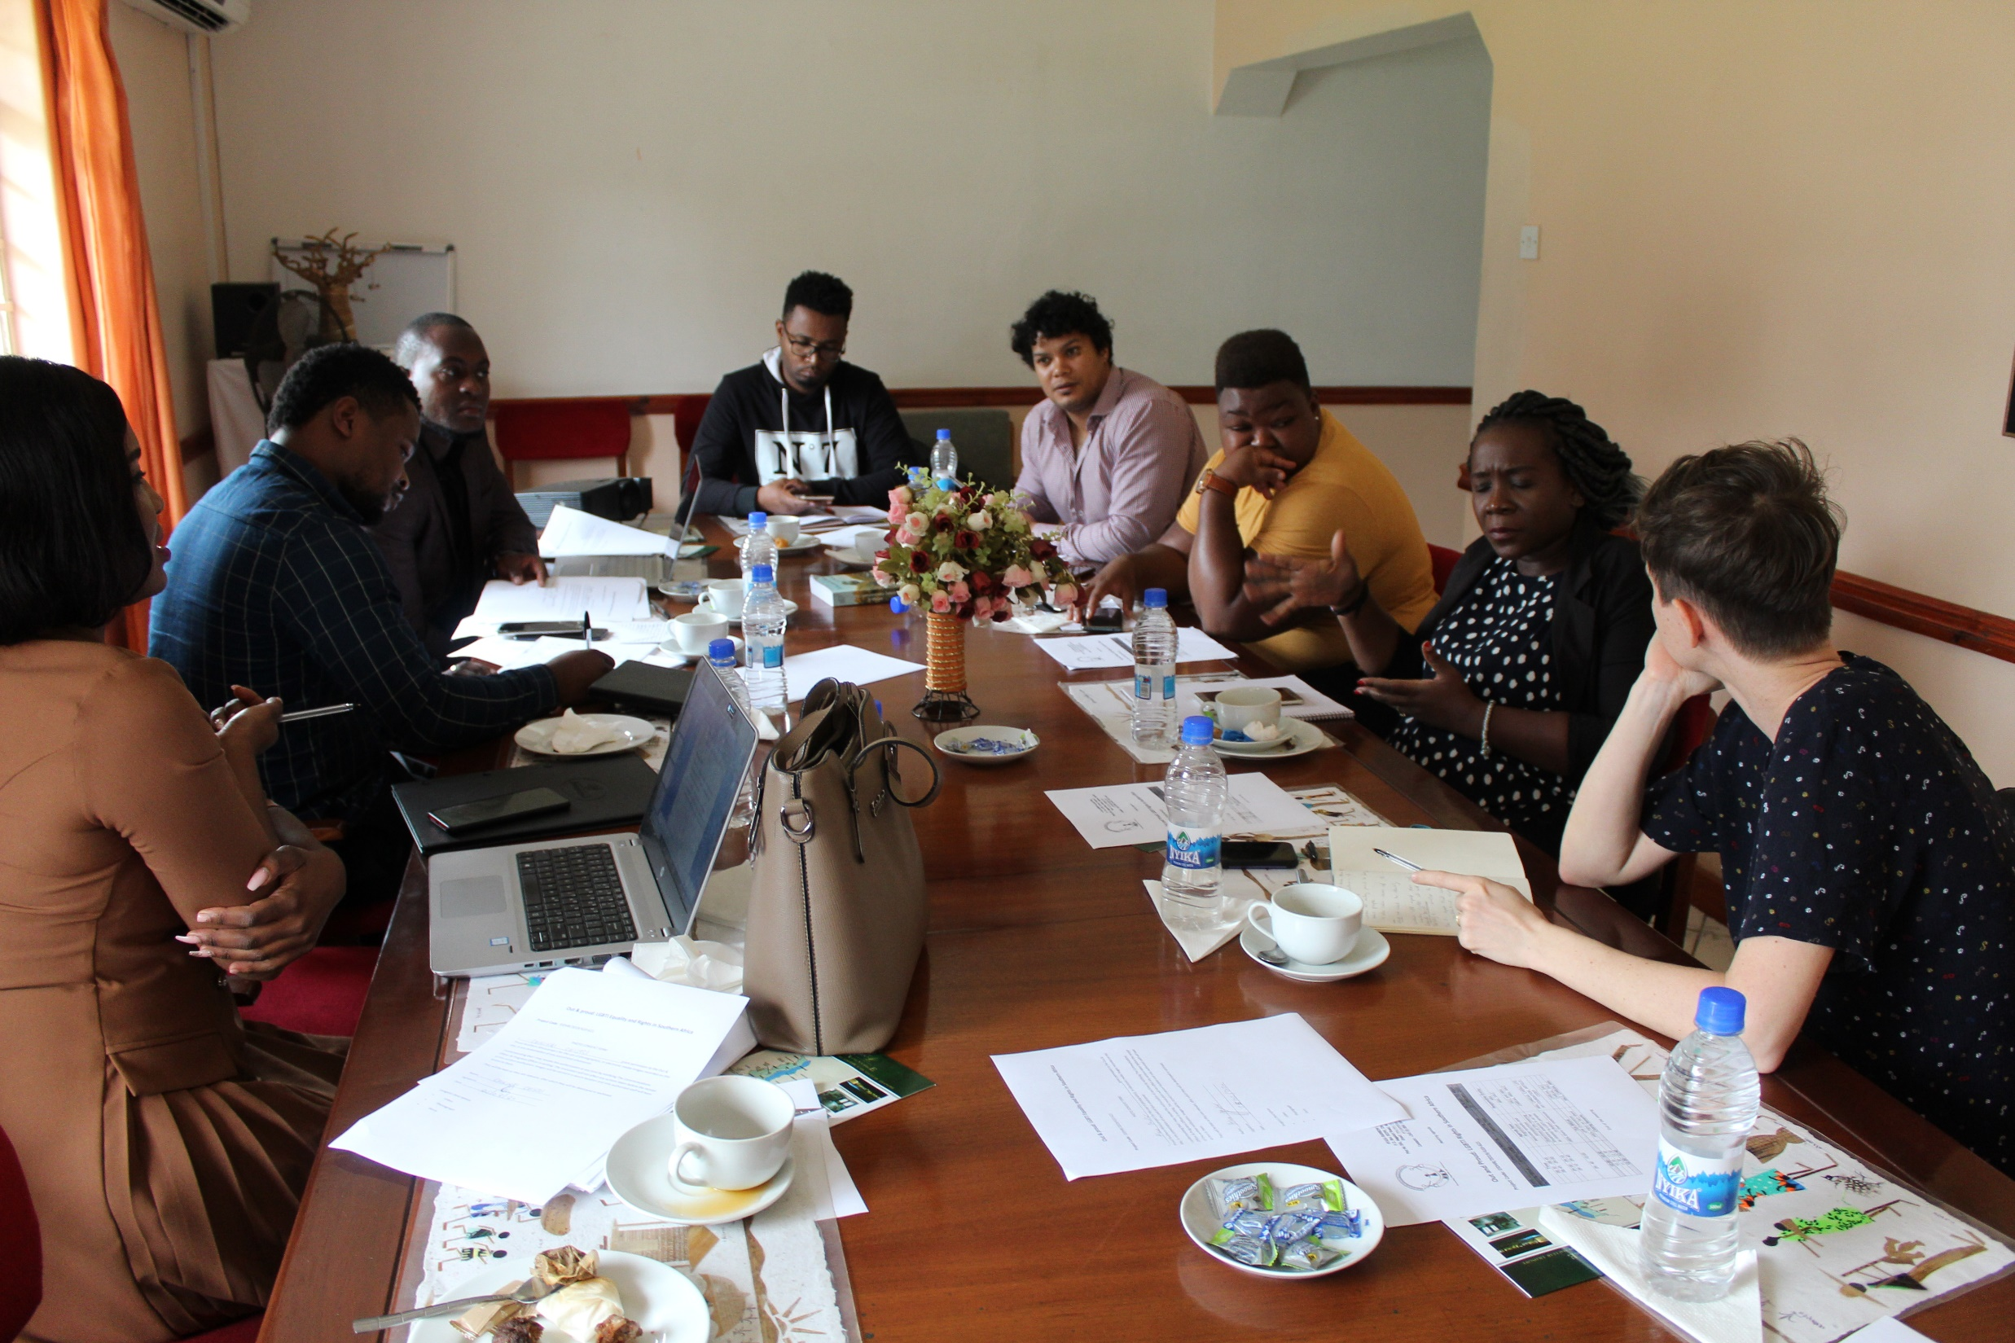

Slide 7
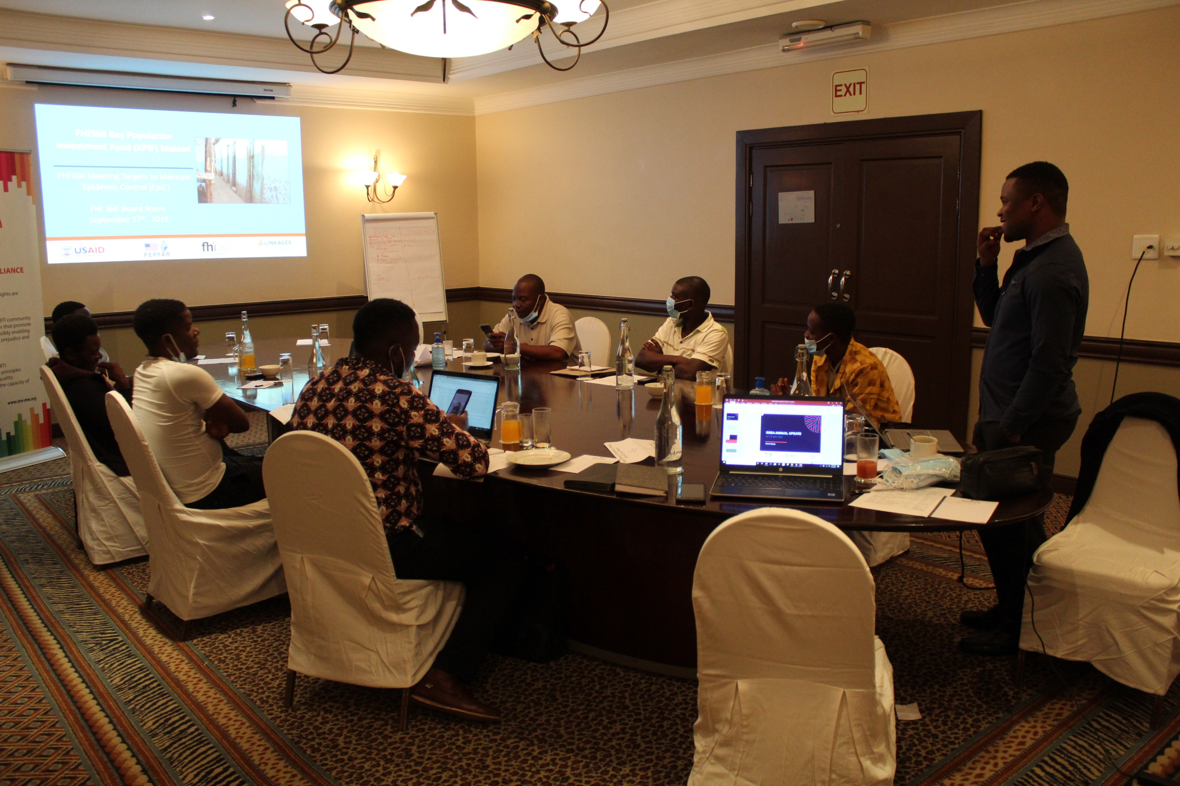

Slide 8
CAPACITY STRENGTHENING
ADVOCACY
MOVEMENT BUILDING

Slide 9
OUT & PROUD
Risk and Vulnerability Analysis

Slide 11
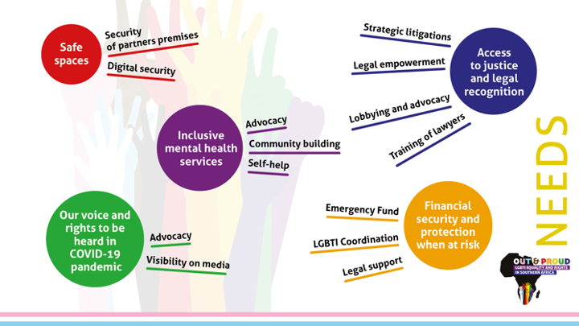

Slide 12
EMMGERNCY RESPONSE THROUGH CRISIS RESPONSE TASK TEAM
Registered 32 cases since 2021
Assisted only 11
Most cases faced negligence at hospital and police
Sensitive

Slide 13
OUT & PROUD
Barometer Indicators Development

Slide 14
The objective is to measure exclusions based on SOGIE in Malawi, Eswatini and Zimbabwe.
Collect lived experiences of social exclusion and its various dimensions and forms
Social Exclusion Measuring Tool

Slide 15
SOCIETAL.
CIVIC AND POLITICAL.
CULTURAL AND RELIGIOUS.
ECONOMIC.
Social Exclusion Dimensions

Slide 16
OUT & PROUD
Media Guide

Slide 17
Guide to equip the media, journalists and LGBTQI+ human rights activists in Southern Africa, more specifically Eswatini, Zimbabwe and Malawi, with tools for engagement with the media.

Slide 18
CHAPTERS OF THE MEDIA GUIDE
How to Dialogue with the Media.
News Media Analysis of LGBTIQ+ Coverage in Southern Africa.
Media Laws and Codes of Ethics for Journalists in Southern.

Slide 19
Alternative /shadow report submission.
Contributions to the report of the UN Independent Expert on Protection against Violence and Discrimination based on sexual orientation and gender identity.
National lobbying using committee recommendations.
ADVOCACY
UN AND ACHPR HUMAN RIGHTS MECHANISM

Slide 20
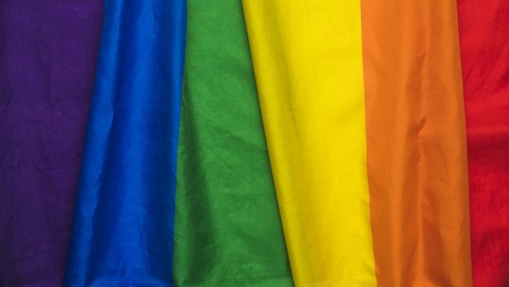
LGBTI HRDs and their organisations are better able and more secure to operate in their countries;
LGBTI HRD’s create/reinforce alliances and solidarity networks at regional level;
LGBTI HRDs engage with HRs international mechanisms and advocacy at national level for policy reforms and awareness raising
Expected results

Slide 21
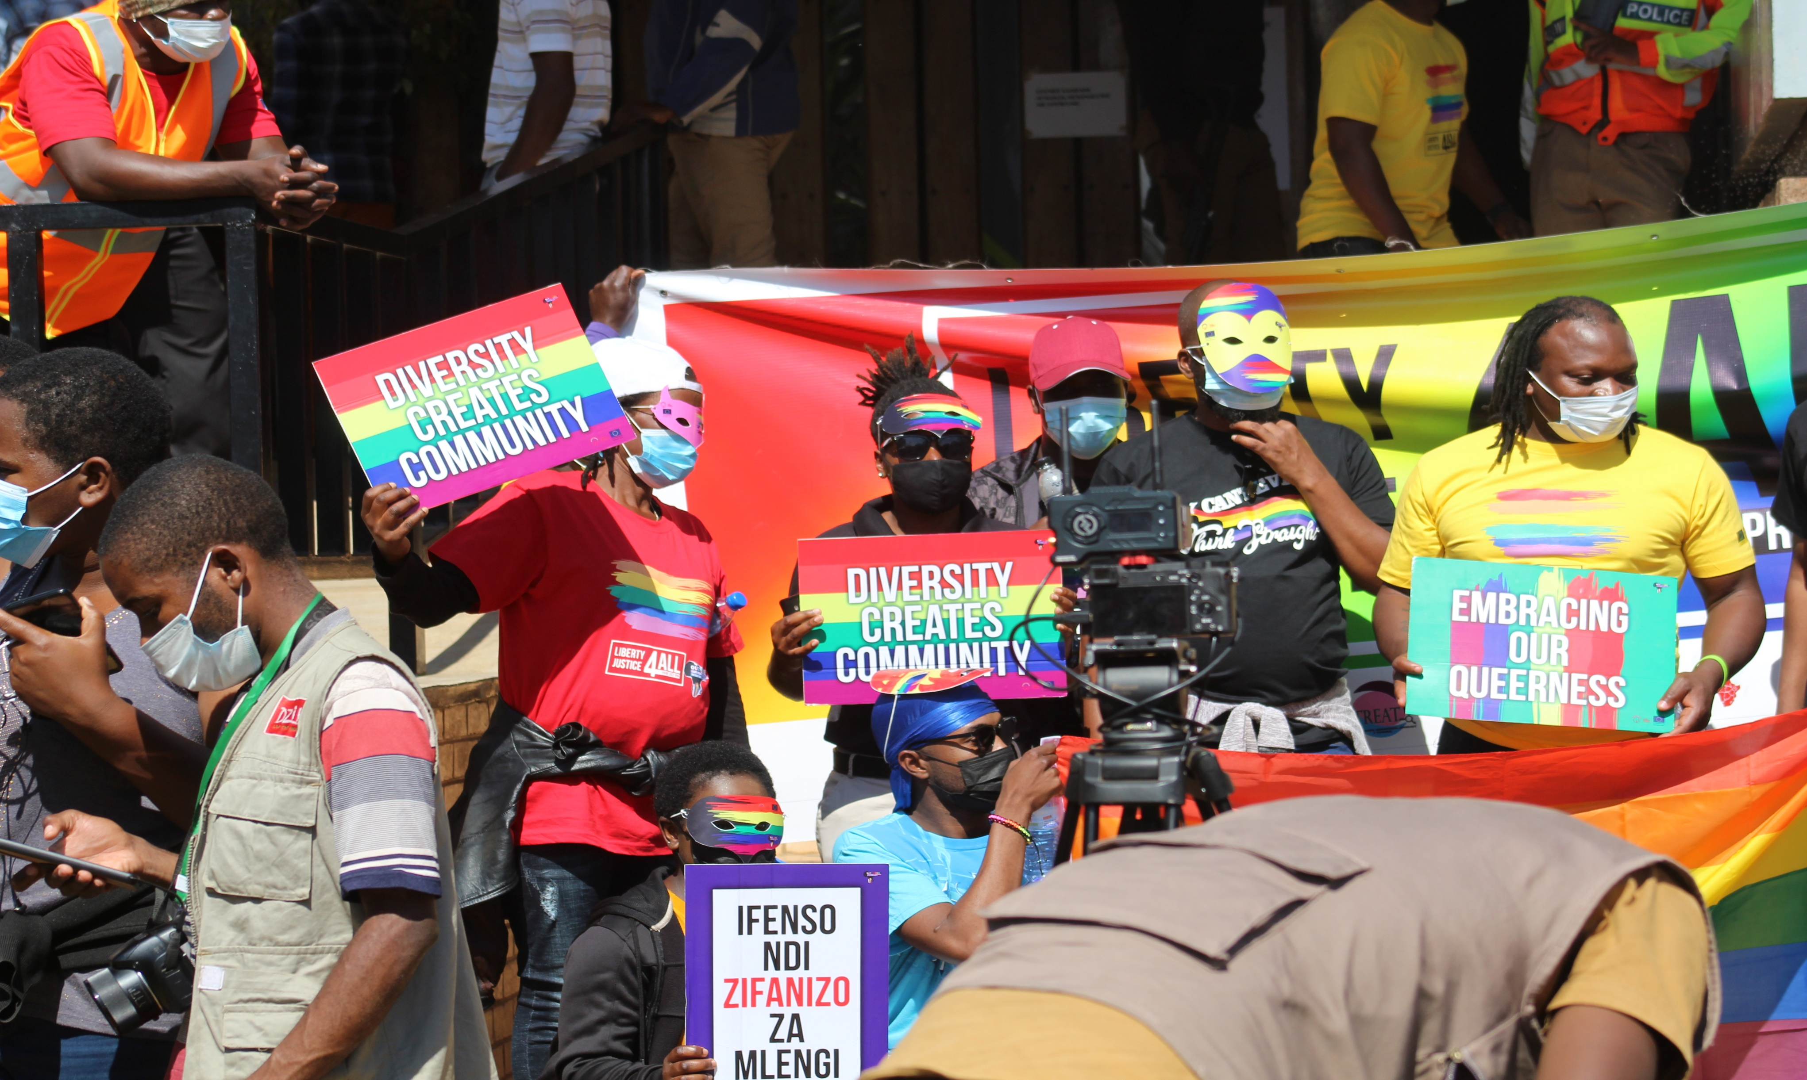

Slide 22
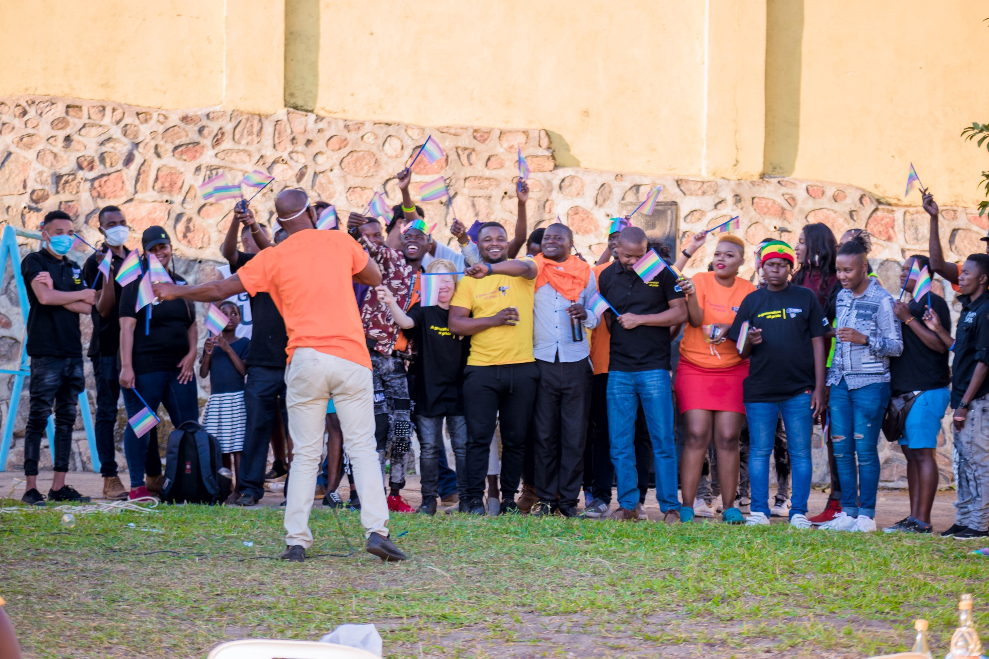
Thank you

