Slide 1
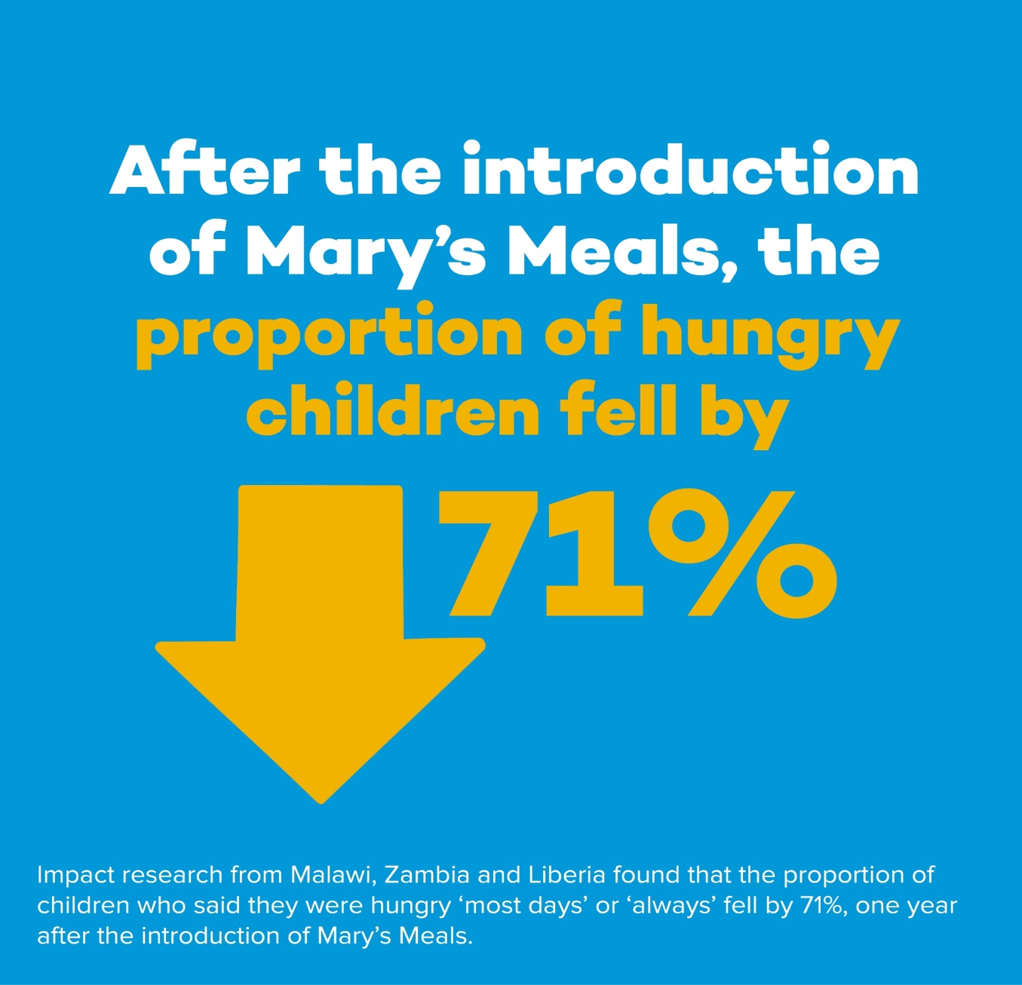
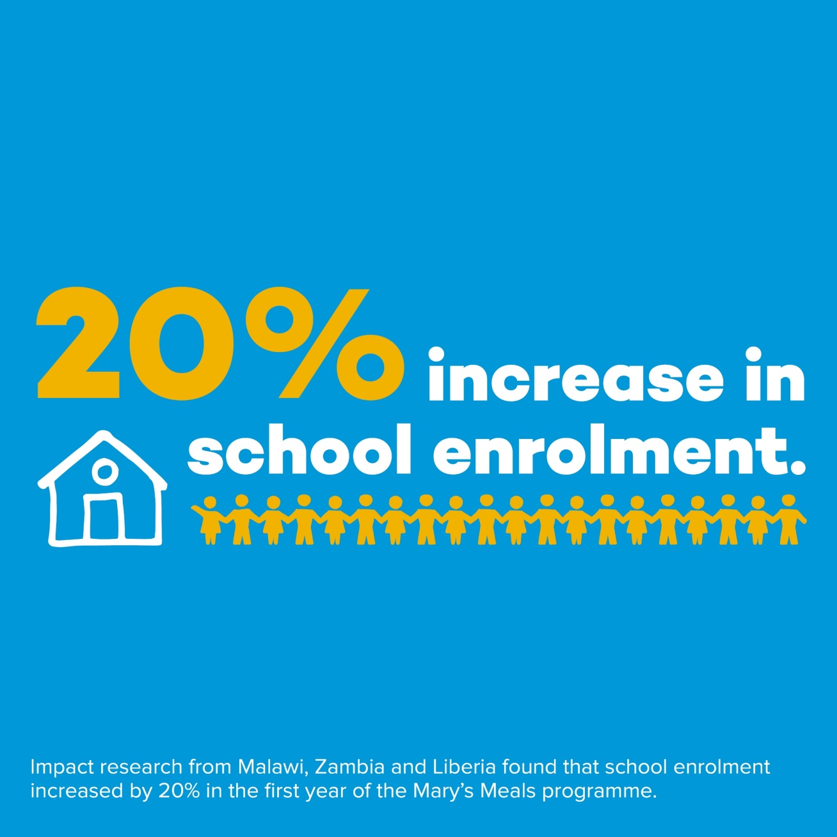
Mary’s Meals Impact

Slide 2
Mary’s Meals Impact

Slide 3
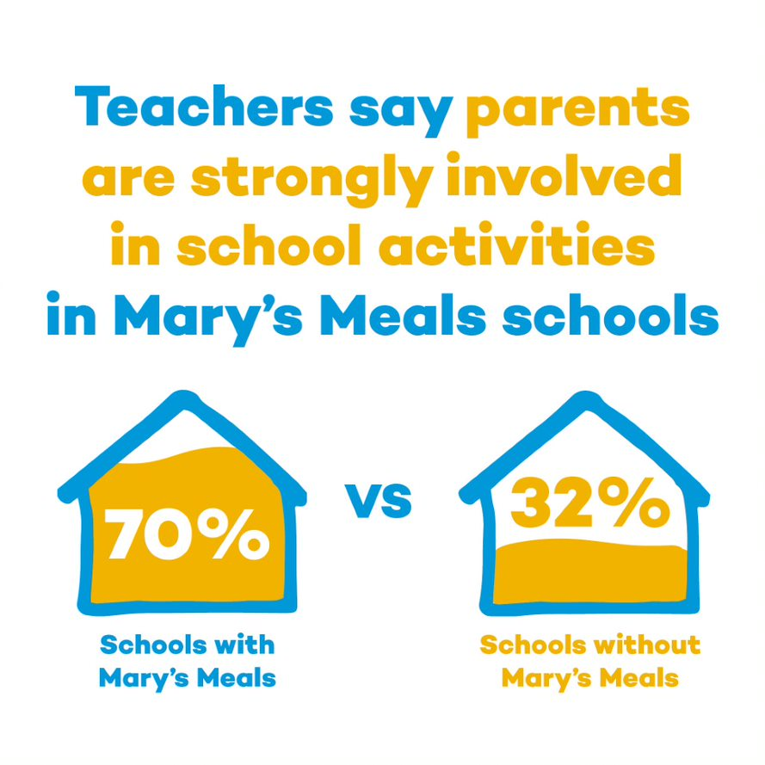
A community based school feeding programme
Involving the community in school feeding provides multiple benefits:
Builds capacity of community by increasing skills and knowledge base
Increases local support for education
Improves the sustainability of the programme
Our dedicated volunteers keep our running costs low (93% of donations go directly to charitable activities).
Importance of community engagement, link to case studies

Slide 4
Project results to date
Key results are:
27 SFP training sessions were delivered - on track.
Primary schools, boy’s enrolment increased by 6.4% from baseline and girls increased by 6.6% - already exceeding year two target.
ECD centres, enrolment increased by 24% from baseline - already exceeding year-end targets of a 2% increase in enrolment.
Progression rates through primary school have increased. The number of children in Standard 2 increased by 6% and 4.9% in Standard 5, exceeding targets of 5% and 2.5% respectively. The number of children in the last available grade increased by 10%, surpassing the target of 1%.
1,404 learners graduated from ECDs to primary schools in July.
Attendance of primary school boys was 91% and girls 92% - exceeding targets of 89% and 90% respectively.
Primary schools delivered school feeding on 97% of planned days and ECD centres delivered feeding on 94% - exceeding the target of 90% for both types of education centres.
Notes:
The project remains on track to achieve year-end targets. Attendance for ECD centres is 66% and although this misses the target of 79%, families were faced with challenges and conflicting priorities which prevented them from taking children to school every day. For example, cold weather from May-July discouraged parents from sending young children to school and attendance at ECDs is not compulsory.

Slide 5
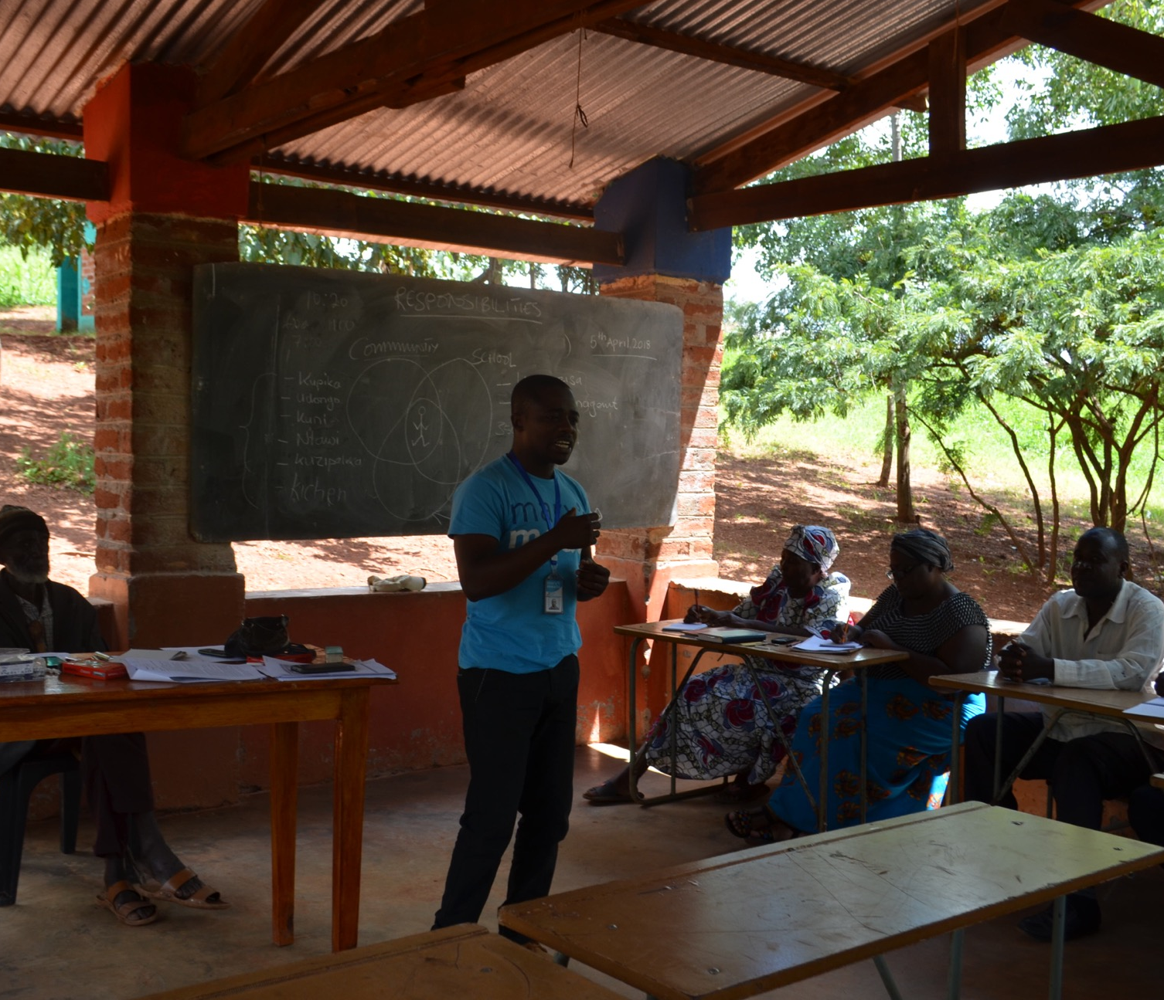
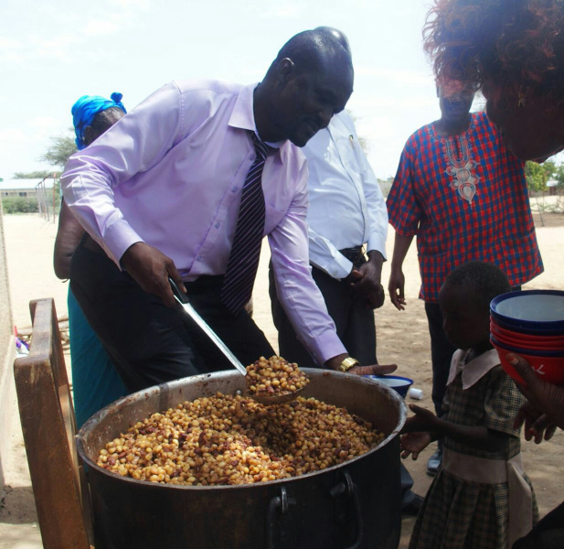
Working with Governments

Slide 6
Government support for school feeding
Increase capacity to deliver sustainable, inclusive, efficient school feeding programmes at community, district and national level.
Facilitated 13 meetings at zonal level to Government of Malawi representatives, partners and other stakeholders, and 4 at district level – on track.
Malawi. School Meals in Malawi: A Best Practice Guide. Imani Consultants.
Commissioned by the Government of Malawi. 2018.
“A sustainable school feeding programme is something the country is still striving towards. While the Government of Malawi seek to achieve this, it is counterproductive to real sustainability to postpone adequate school meal provision until such conditions and preliminary goals are met…it is important to keep in mind that the provision of nutrition is a highly efficient driver of long-term prosperity and is also strongly in the interests of the individual.”

